Slide 1


OCEAN COUNTY MUNICIPAL COORDINATORS MEETING
September 2025
1.5 CRP | 1.5 NJCCC
MEETING POINTS
Document Shredding / HHW / Boat Flare
Recycling Rates MTG Reports
Clean Communities Reports
Green Schools Program - Utilizing CC funds
Outreach + Materials
Recycle Coach Training

Slide 2
Document Shredding / HHW

Slide 3



Slide 4
2026 DRAFT SHREDDING PROGRAM TENTATIVE SCHEDULE! DO NOT POST/ADVERTISE!
Location | Date | Population | # of Trucks
1. Lakewood | Friday, March 27, 2026 | 135,158 | 2
2. Berkeley | Saturday, April 18, 2026 | 43,754 | 2
3. Waretown | Saturday, May 2, 2026 | 9,062 | 2
4. Stafford | Saturday, May 16, 2026 | 28,617 | 2
5. Jackson | Saturday, June 6, 2026 | 58,544 | 2
6. Pt. Borough | Saturday, June 27, 2026 | 18,941 | 2
7. Manchester | Saturday, August 29, 2026 | 45,115 | 2
8. Lacey | Saturday, Sept 19, 2026 | 28,655 | 2
9. Toms River | Friday, Sept 25, 2026 | 95,438 | 2
10. Brick | Saturday, October 3, 2026 | 73,620 | 2
11. *Barnegat (Rotate w/ LEH) | Saturday, October 17, 2026 | 20,065 | 2
12. Beachwood | Saturday, October 24, 2026 | 10,859 | 2

Slide 5
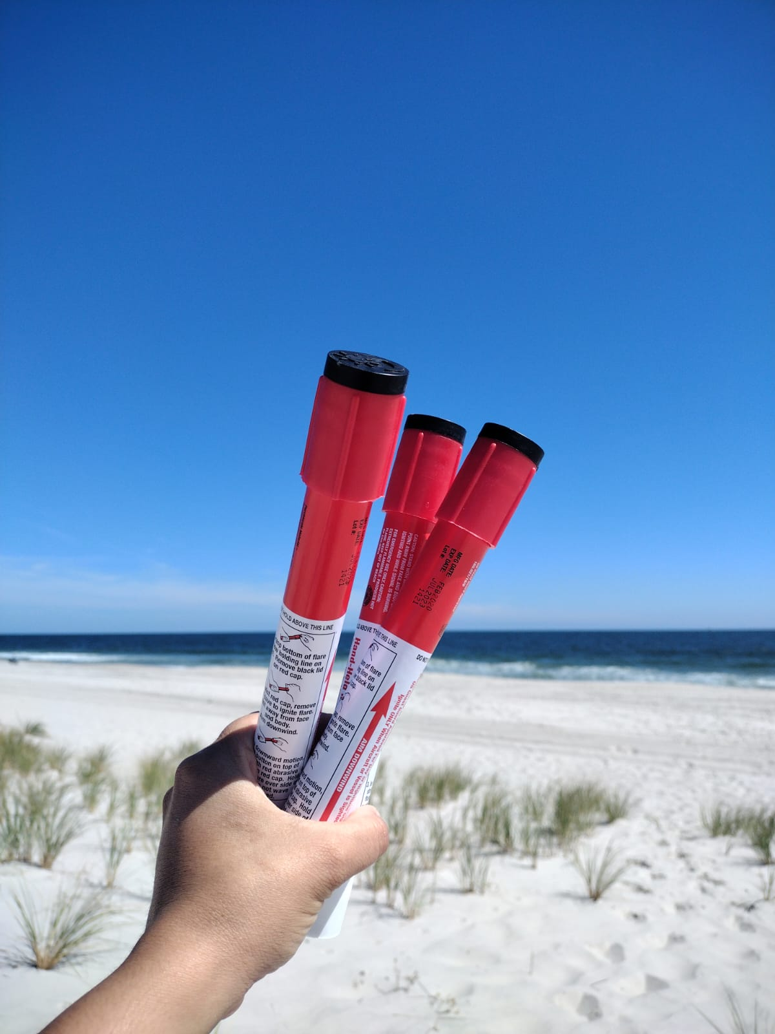
Boat Flare Program
June 18th
August 20th
October 22nd
Wednesdays
Registration required
1pm to 3pm

Slide 6
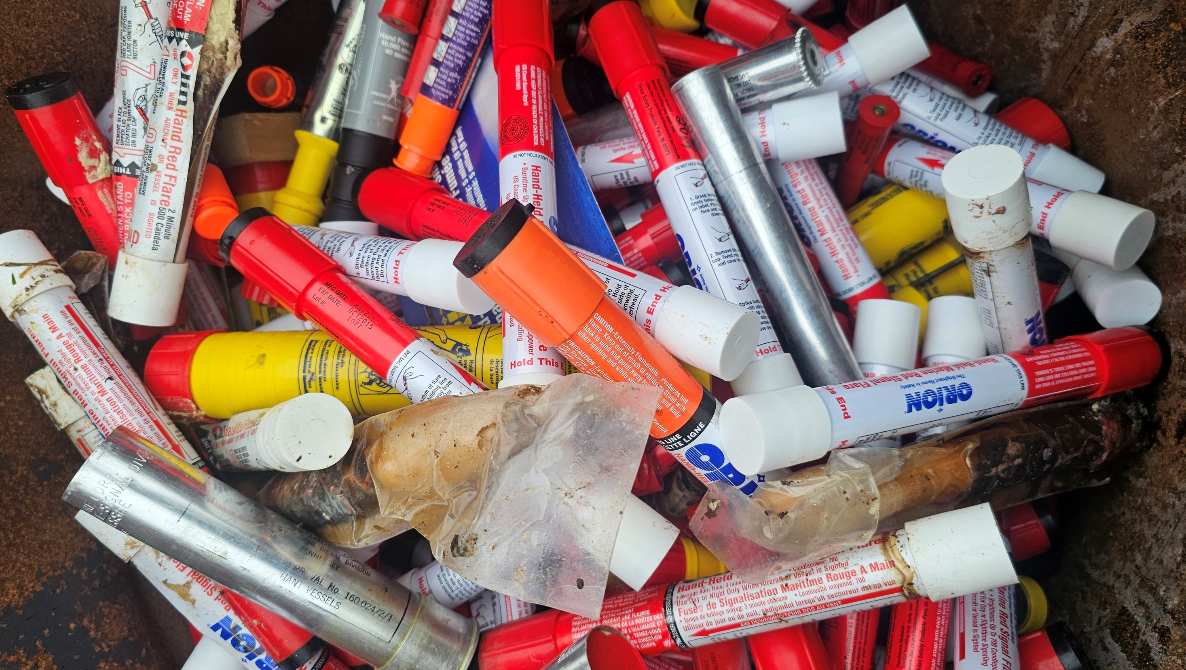
 | Participants | Appointments | Attendance Rate | Flares Collected
5/1/2023 | 136 | 216 | 63% | 1250
10/1/2023 | 66 | 101 | 65% | 630
6/1/2024 | 65 | 78 | 83% | 680
10/19/2024 | 55 | 88 | 63% | 649
6/18/2025 | 68 | 85 | 80% | 662
8/20/2025 | 47 | 60 | 78% | 574
Program Collected
4445 Flares

Slide 7
Recycling Rates

Slide 8
Barnegat | 23%
Barnegat Light | 42%
Bay Head | 49%
Beach Haven | 46%
Beachwood | 28%
Berkeley | 19%
Brick | 35%
Eagleswood | 72%
Harvey Cedars | 60%
Island Heights | 49%
Jackson | 42%
Lacey | 42%
Lakehurst | 50%
Lakewood | 36%
Lavallette | 25%
Little Egg Harbor | 29%
Long Beach | 46%
Manchester | 30%
Mantoloking | 67%
Ocean | 48%
Ocean Gate | 15%
Pine Beach | 48%
Plumsted | 78%
Pt. Pleasant Borough | 38%
Pt. Pleasant Beach | 34%
Seaside Heights | 40%
Seaside Park | 38%
Ship Bottom | 16%
South Toms River | 37%
Stafford | 39%
Surf City | 21%
Toms River | 54%
Tuckerton | 25%
Ocean County’s Rate 41%

Slide 9


Plumsted had the highest recycling rate for 2024

Slide 10


Slide 11


Slide 12


Slide 13


Slide 14


Slide 15


Slide 16
Clean Communities Reports

Slide 17
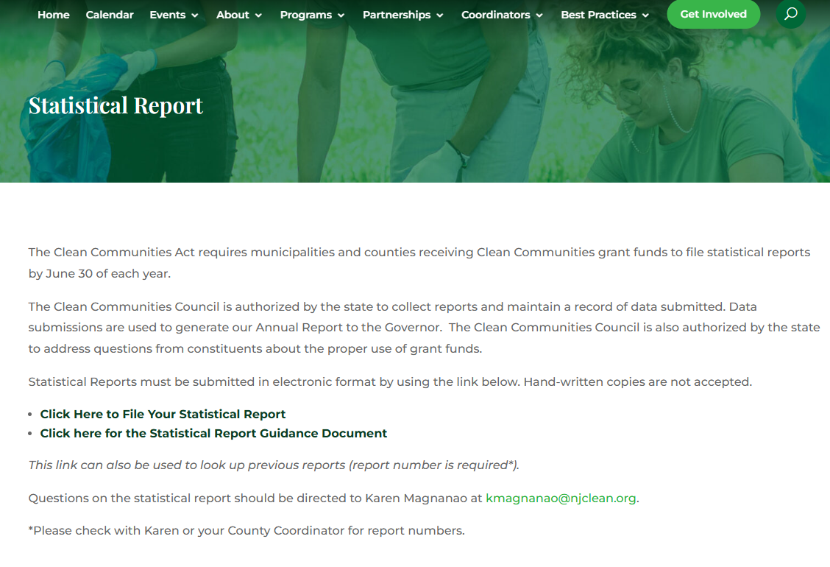
Submitted | 83%
Open | 3%
Not Submitted | 21%

Slide 18
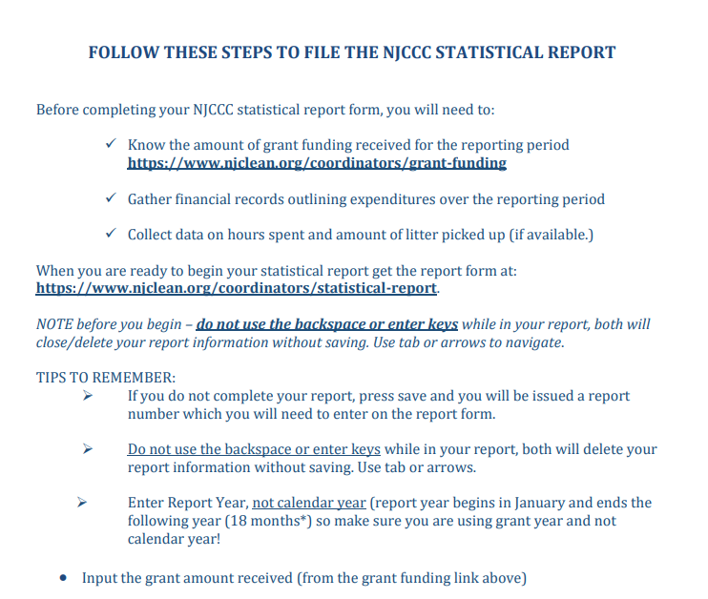
Full document at njclean.org

Slide 19

Green Schools Program

Slide 20
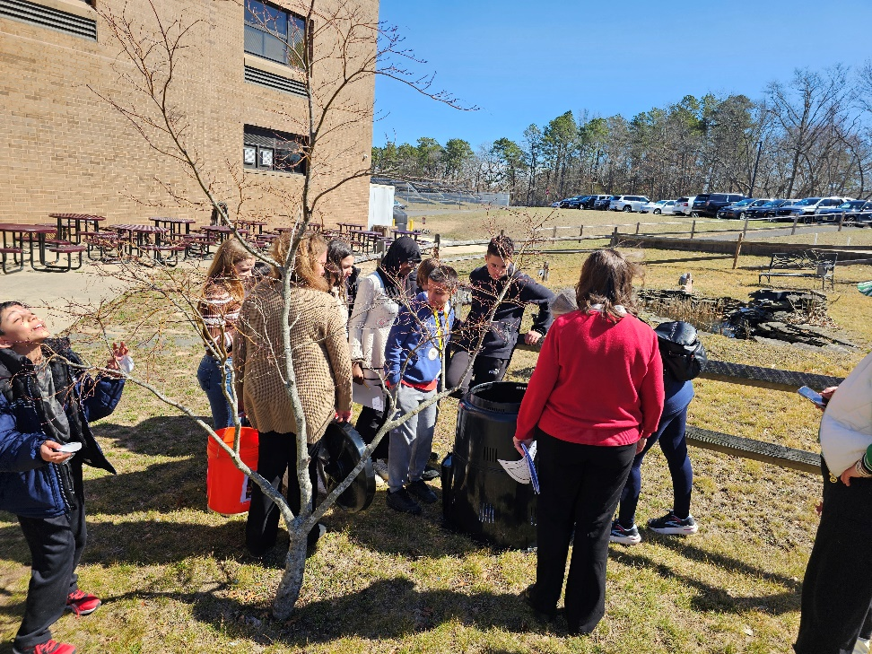
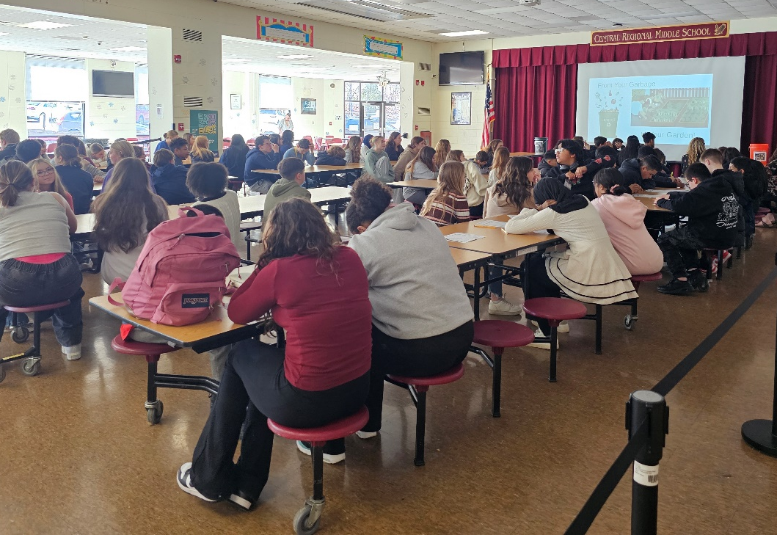
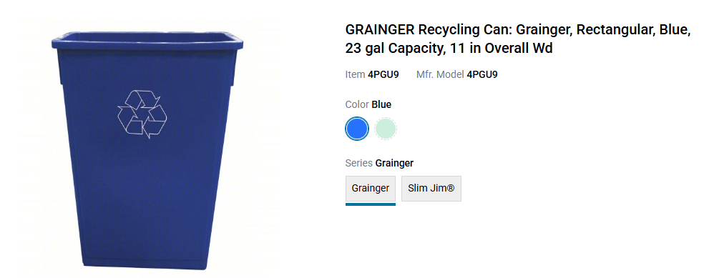
Berkeley – Central Regional

Slide 21
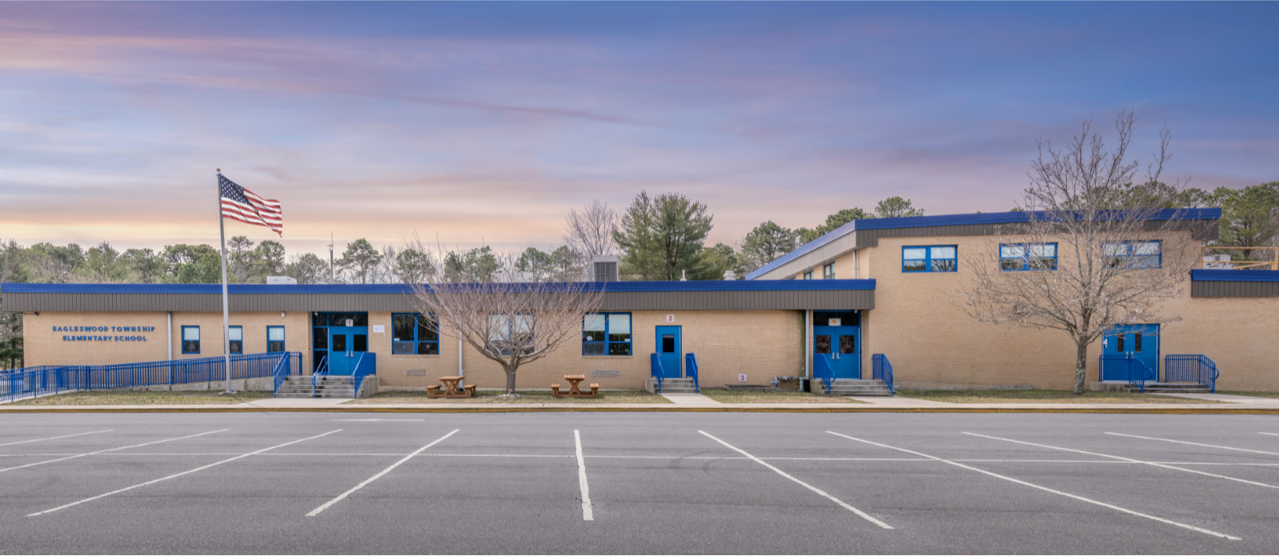
Eagleswood

Slide 22
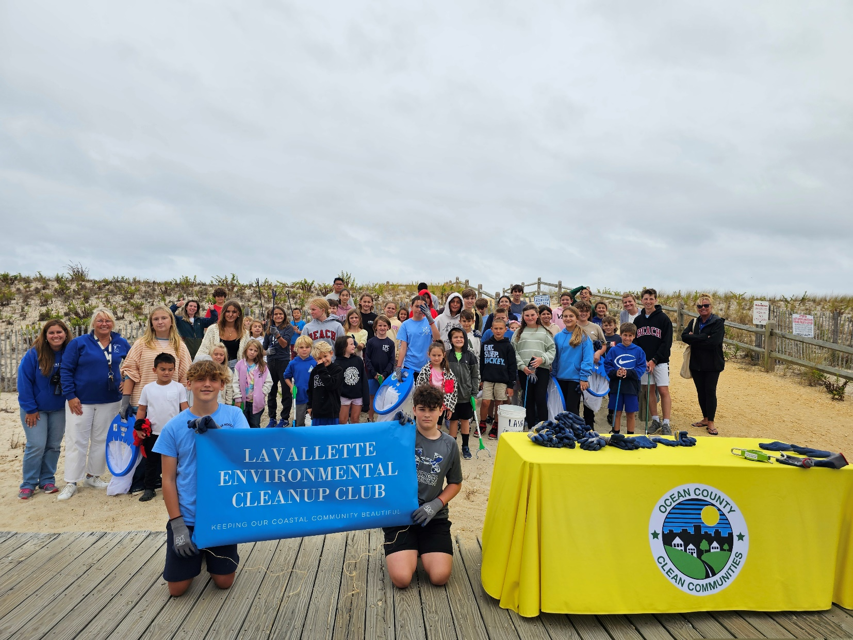
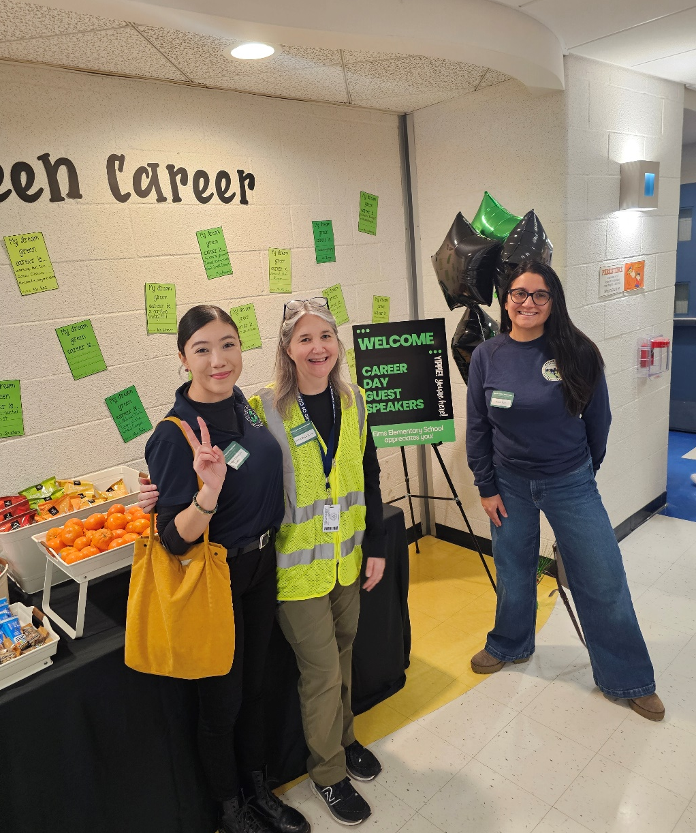

Slide 23



Slide 24
The weather pros | Rob@theweatherpros.com
Grand Falloons | grandfalloons@aol.com | The cost of the live show is now $825.00 per show. A second consecutive show is $500.0
Illusion Makers | illusionmaker563@gmail.com | Usually do 2 shows per school

Slide 25
Need Supplies for an Event?

Slide 26
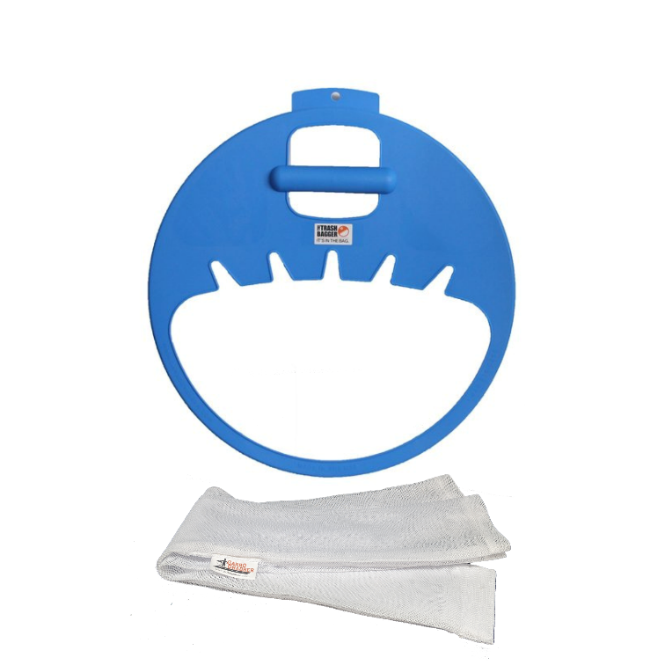



Slide 27
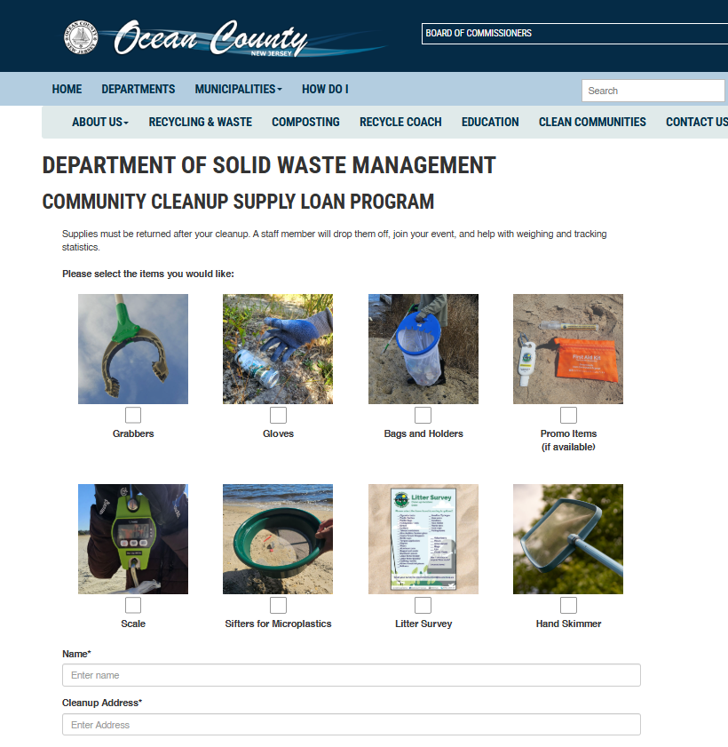

Slide 28
Freon

Slide 29
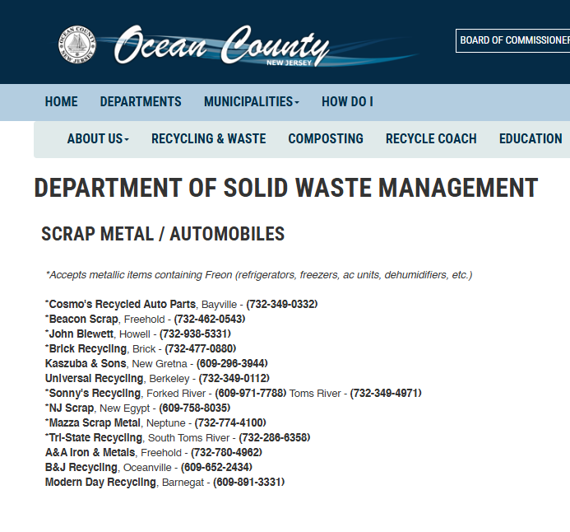
The final person in the disposal chain (e.g., a metal scrapyard) is the one who needs to make sure the Freon is removed.

Slide 30
Outreach Materials

Slide 31

Grab them!!!!

Slide 32
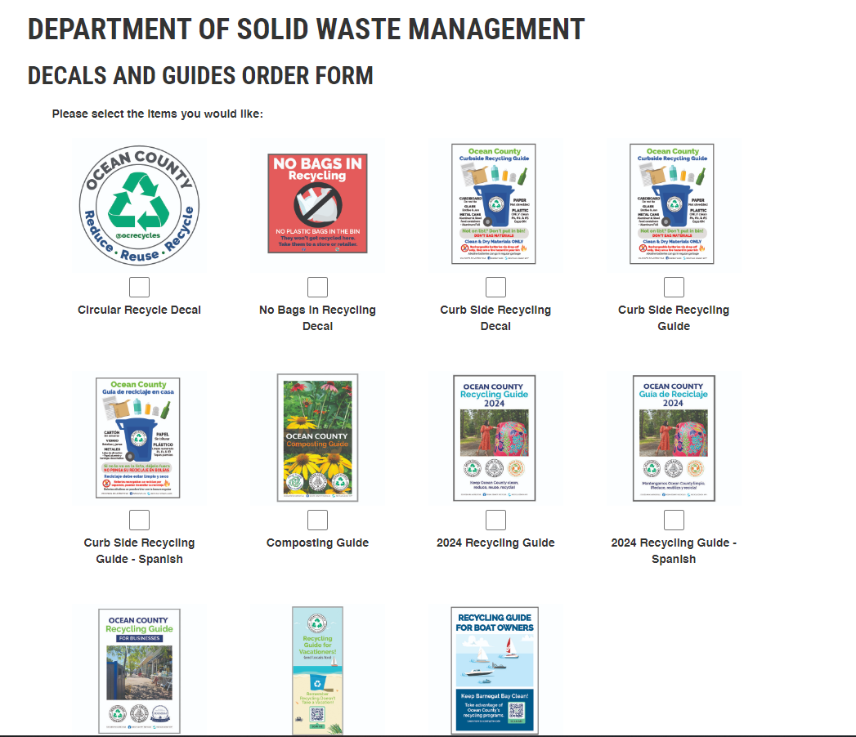

Slide 33
Thank you!

