Slide 1


Slide 2
Composting Tonnages

Slide 3
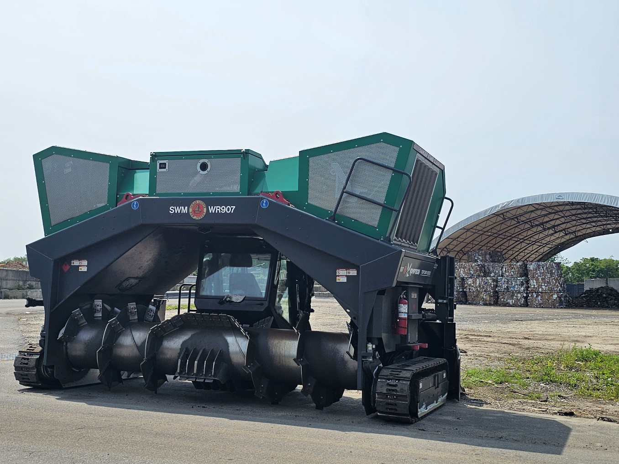
Shared Service Agreement
 | Brush | Leaves
Berkeley (BE) | 1126.27 | 0.00
Brick (BR) | 563.13 | 5197.62
Jackson (JA) | 891.63 | 3118.57
LA (LA) | 703.92 | 4366.00
LE (LE) | 1267.05 | 2079.05
Manchester (MA) | 938.56 | 2286.95
(OCL) | 0.00 | 0.00
Ma Road Garage (MRG) | 0.00 | 2567.27
Toms River (TR) | 610.06 | 1663.24
total | 6100.61 | 21278.70

Slide 4
Barnegat Bay Blitz

Slide 5
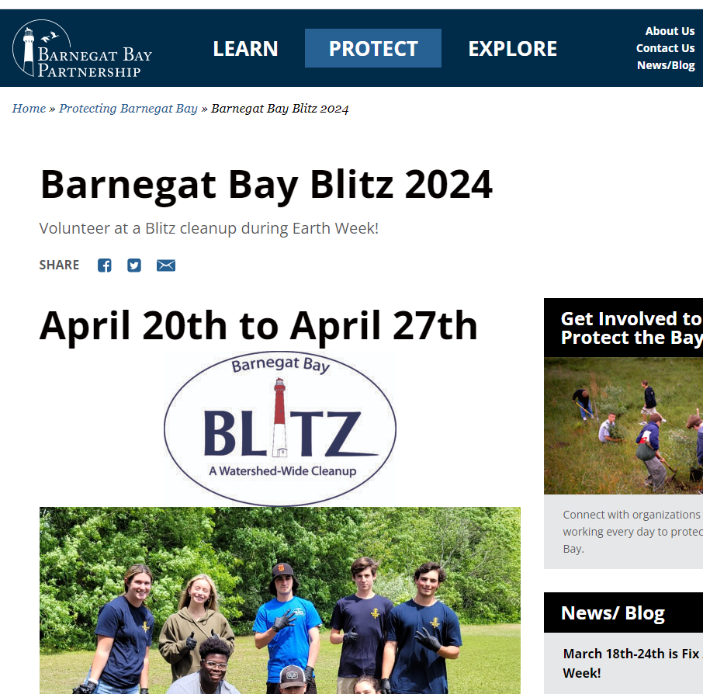
Ocean County Clean Communities is supporting the event.
If you want to host a Cleanup or want to add Cleanup to the list contact Bailey Sanders bsanders@ocean.edu
If you are participating take some goodies!
We are setting up a supply station at the LBT Field Station

Slide 6
BB Educators Roundtable

Slide 7
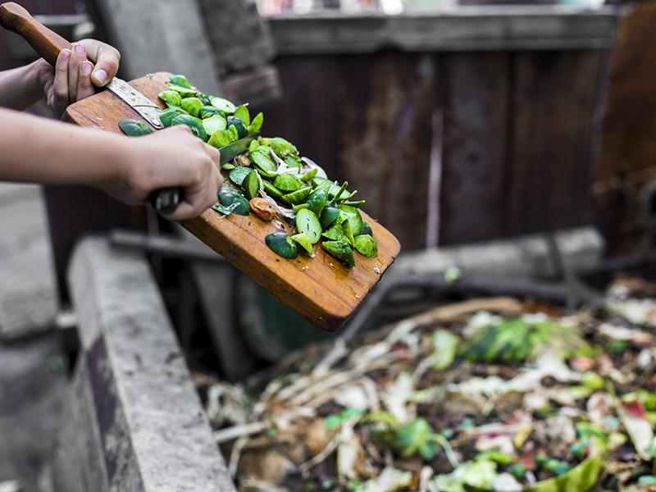
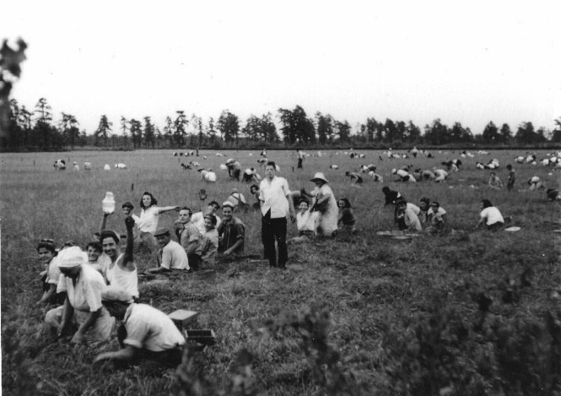
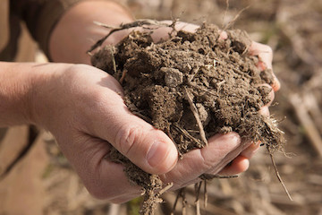
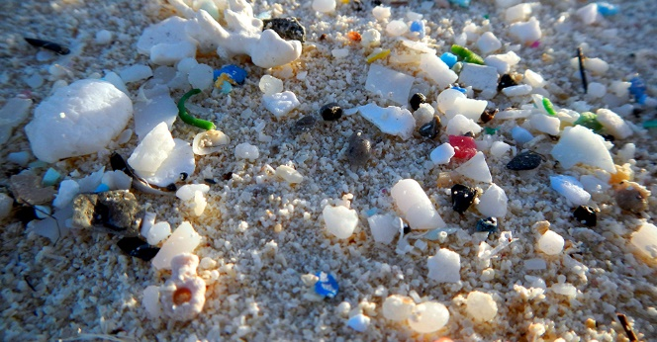

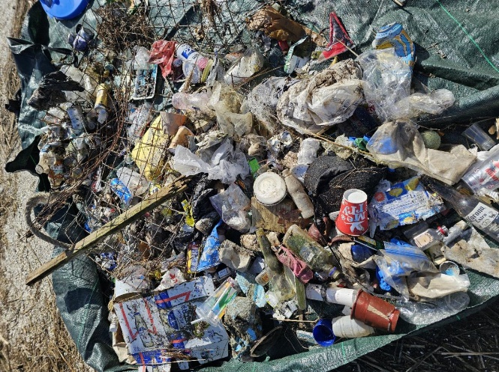
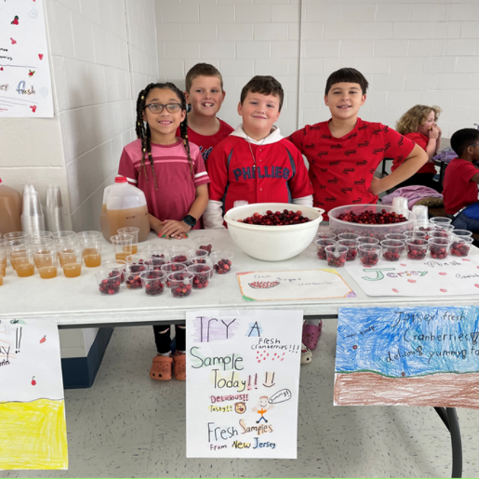
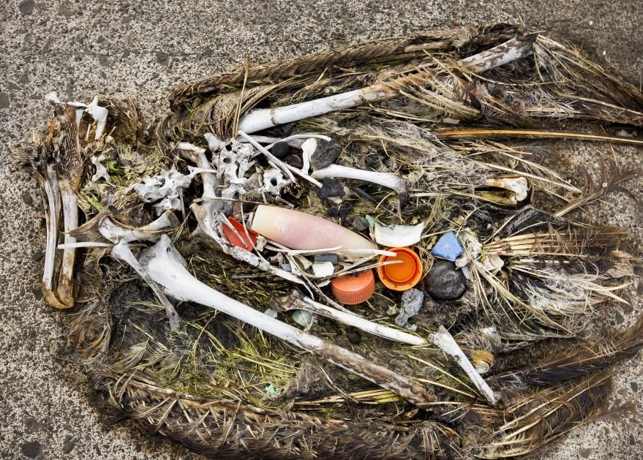
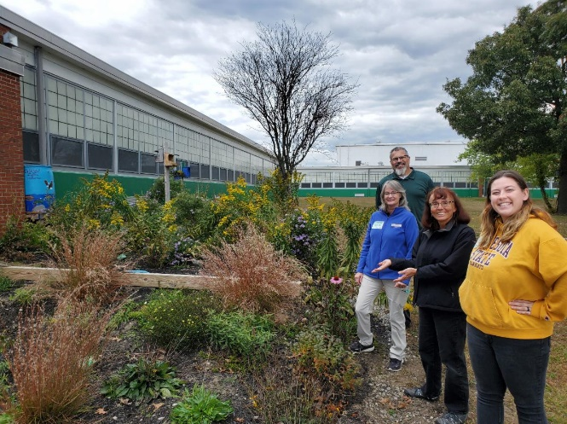
Cranberry Bogs and Lumber Mills - two sustainable industries that shaped Ocean County, presented by Andrew Anderson, Double Trouble State Park
Soil – sustaining the future from the ground up, presented by OCSCD staff and Eileen Miller, South Jersey Resource Conservation and Development Council
Farm to School, presented by Nicole Broadwater, New Jersey Department of Agriculture.
Jersey-Friendly Yards School Certification, presented by Bailey Sanders, Barnegat Bay Partnership
Composting in the Classroom, presented by Sandra Blaine-Snow and Margaret DeLeon-Rivera, Ocean County Department of Solid Waste Management
Clean Communities Credits
Navigating Microplastics, presented by Mindy Voss, Alaina Perdon and Rosemary Higgins, NJ Sea Grant Consortium
Trash in the Environment – clean-up and ecology walk, presented by Tanara Hall, Ocean County Department of Solid Waste Management and Chris Claus, Ocean County Parks & Recreation
Effects of Marine Debris on Wildlife, presented by Kaitlin Gannon, Jacques Cousteau National Estuarine Research Reserve
Plastics and Climate – how our consumption controls our survival, presented by Jennifer Lengares Meyer, Jenkinsons Aquarium

Slide 8

Conference Recap

Slide 9
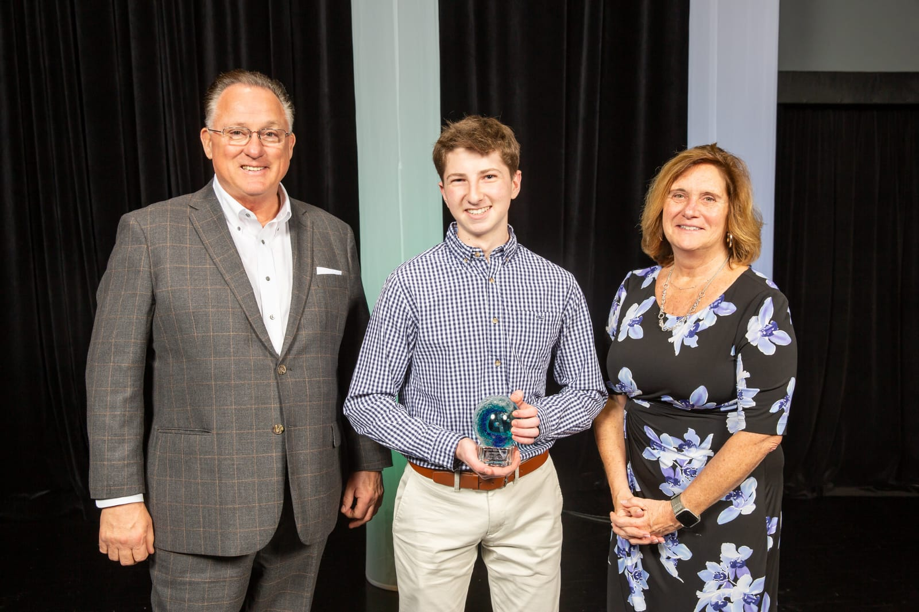
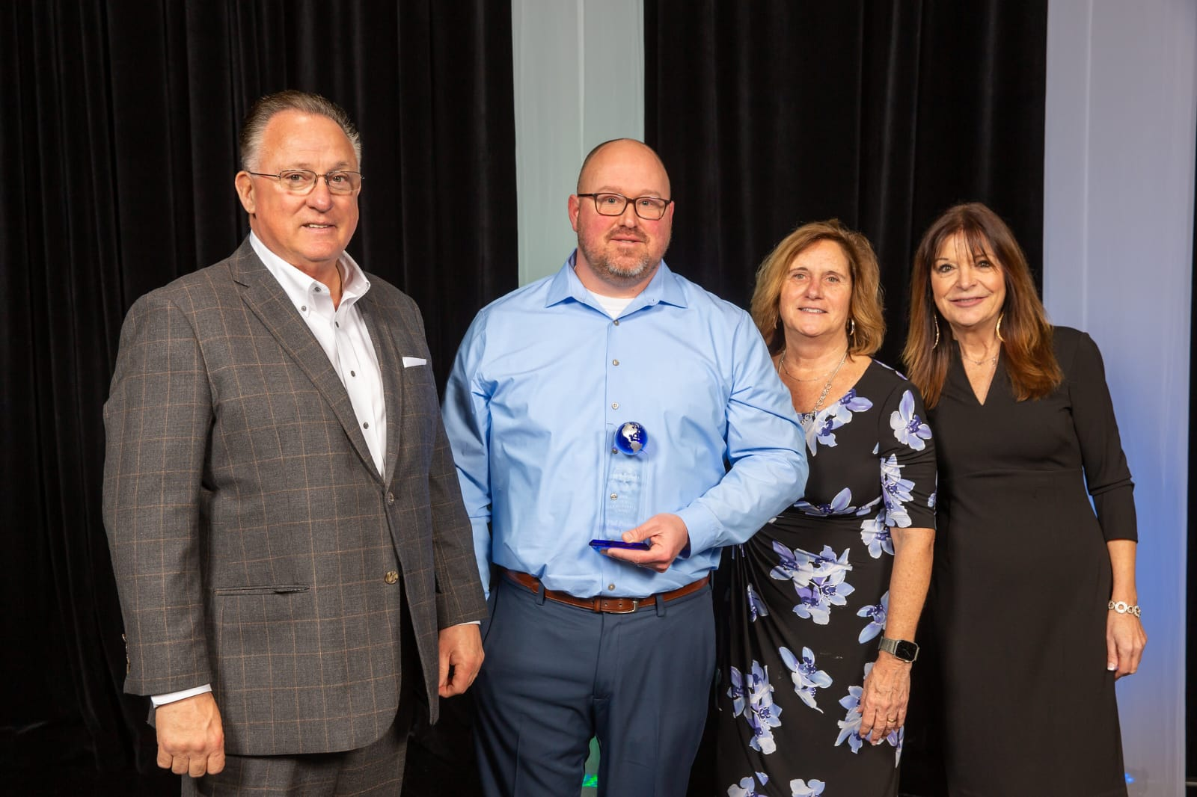
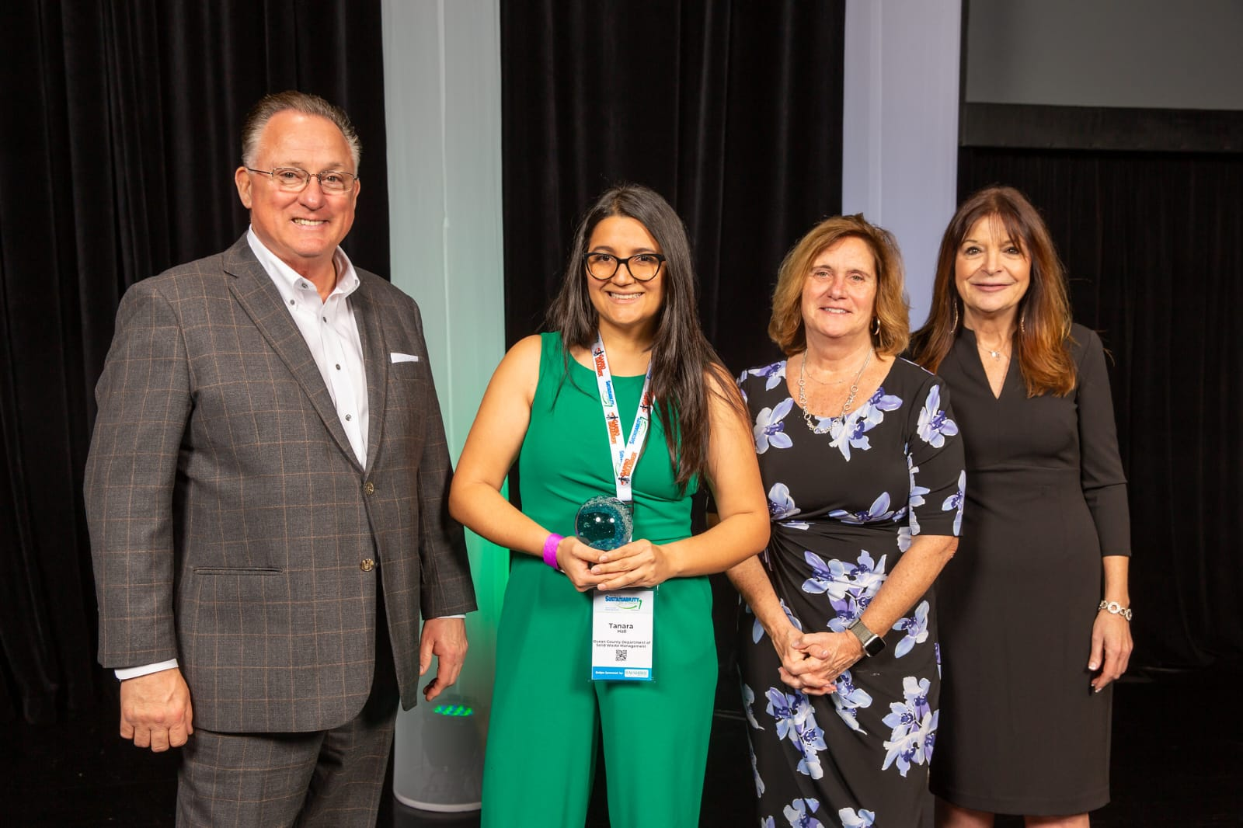

Slide 10
Outreach Materials

Slide 11


Slide 12

Please take some

Slide 13
Events

Slide 14

Swap & Share Sessions (Free to attend!)
Southern Session — May 1st
Long Beach Township Field Station
127 W Osborn Ave, Holgate, NJ 08008
10am-12pm
(address may show as Beach Haven on GPS)

Slide 15



Slide 16


Slide 17
Thank you!

