Slide 1
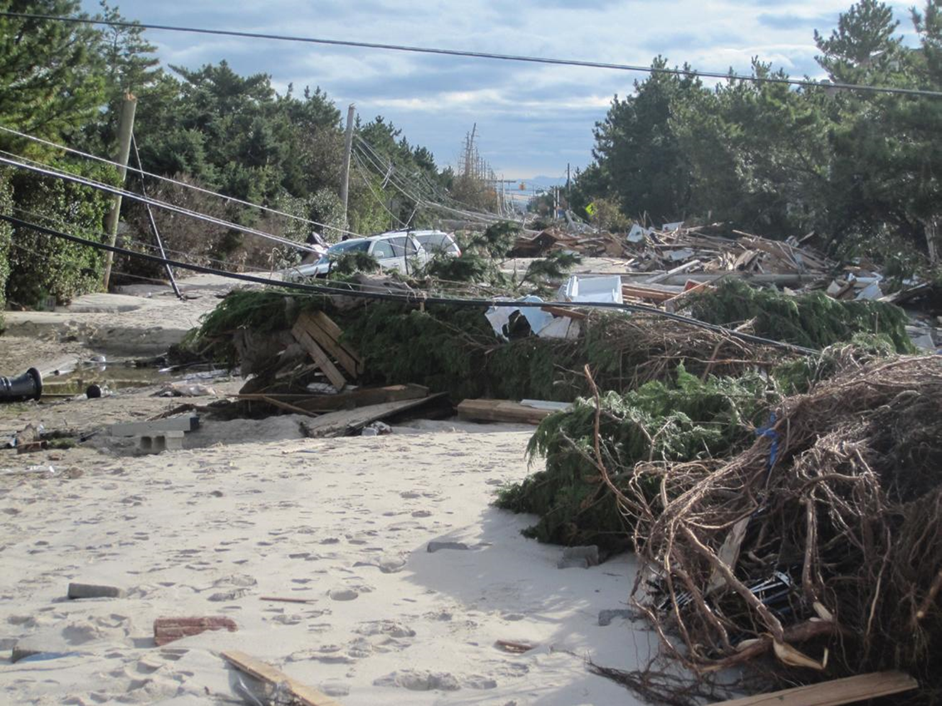
Debris Planning in New Jersey
Ocean County Workshop
December 3, 2014
Photo credit: NJDOT

Slide 2
Why Worry About Debris?
Slide written October 5, 2012 B.S. (Before Sandy)
Between 1999 and 2010 no more than 6 debris generating incidents
Between August 23, 2011 and June 30, 2012:
  Earthquake
  Hurricane Irene
  Tropical Storm Lee
  October N’oreaster
  South Jersey Derecho
  What’s next?????

Slide 3
What is Debris?
Solid Waste generated after a storm or other emergency event
  Hurricane, tornado, earthquake, collapsed building(s), terrorist attack, fire, etc.
Can be vegetative, municipal waste (putrescible & non-putrescible), construction & demolition debris, household hazardous waste, hazardous waste, or e-waste

Slide 4
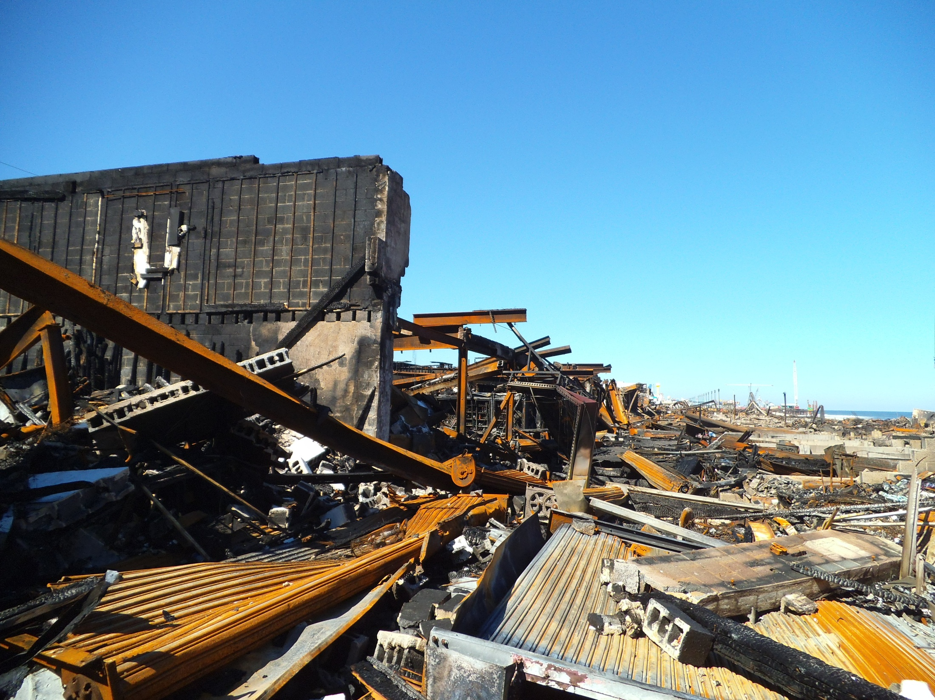

Slide 5
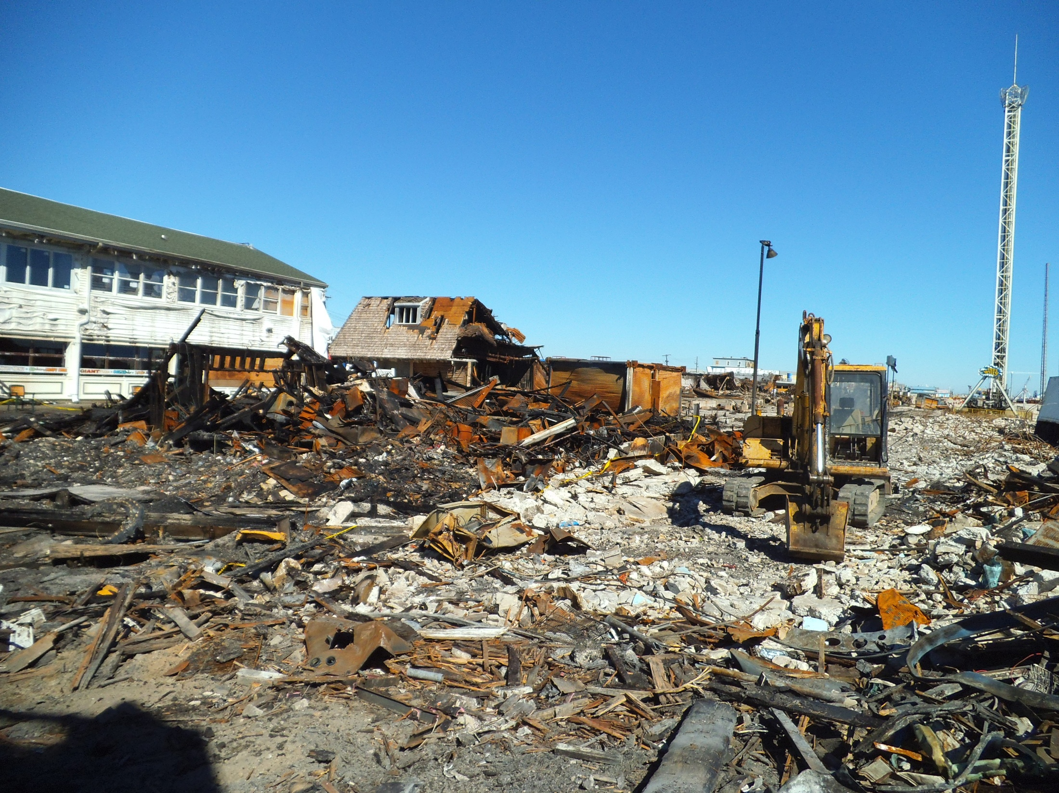

Slide 6
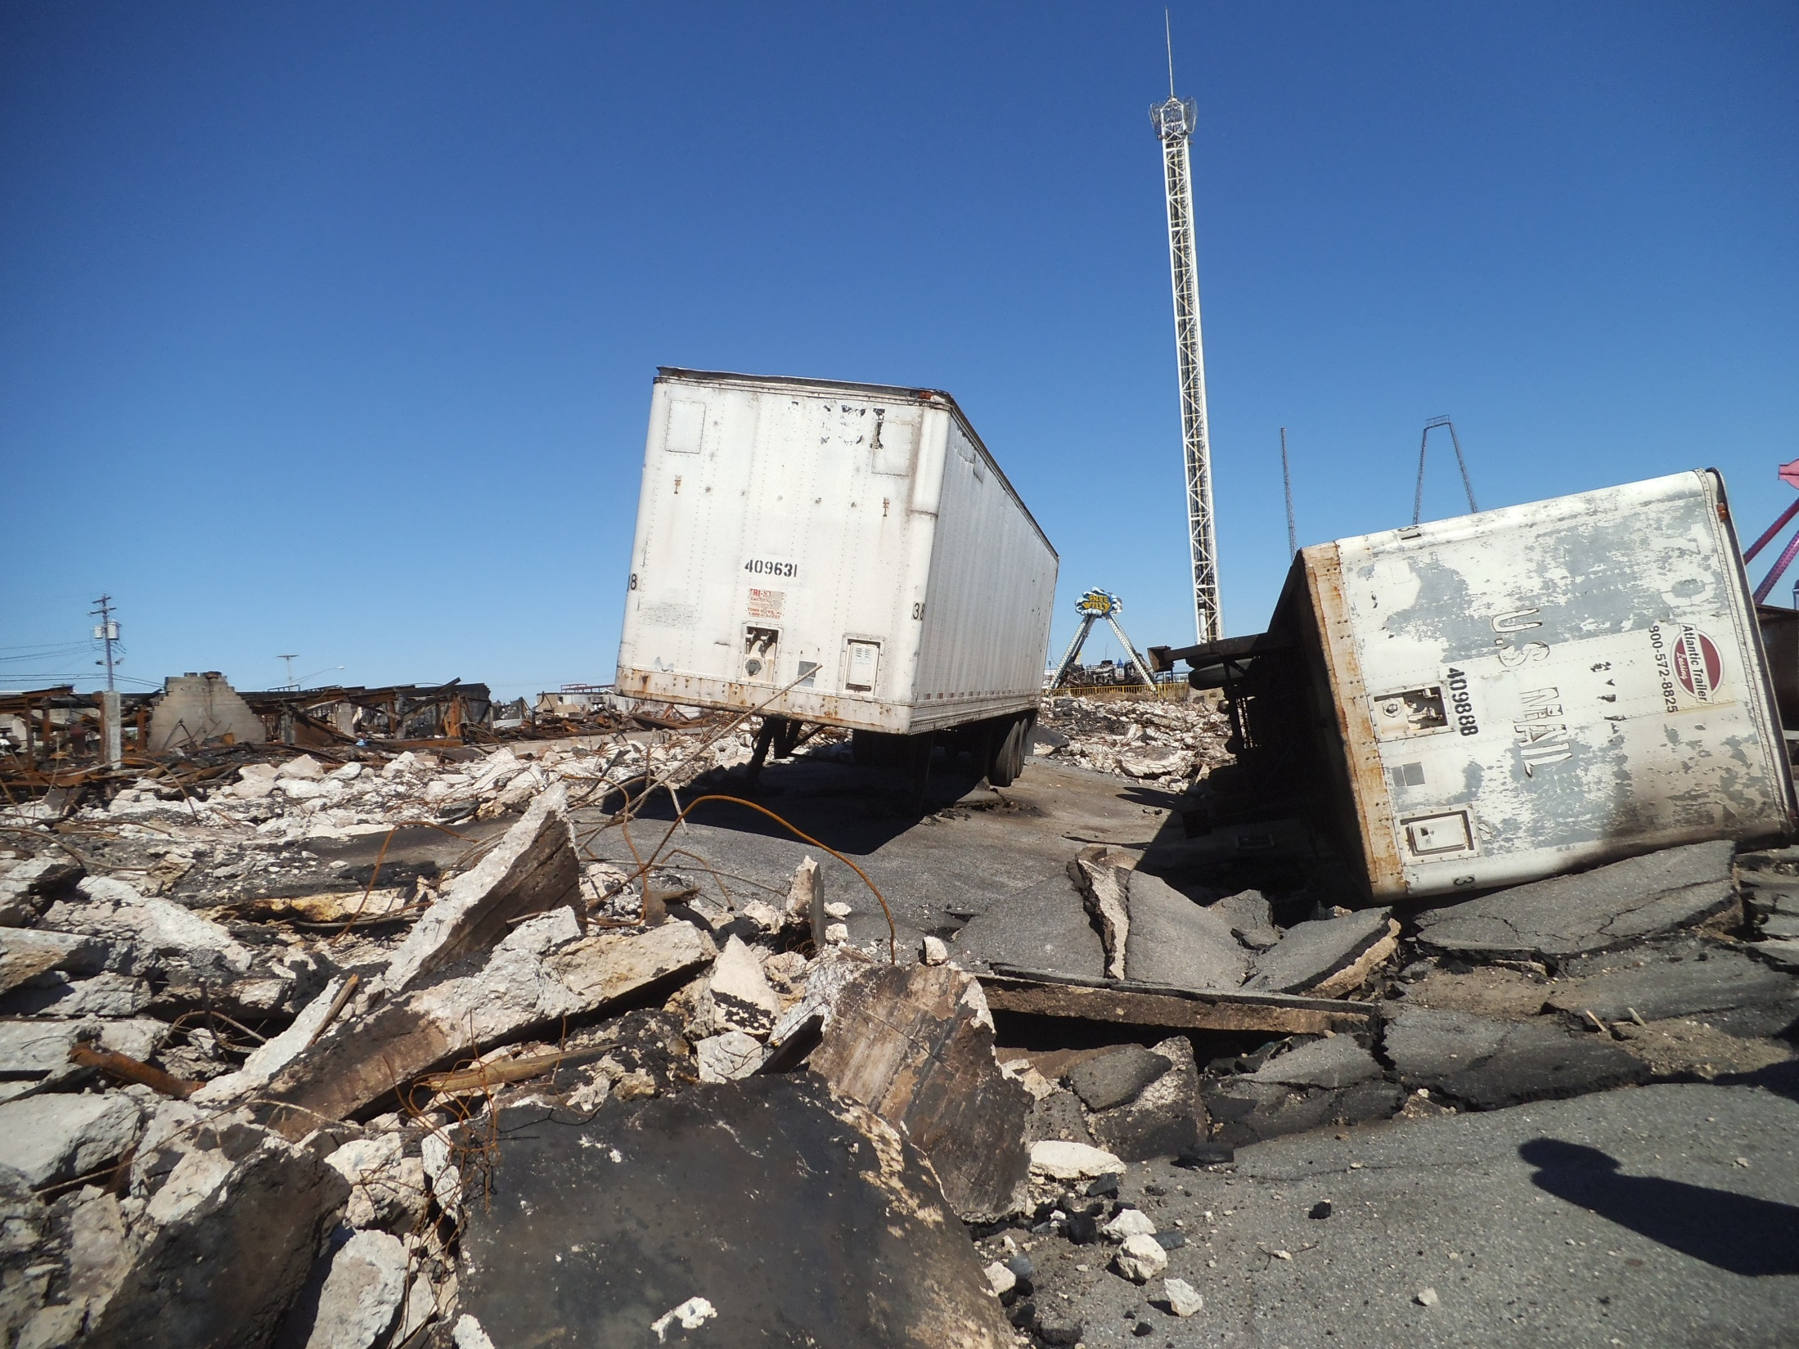

Slide 7
Municipal Tool Kit
Provides information to help municipalities plan for disaster debris
Released November 2013 and available on-line

Slide 8
Municipal Tool Kit (cont.)
Tool Kit provides information on:
  Developing a Debris Management Plan
  Siting Temporary Debris Management Areas (TDMAs)
  Guidance on determining TDMA acreage
  Obtaining pre-approval of TDMAs
  TDMA Pre-approval Request Form
  TDMA FAQs
  Debris removal and monitoring contracts info.
  “Speed Up Your Cleanup” informational handout

Slide 10
Debris Management Plan
Should identify all procedures to be implemented in the event of an emergency
First response – clearing debris hindering emergency response actions
  Access to hospitals, shelters, etc.
Subsequent response – clearing remaining debris & collecting debris from roadsides
Have stand-by contracts for debris removal

Slide 11
Debris Management Plan (cont.)
Identify all areas to be used as Temporary Debris Management Areas
Identify all equipment available in an emergency (both government & private)
Identify disposal locations, including recycling centers
  Include alternative locations in case of wide-spread emergencies

Slide 12
Debris Management Plan (cont.)
Prepared in conjunction with County OEM, HHW program, health department, Solid Waste Management Office, local police & fire
DEP assistance is available if requested
FEMA assistance is also available
May need to work on a regional basis to identify Temporary Debris Management Areas (TDMAs)

Slide 13
Reasons to Have a Debris Management Plan
Faster response in an emergency
More efficient response in an emergency
Decreased costs in an emergency (not duplicating work)
Happier residents – back to normal sooner
Higher cost share with FEMA if municipality/county has an approved debris management plan

Slide 14
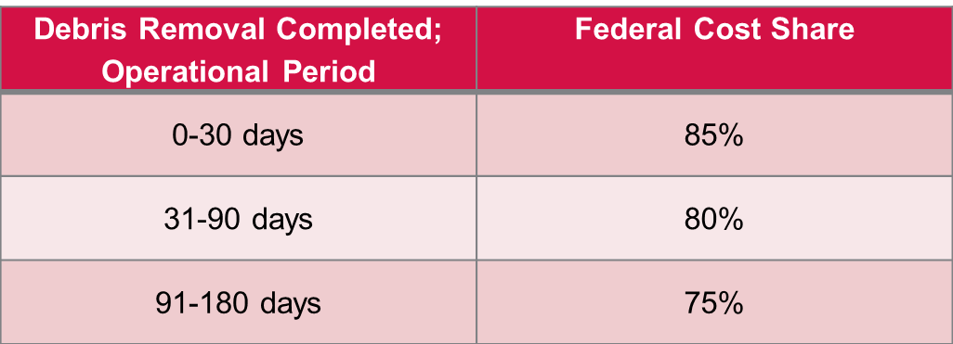
FEMA Debris Removal Pilot Program
Public Assistance Alternative Procedures Pilot Program for Debris Removal
  www.fema.gov/alternative-procedures
Accelerated Debris Removal Cost Share

Slide 15
FEMA Debris Removal Pilot Program (cont.)
Retain revenues from recyclables
Straight time force account labor reimbursable
  Reimbursed at appropriate cost share level
  Accurate records required
Debris Management Plan Incentives
  One time additional 2% cost share for first 90 days
  Must have a FEMA-reviewed plan before the date of declaration

Slide 16
What’s the Catch?
Voluntary program upon request
Must sign acknowledgement
Must have an “approved” Debris Management Plan
  FEMA has list of required elements
Pilot Program in place until June 27, 2015 but may be extended and/or made permanent

Slide 17
County Debris Plan Template
Developed by DEP for use by counties but municipalities may also use
Currently draft but expected to be released soon
All of the FEMA required elements are included in the template
Can use template as a guide when developing a Debris Management Plan

Slide 18
Temporary debris management areas

Slide 19
Temporary Debris Management Area
Site where debris is temporarily stored until it can be sent to a final destination (disposal or recycling)
Storage in containers at a convenience center is not a TDMA
  Must meet definition of a convenience center
Exempt recycling sites are not TDMAs
  Activities must be in compliance with exemption, including notification to the Department

Slide 20
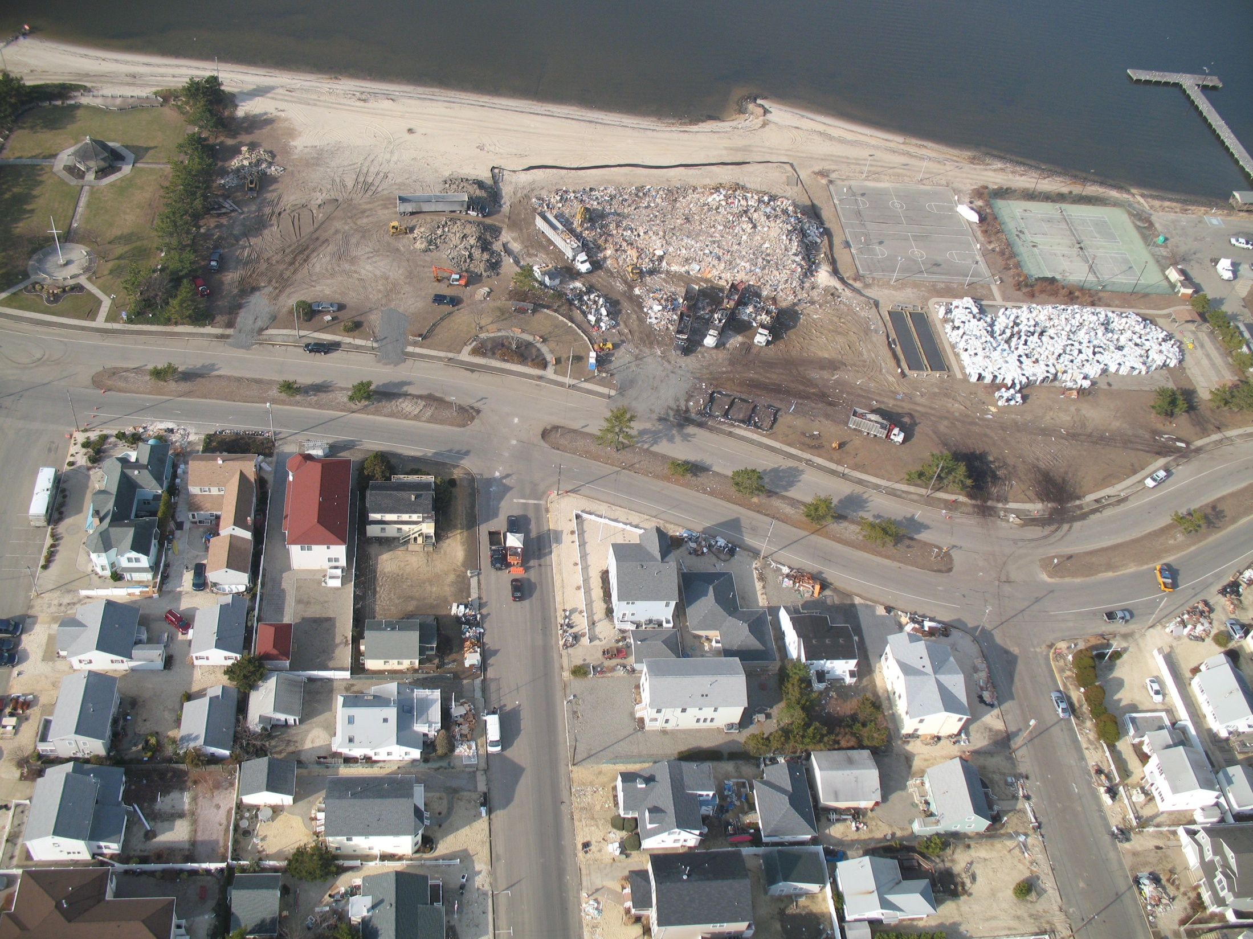
Silt Fencing
C&D Debris
White Goods
Notes:
Lavallette TDMA

Slide 21
Temporary Debris Management Area (cont.)
All temporary debris management areas must have DEP approval
FEMA will not reimburse for debris management if a town/county did not obtain DEP approval
  Will not reimburse for activities that do not follow FEMA guidelines

Slide 22
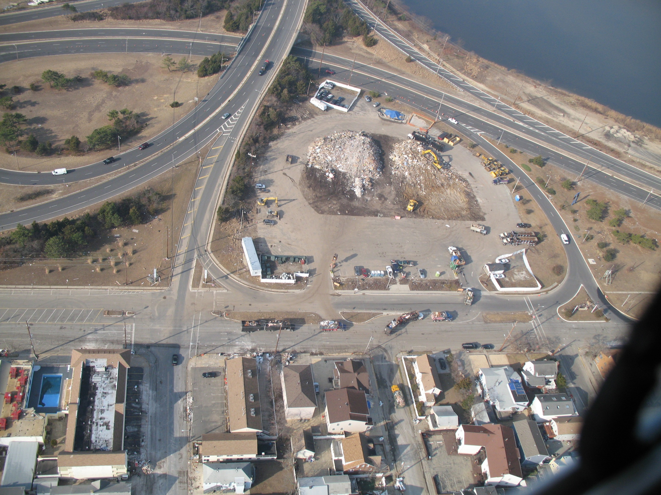
C&D Debris

Slide 23
Siting a Temporary Debris Management Area
Secured or securable sites only
Putrescible waste, white goods, e-waste, and HHW must be stored on a paved surface
Vegetative waste should be stored on a permeable (unpaved) surface
Use public lands if at all possible
  Lease agreement required for private land

Slide 24
Siting a Temporary Debris Management Area (cont.)
Avoid areas near residences, schools, and hospitals
Cannot be located within a Flood Hazard Area or in/near wetlands
Cannot be located in environmentally sensitive areas and historic/archeological sites
  Need approval from State Historic Preservation Office
  Certification of no endangered species on-site

Slide 25
Siting a Temporary Debris Management Area (cont.)
Highlands Council or Pinelands Commission approval, if applicable
Must obtain approval from county OEM and local fire official
Conduct baseline environmental survey before site is used
  Must return site to original conditions at conclusion of debris operations

Slide 26
Ideal TDMA Locations
DPW Yard
Exempt recycling sites
Vacant municipal property
Closed municipal landfill
  May require an additional approval from DEP
Closed cell on operating landfill

Slide 27
Pre-approval of TDMAs
Currently TDMA approvals are event specific
DEP is implementing a pre-approval process for “recurring” TDMA locations
Detailed review of submitted information will be conducted prior to issuing a pre-approval
  Sites approved for Sandy or Irene will not be automatically approved
Establishment of regional TDMAs is encouraged

Slide 28
Pre-approval of TDMAs (cont.)
TDMA Pre-approval Request Form in Municipal Tool Kit
  Available as a fillable PDF document
Must include a site drawing, photographs, and fire official and County OEM approvals
Department will coordinate getting all other approvals (Pinelands, Stormwater, Green Acres, etc.)
Submit to solidwasteemergencies@dep.nj.gov

Slide 29
Activating a Pre-Approved TDMA
Use of a TDMA is limited to when an Executive Order is signed by the Governor declaring a state of emergency and the Commissioner signs an Administrative Order waiving limited Solid Waste Rules
Activate TDMA during/after an emergency by e-mailing solidwasteemergencies@dep.nj.gov, sending a fax (609-984-0565), or calling (609-292-9880)

Slide 30
What if there is no Executive Order?
Enforcement Discretion can be used in limited circumstances if there is no declaration of a state of emergency
  Utilized following the South Jersey Derecho
If used DEP will notify potentially impacted towns that have pre-approved TDMAs

Slide 31
Resources Available
Municipal Debris Management Planning Tool Kit
FEMA Debris Management Guide
  www.fema.gov/pdf/government/grant/pa/demagde.pdf
FEMA Pilot Program Guide
  www.fema.gov/alternative-procedures
Division of Solid & Hazardous Waste - 609-292-9880
  Robin Heston – robin.heston@dep.nj.gov
  Tom Byrne – tom.byrne@dep.nj.gov
solidwasteemergencies@dep.nj.gov

