Slide 1


OCEAN COUNTY MUNICIPAL COORDINATORS MEETING
February 2025
1.5 CRP | 1.5 NJCCC
MEETING POINTS
Year Recap
Health Department Updates
Document Shredding / HHW Events
Barnegat Bay Blitz
Fire Upgrade Update
Monofilament
Green Wave Electronics
Outreach Materials
Tonnage Reports

Slide 2
Year Recap

Slide 3
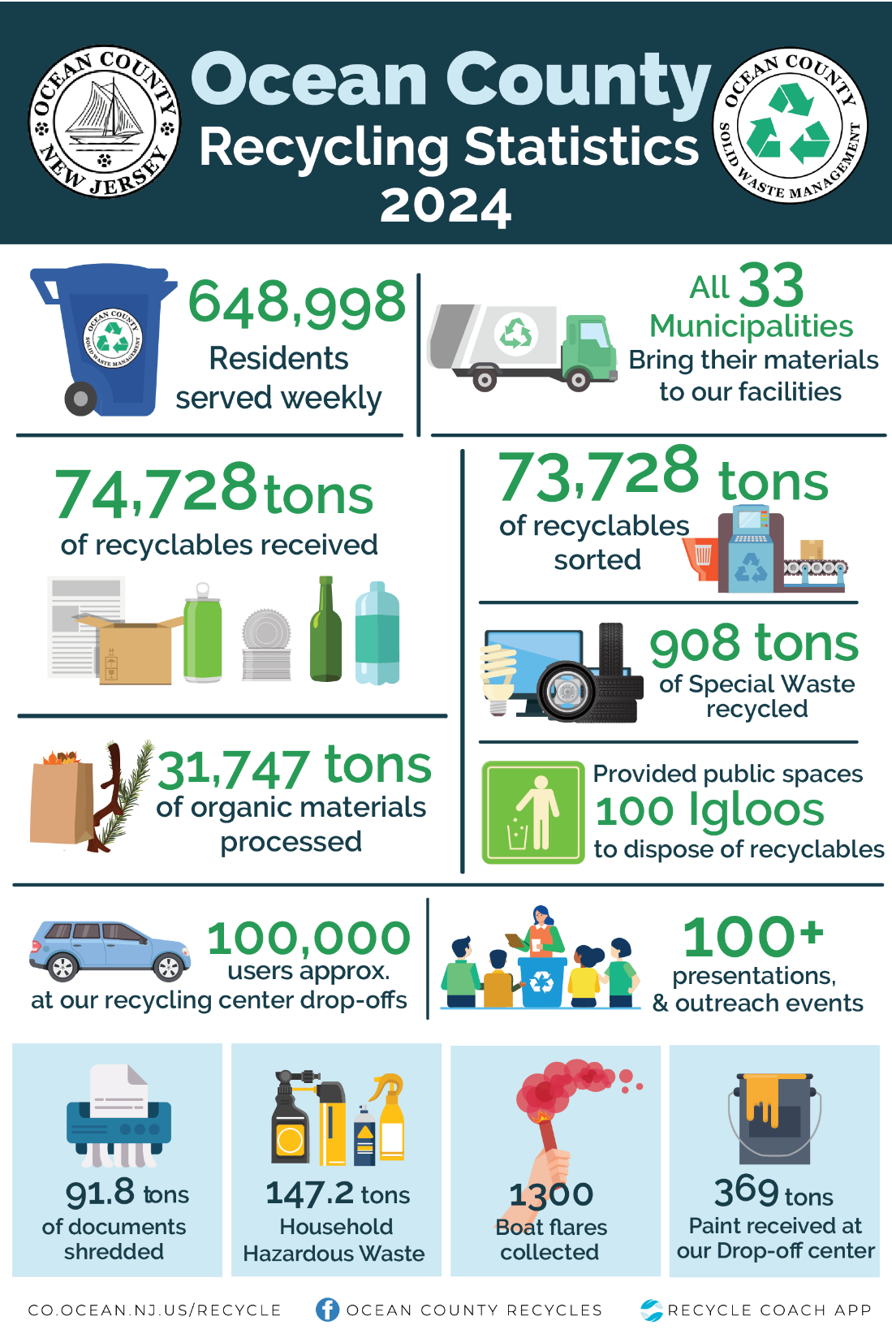
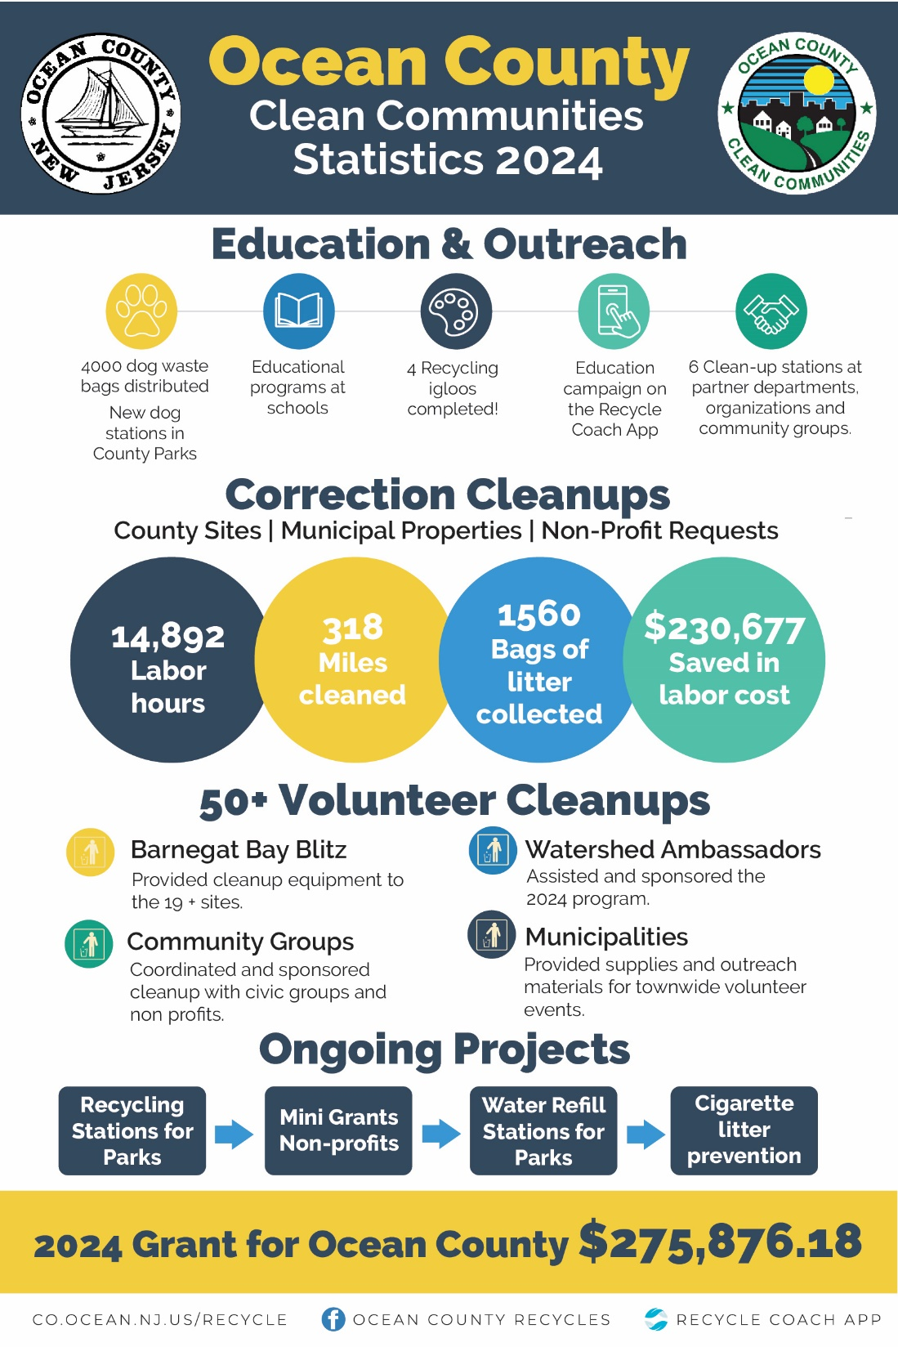

Slide 4
Health Department

Slide 5
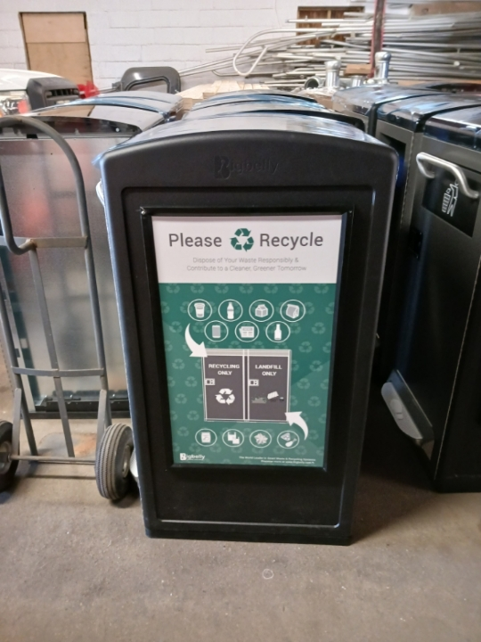
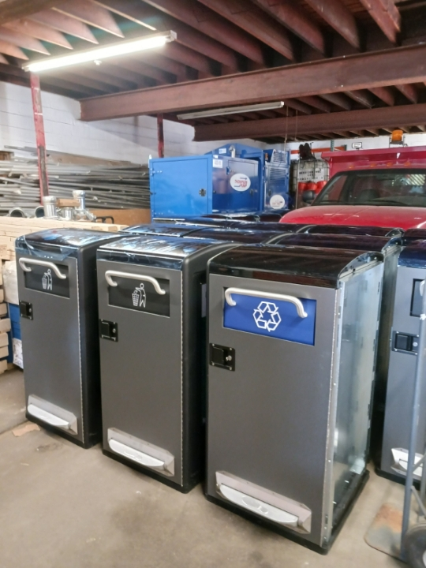

Slide 6

Guide available to municipalities.

Slide 7
Document Shredding / HHW Events

Slide 8
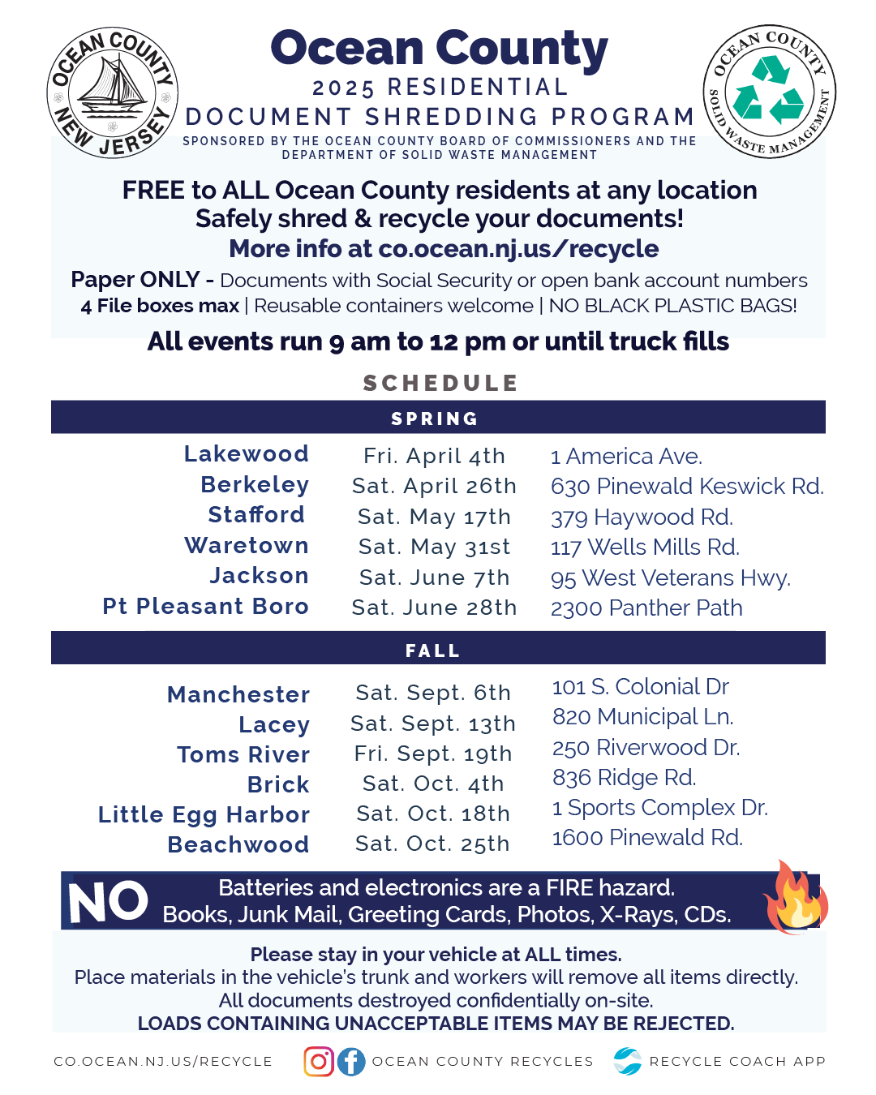
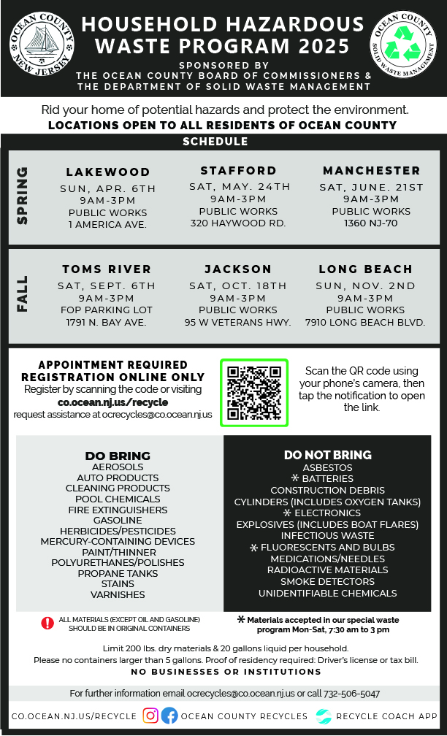

Slide 9
Barnegat Bay Blitz
April 12th to April 19th, 2025

Slide 10



Slide 11
Fire Upgrade Update

Slide 12
Monofilament

Slide 13

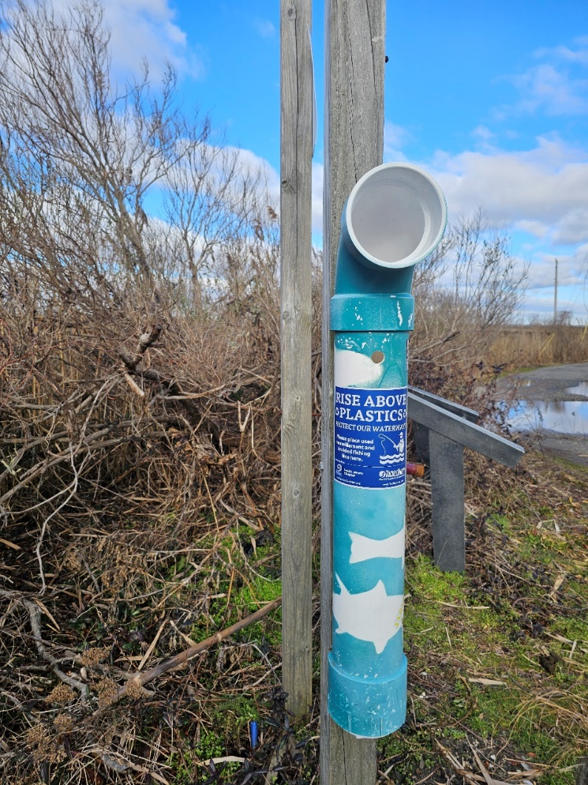
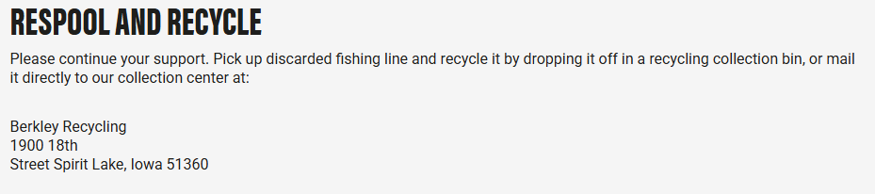

Slide 14
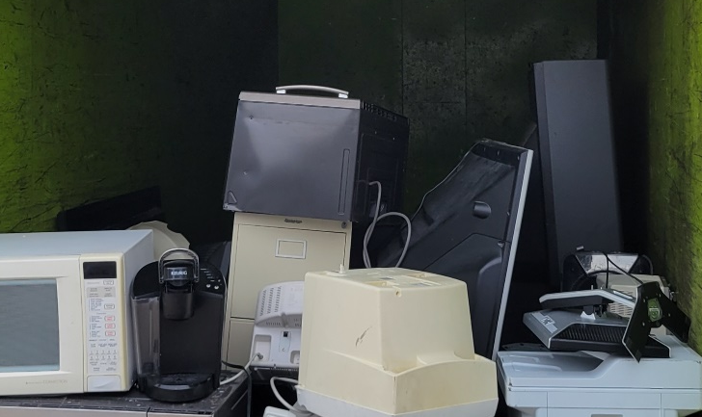
Green Wave Electronics
TJ Feury

Slide 15
Outreach Materials

Slide 16

Will be announced
Feb 26th

Slide 17
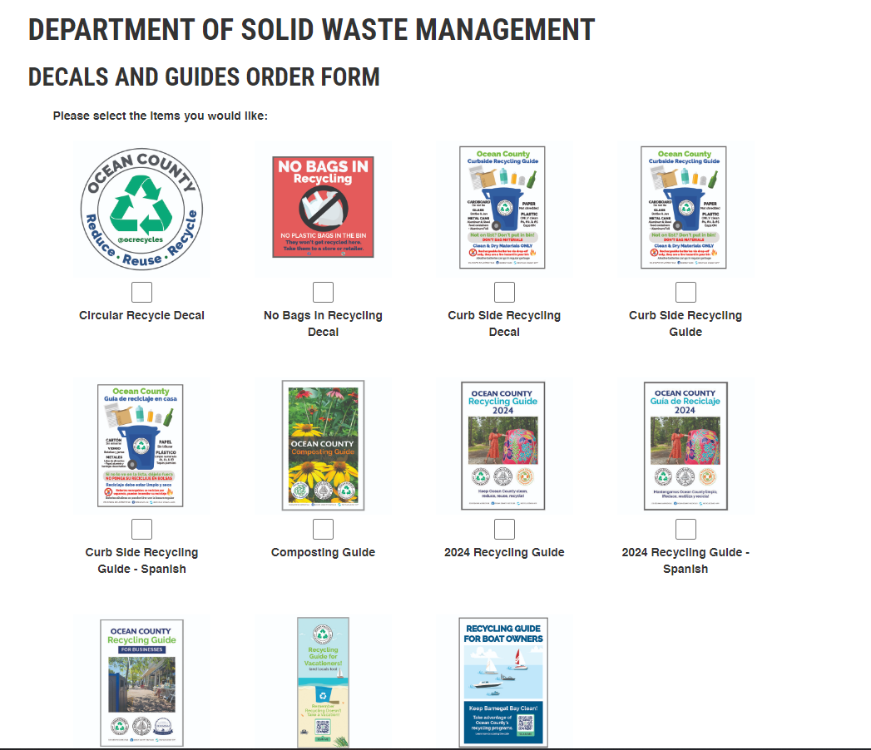

Slide 18
Important Dates

Slide 19
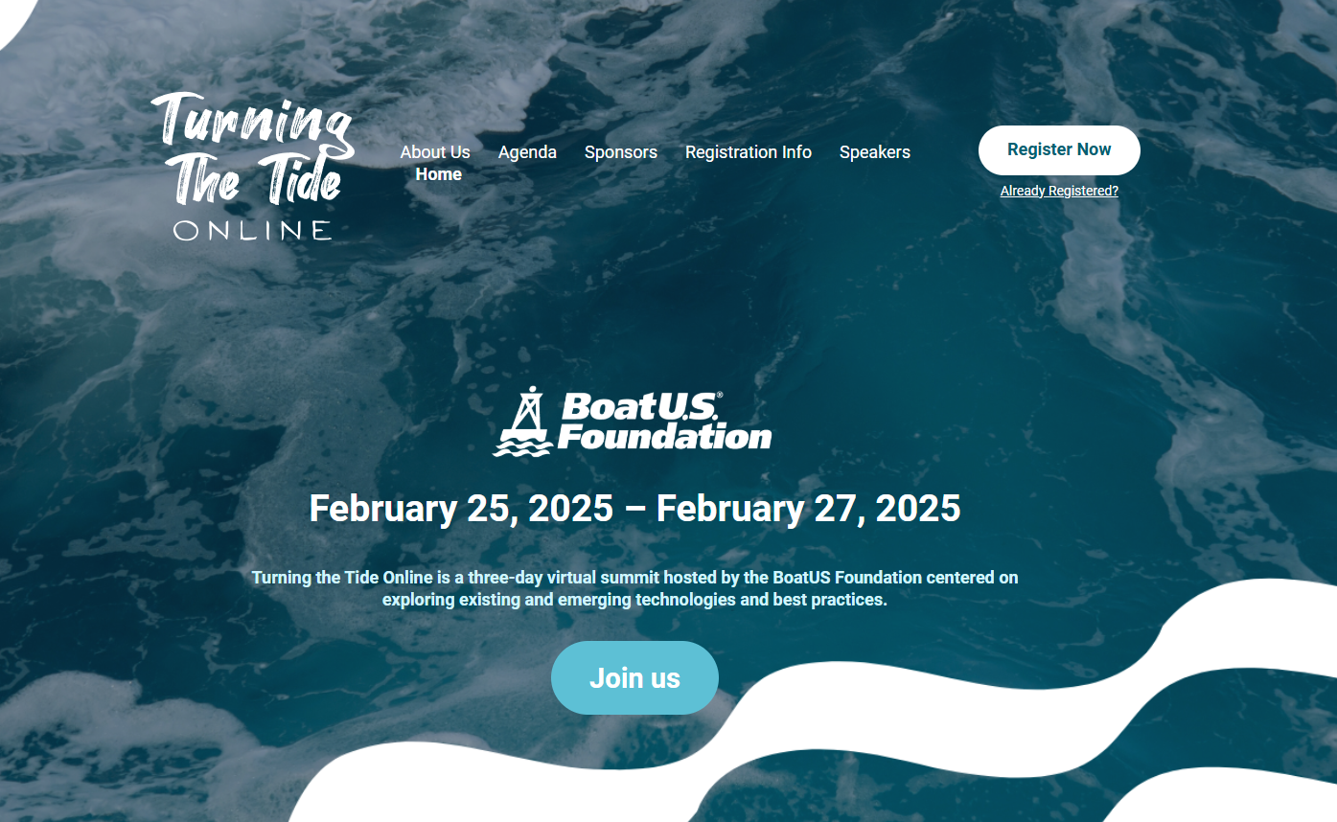

Slide 20


Slide 21
Tonnage Report Season
Deadline for our review: April 1st
State deadline: April 30th

Slide 22
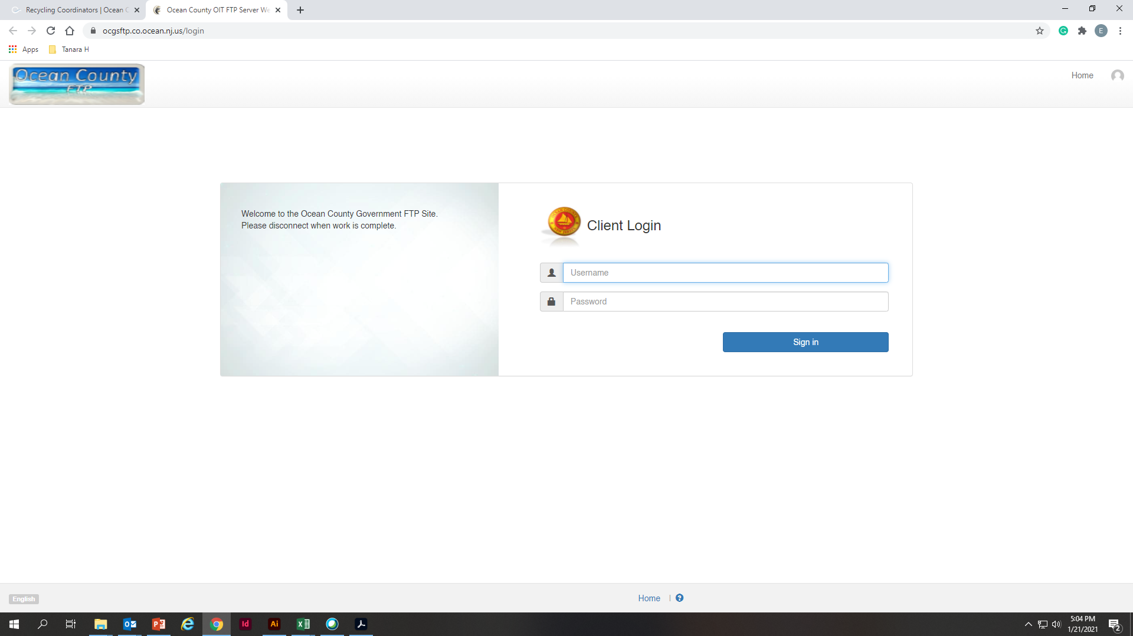
How can I access the reports?
ocgsftp.co.ocean.nj.us
Username: SWMVendorFTP
Password: Vend4SWM_FTP!

Slide 23
I’m new, what reports am I expecting?
Residential
Reports from Ocean County Recycling Centers.
Reports from vendors for materials received at your municipal center.
Commercial
All other reports added to the Class A, B, C, or D folders.
Any report received from items not collected at municipal or county recycling center.

Slide 24
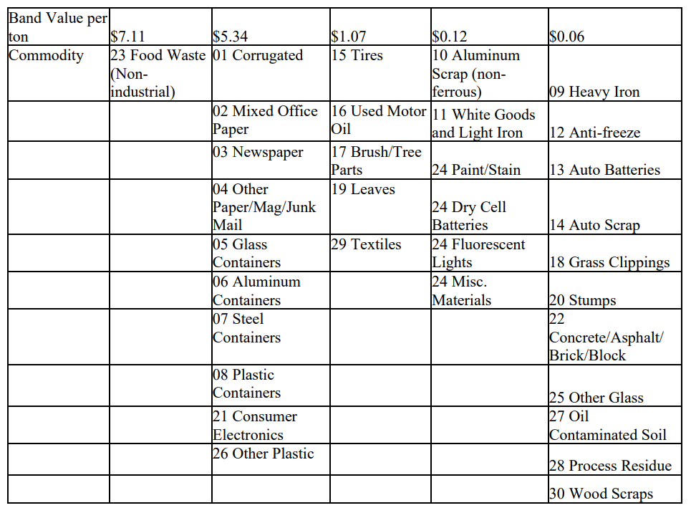

Slide 25
Not sure if your report is right?
Need help with your report?
First time filling out your tonnage report?
Make an appointment with us!

Slide 26

Reviews:
“Tanara and Margaret turn chaos into compliance with style and precision.” – The New York Times
“Who knew tonnage reports could be this entertaining?” – Variety
“Deadlines, data, and drama—surprisingly fun to watch.” – The Washington Post
“Spreadsheets have never been this compelling.” – The Wall Street Journal
“Municipal reporting meets masterful problem-solving.” – The Guardian

Slide 27
Thank you!

