Slide 1
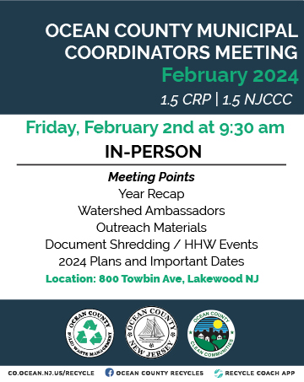

Slide 2
Year Recap

Slide 4
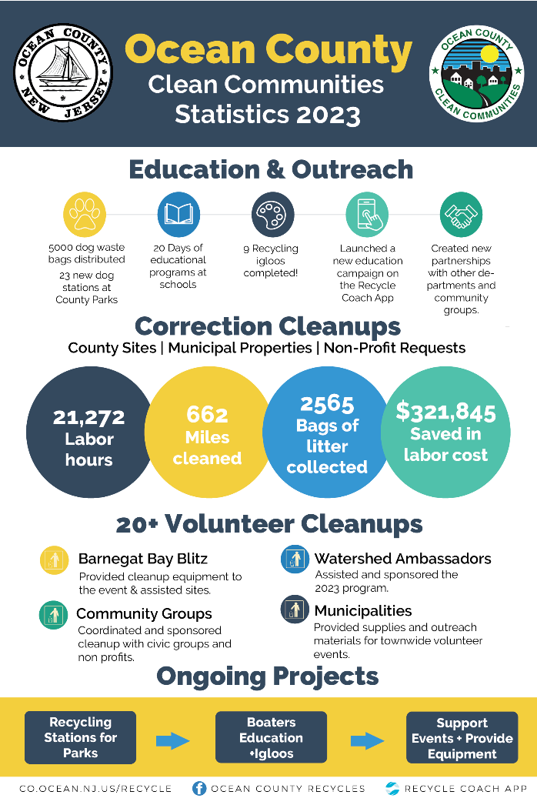

Slide 5
Watershed Ambassadors

Slide 6
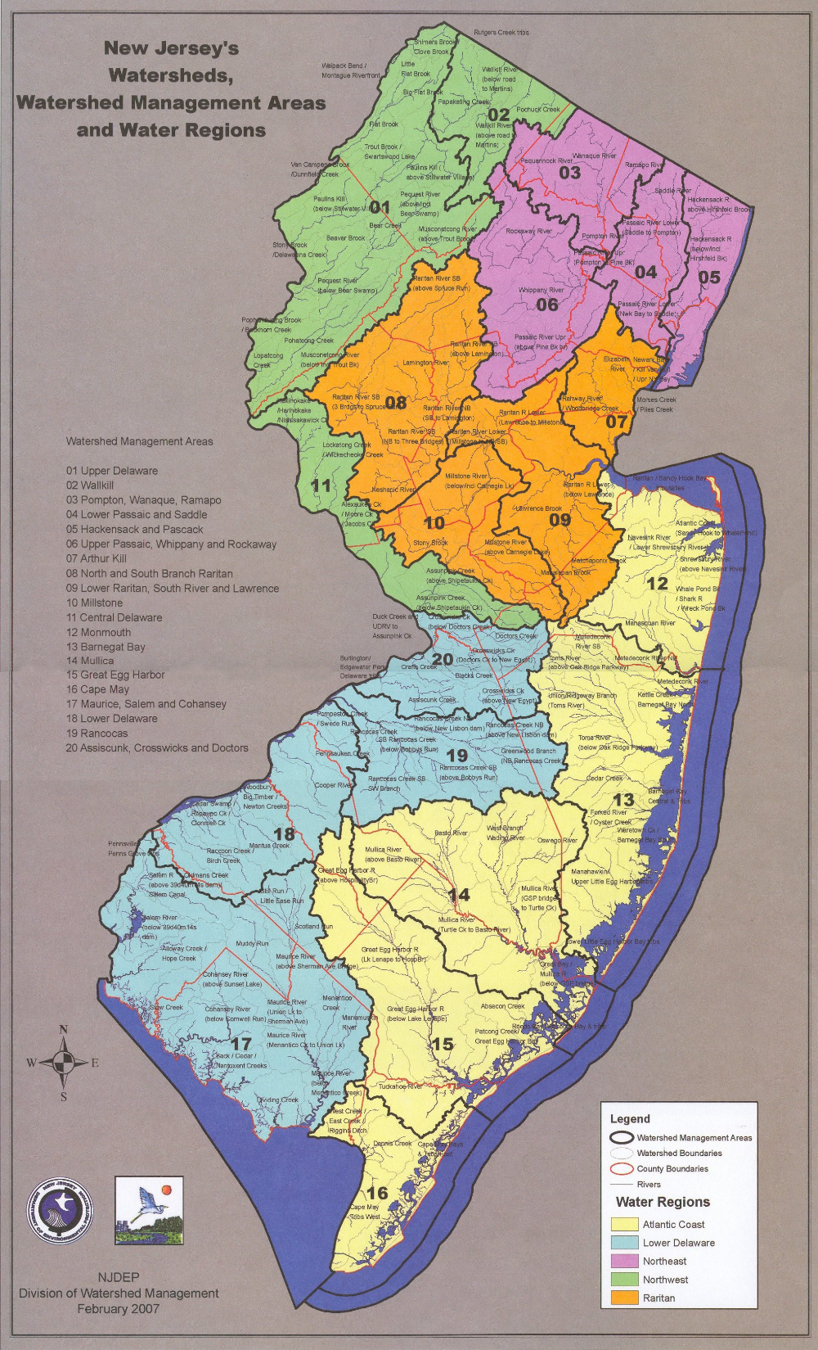
2024 Ambassadors
WMA 13:Caroline McFarland
wma14.njwap@gmail.com
WMA 14: Melanie Thorn
wma14.njwap@gmail.com

Slide 7
Save Barnegat Bay
Cleanup Program

Slide 8
New Volunteer Cleanup Program
2023 Stats
4/13 - Toms River, Browns Woods (Beach Sweep)
4/15 - Manchester, Northampton Blvd & Montgomery Ave (Blitz)
4/17 - Brick, DeCamp Trail (Blitz)
4/19 - Bayville, Bayview Ave & Sloop Creek Rd (Blitz)
5/13 - Plumsted, Main St
6/25 - Toms River, Riverwood Park
9/16 - Toms River, Shelter Cove (International Coastal Clean-up)
10/1 - Harvey Cedars, James St (Microplastics Survey)
10/15 - Lacey, Laurel Blvd
10/21 - Toms River, Browns Woods
11/18 - Manchester, Manchester Little League
Leigh V Simpson II
Clean-Up Coordinator
programs@savebarnegatbay.org
732-930-4798

Slide 9
Outreach Materials

Slide 10


Slide 11

Health Department will distribute to businesses.
Guide will be available to municipalities.

Slide 12
Events

Slide 13
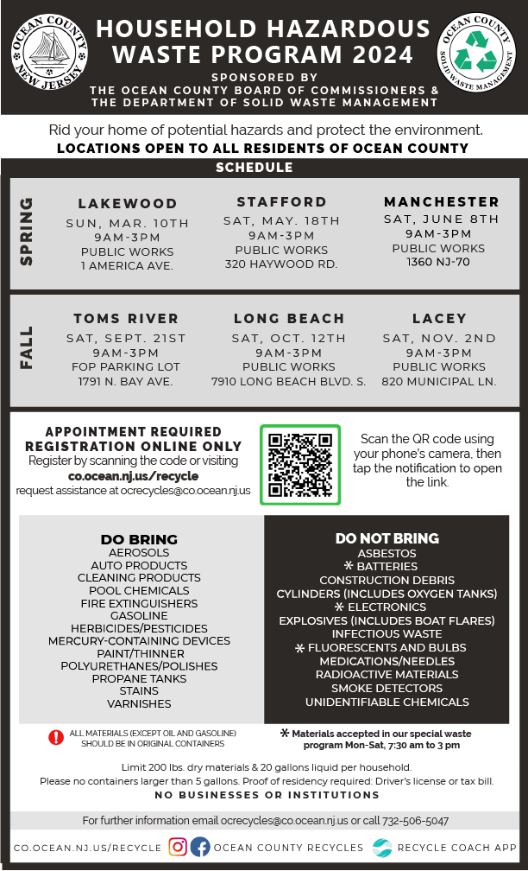


Slide 14

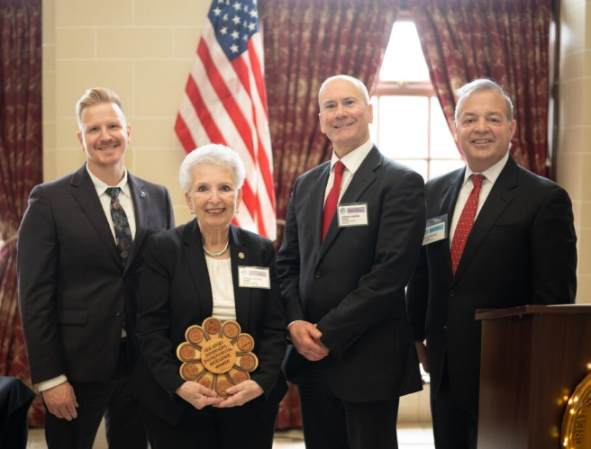

Slide 15
2024 Plans & Important Dates

Slide 16


Slide 17
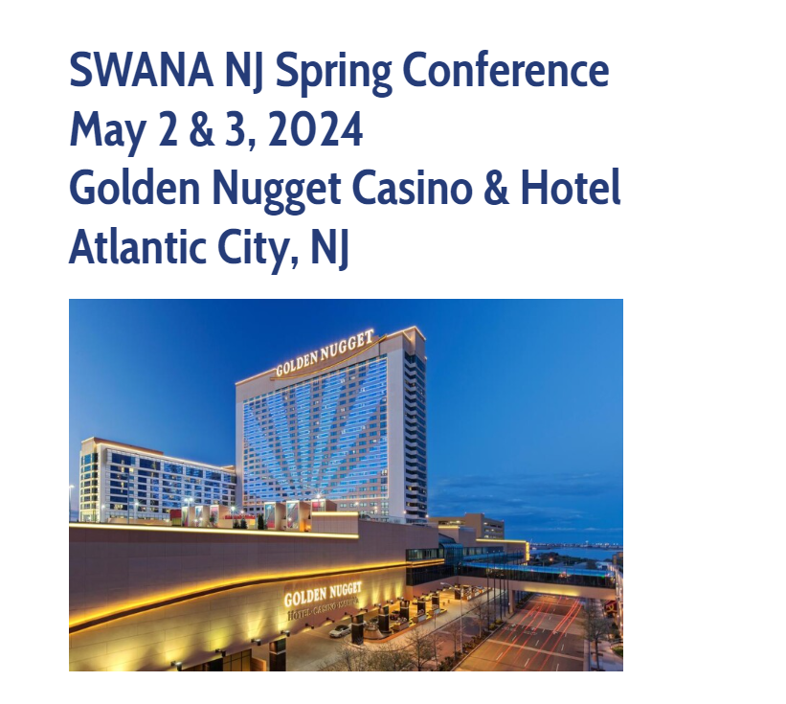

Slide 18

Coordinator Classes
Sign up on their website to get notified once enrollment opens.
Carol Broccoli at 848-932-7207 or carolbr@njaes.rutgers.edu

Slide 19
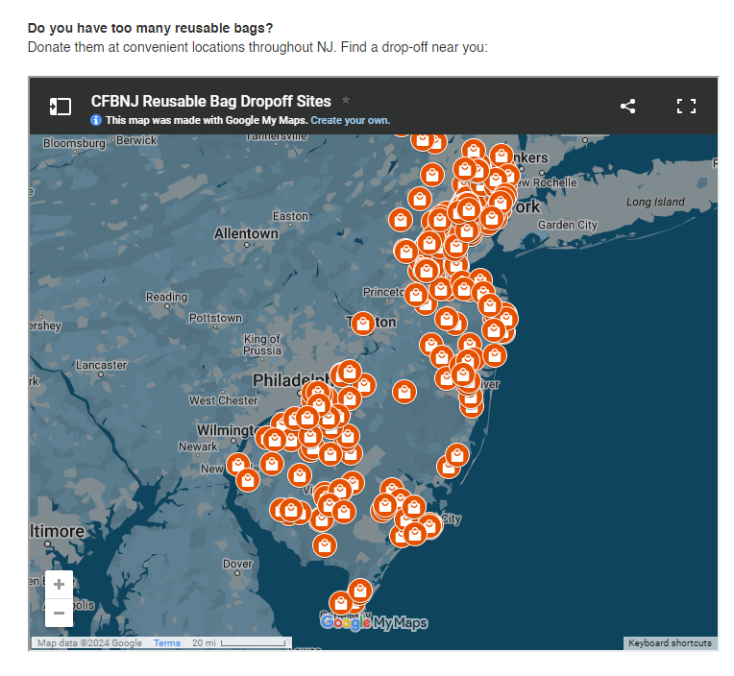
Bag drop off
QR Code
Drop-off sites
Donations
https://www.co.ocean.nj.us/OC/SolidWaste/frmRegContentSW.aspx?ID=5a5860e8-28d9-48db-ab89-b7a4f8317396

Slide 20
Tonnage Report Season
Deadline for our review: April 1st
State deadline: April 30th

Slide 21
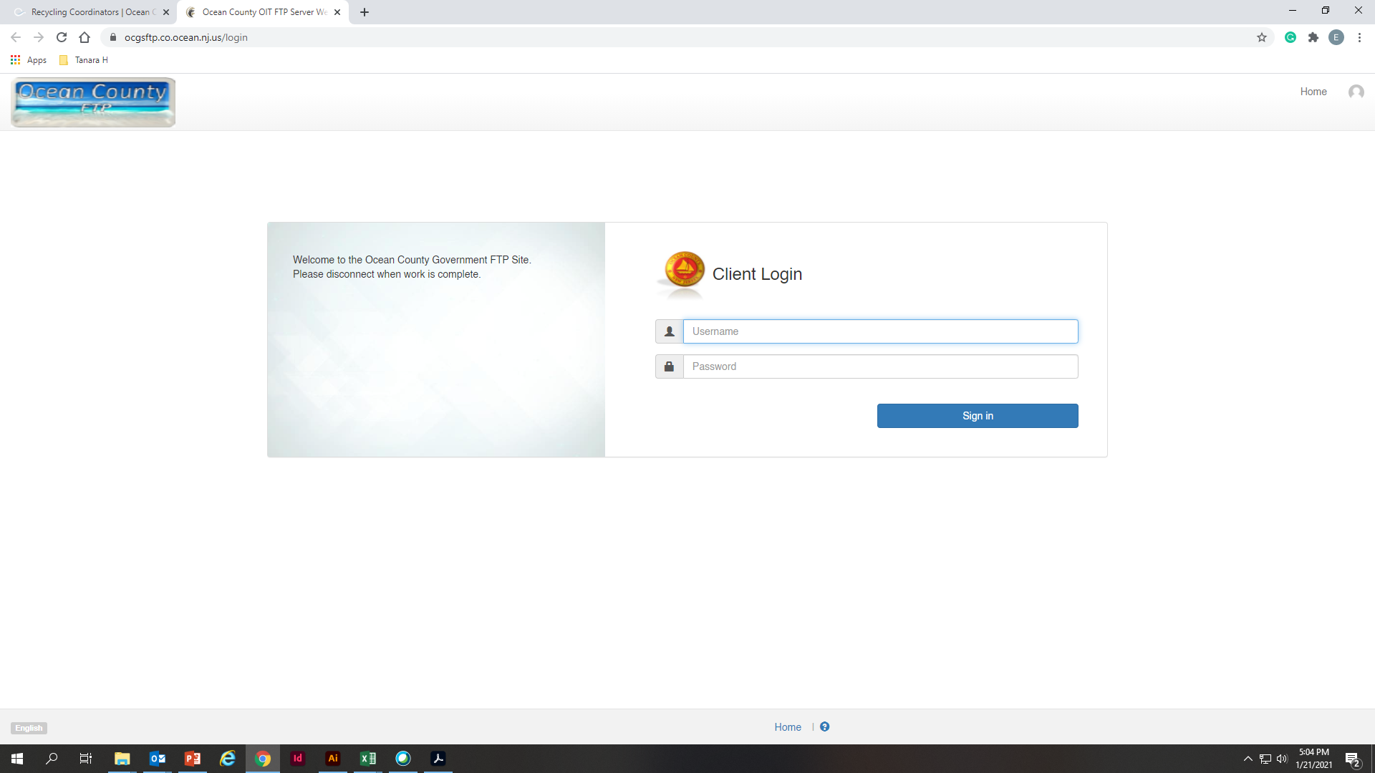
How can I access the reports?
ocgsftp.co.ocean.nj.us
Username: SWMVendorFTP
Password: Vend4SWM_FTP!

Slide 22
I’m new, what reports am I expecting?
Residential
Reports from Ocean County Recycling Centers.
Reports from vendors for materials received at your municipal center.
Commercial
All other reports added to the Class A, B, C, or D folders.
Any report received from items not collected at municipal or county recycling center.

Slide 23
Composting Tonnages

Slide 24
Igloo Program
Rolling Program

Slide 25
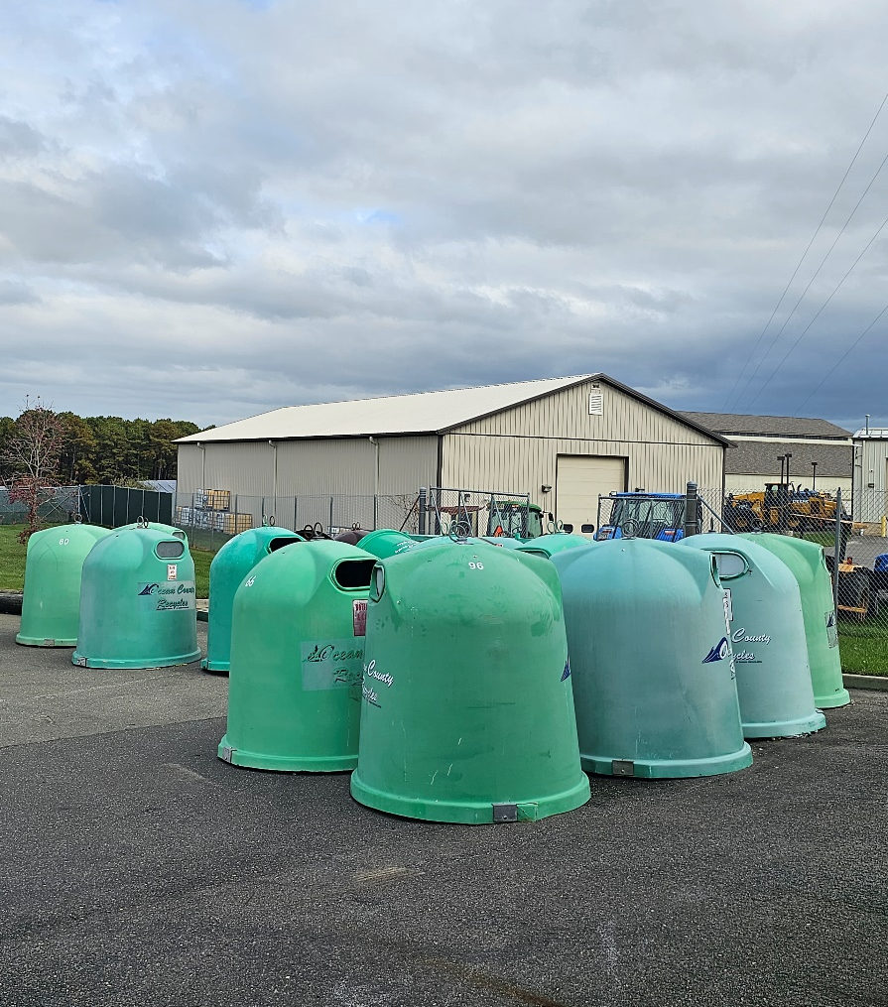
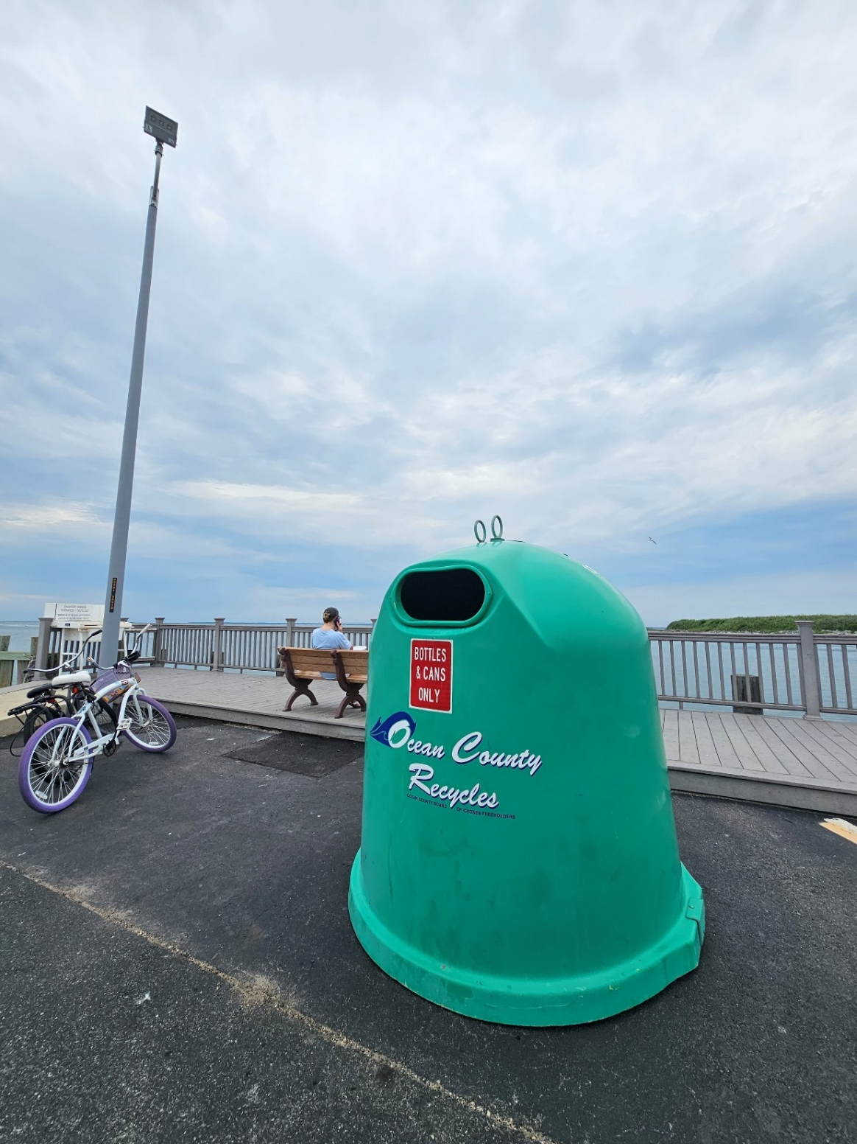

Slide 26
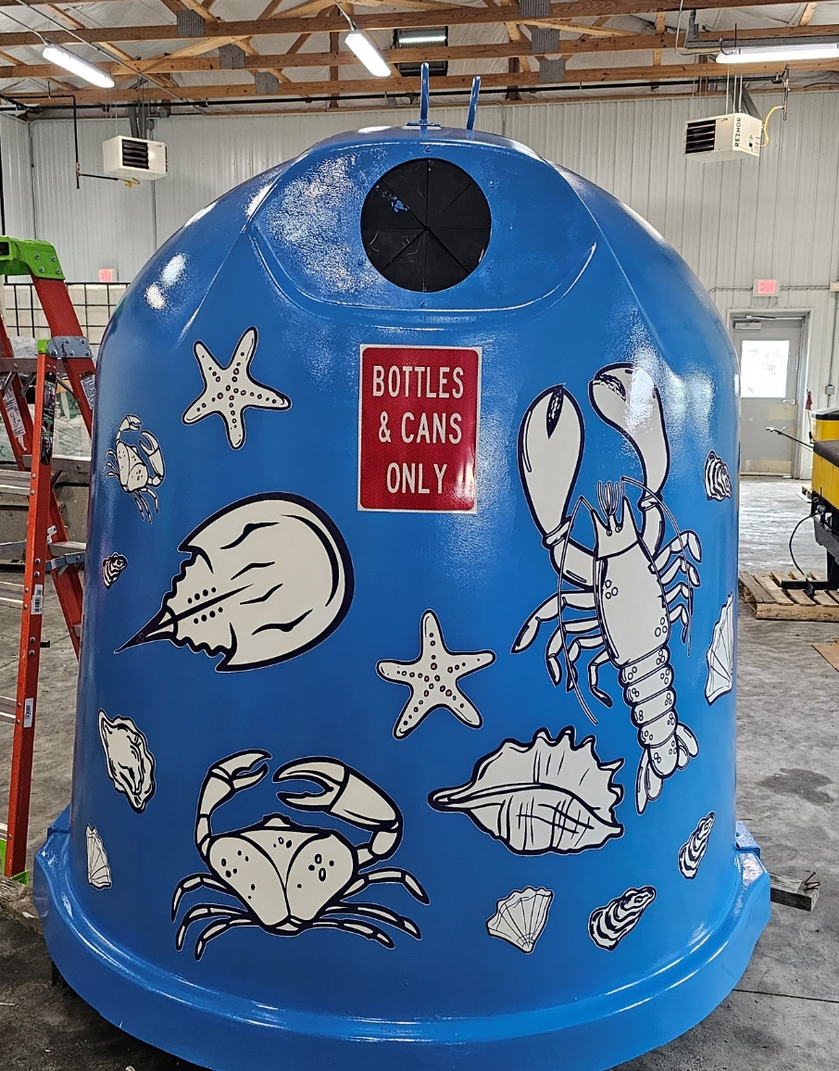
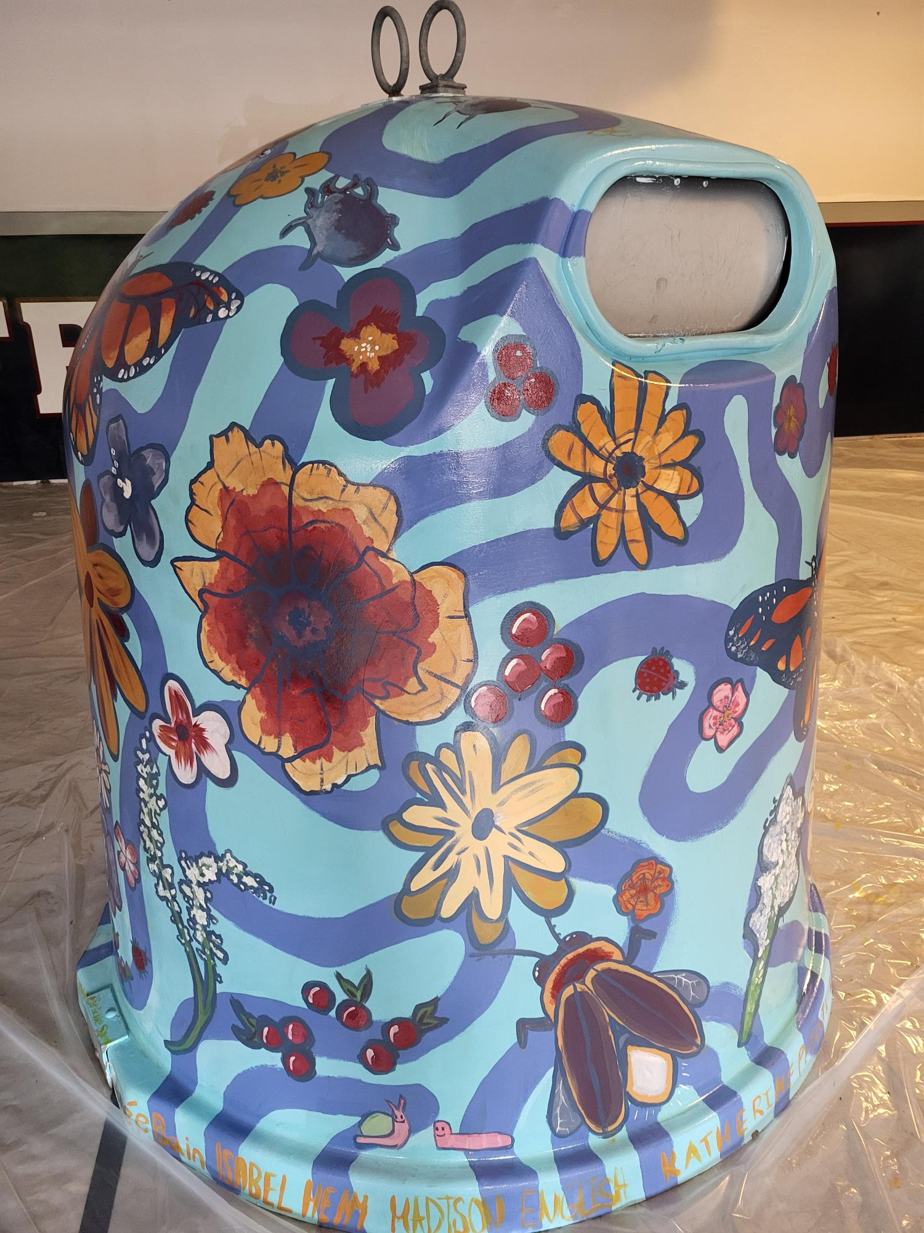
Barnegat | 3
Barnegat Light | 5
Bay Head | 0
Beach Haven | 3
Beachwood | 0
Berkeley | 15
Brick | 19
Eagleswood | 0
Harvey Cedars | 0
Island Heights | 0
Jackson | 0
Lacey | 14
Lakehurst | 0
Lakewood | 3
Lavallette | 3
Little Egg Harbor | 2
Long Beach | 0
Manchester | 0
Mantoloking | 0
Ocean | 7
Ocean Gate | 3
Pine Beach | 0
Plumsted | 0
Pt. Pleasant Borough | 3
Pt. Pleasant Beach | 3
Seaside Heights | 0
Seaside Park | 1
Ship Bottom | 2
South Toms River | 0
Stafford | 1
Surf City | 2
Toms River | 7
Tuckerton | 4

Slide 27
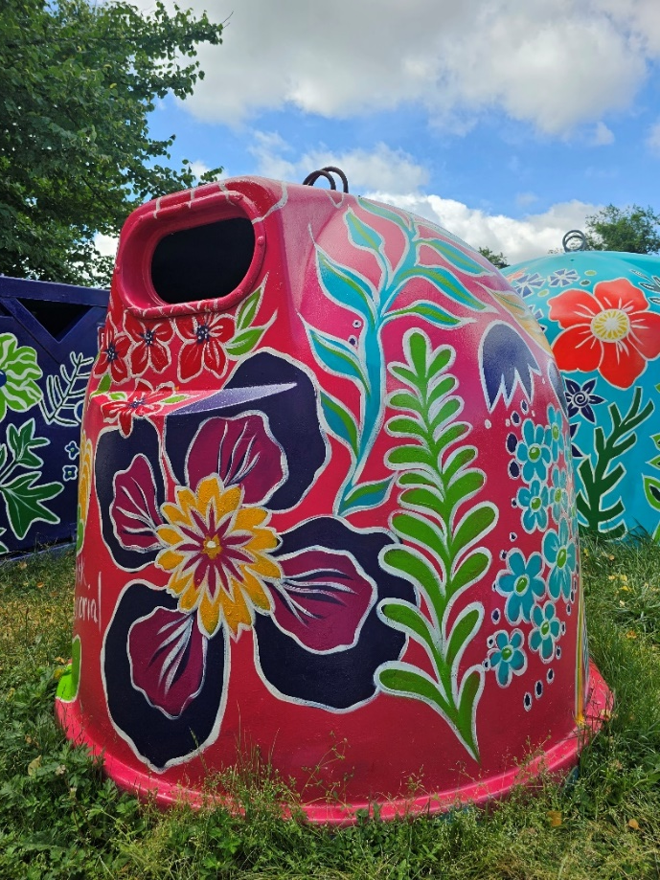
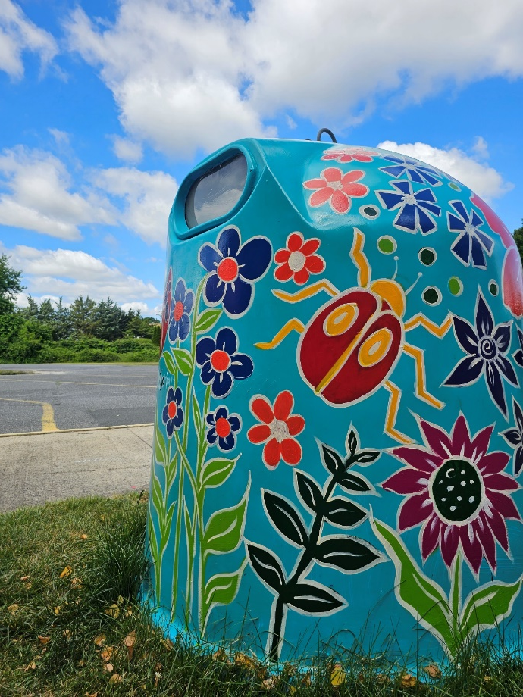
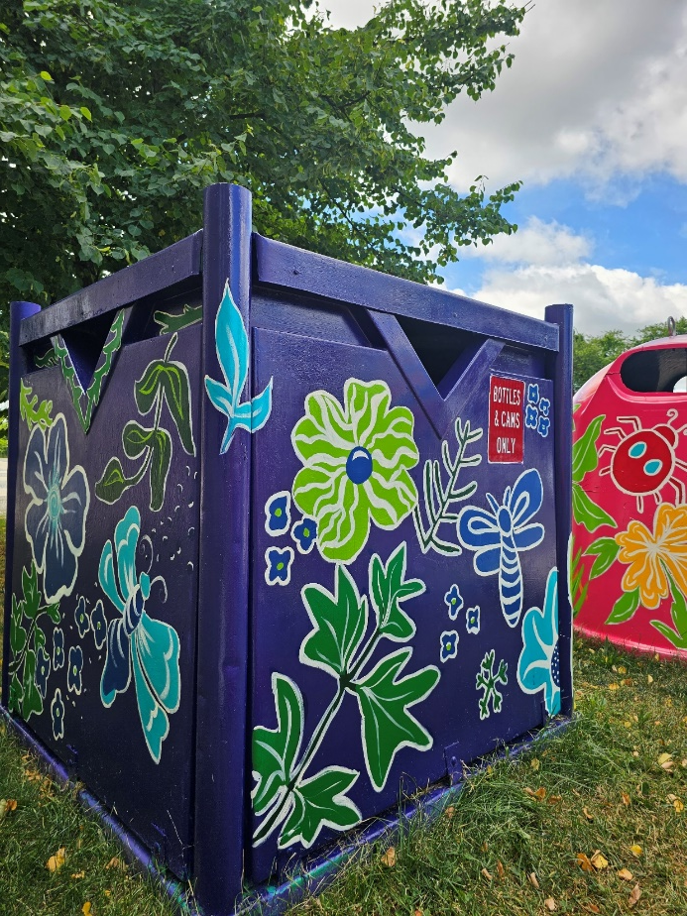
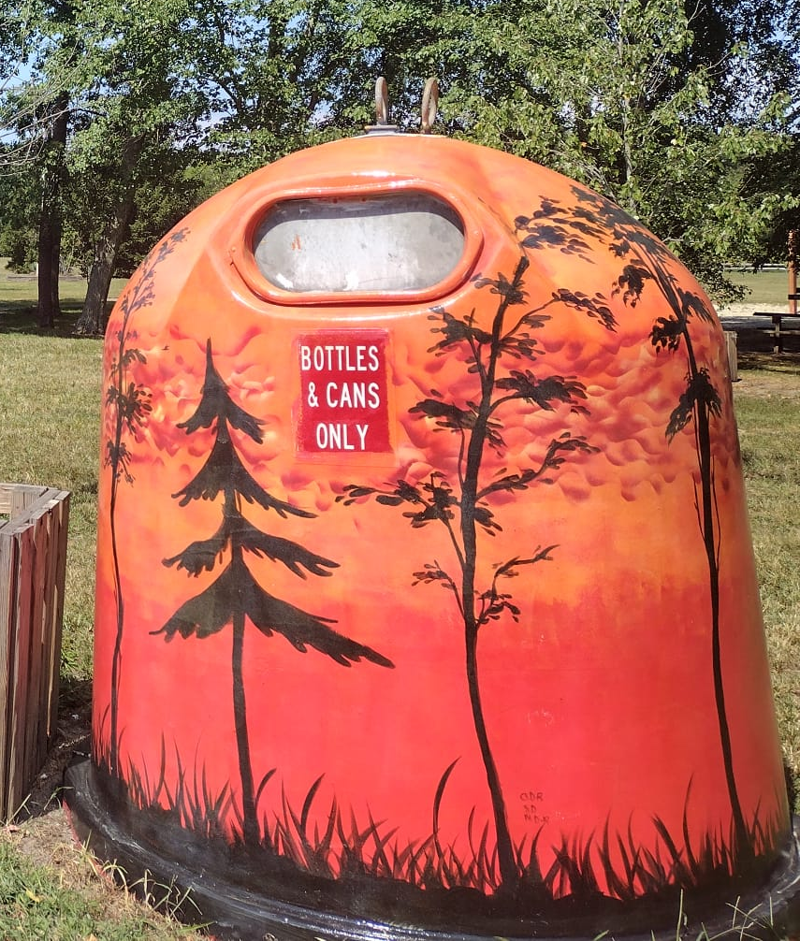
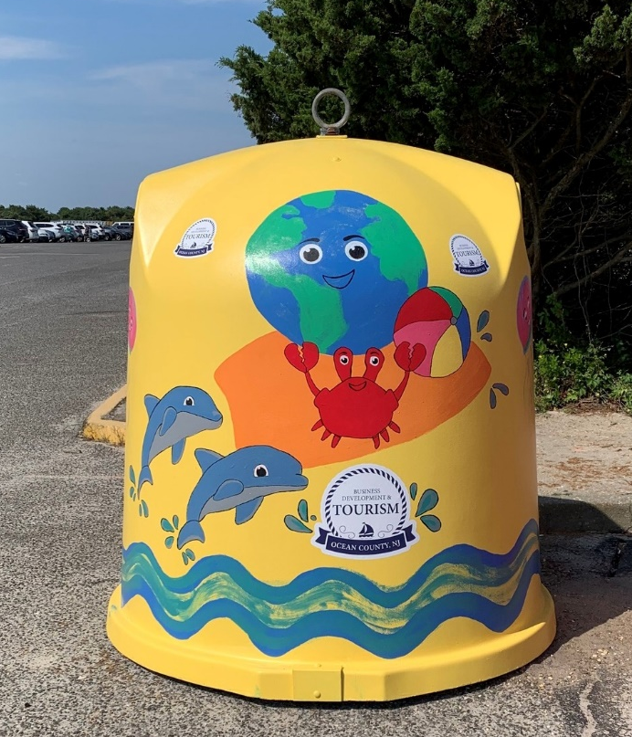
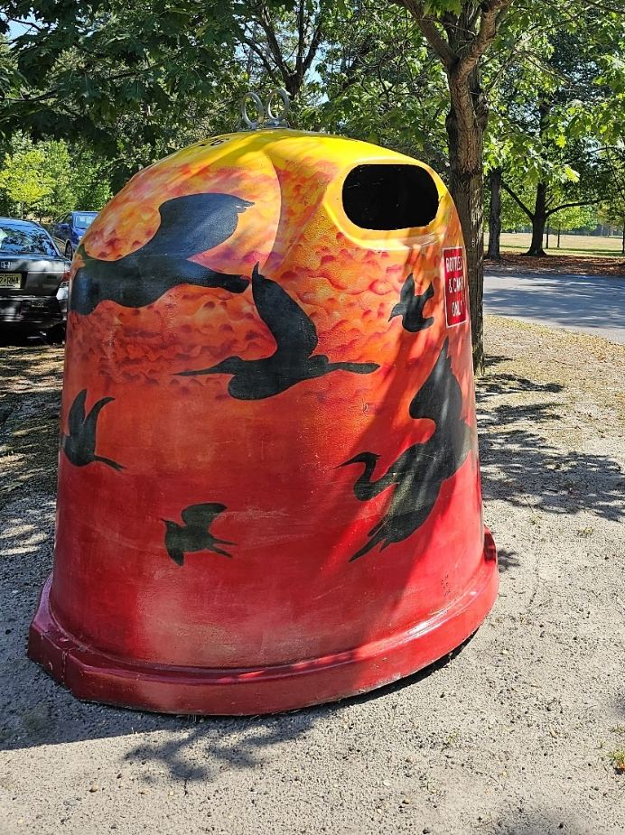

Slide 29
Thank you!

