Slide 1
Recertification Credits

Slide 2
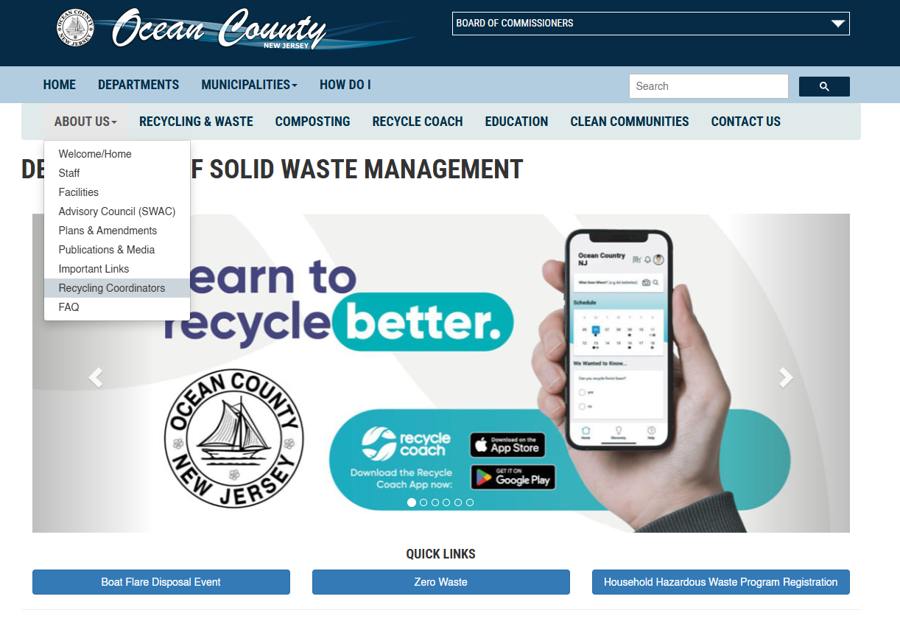

Slide 3
Opportunities for 2025
November 14th – Ocean County Municipal Coordinators Meeting- Credits available for: NJCCC & CRP
November 18th-20th – NJ League of Municipalities (Atlantic City) – Credits available for: NJCCC, CRP, CCFO, CMFO, CPWM, NJCLE, PACLE, LGLP, and RPPO/RPPS
December 4th – New Jersey WasteWise Business Network Webinar(Zoom Meeting) - Credits available for: NJCCC & CRP
December 12th – ANJR & NPN Holiday Party/Board Meeting (Helpsy)- Credits available for CRP

Slide 4
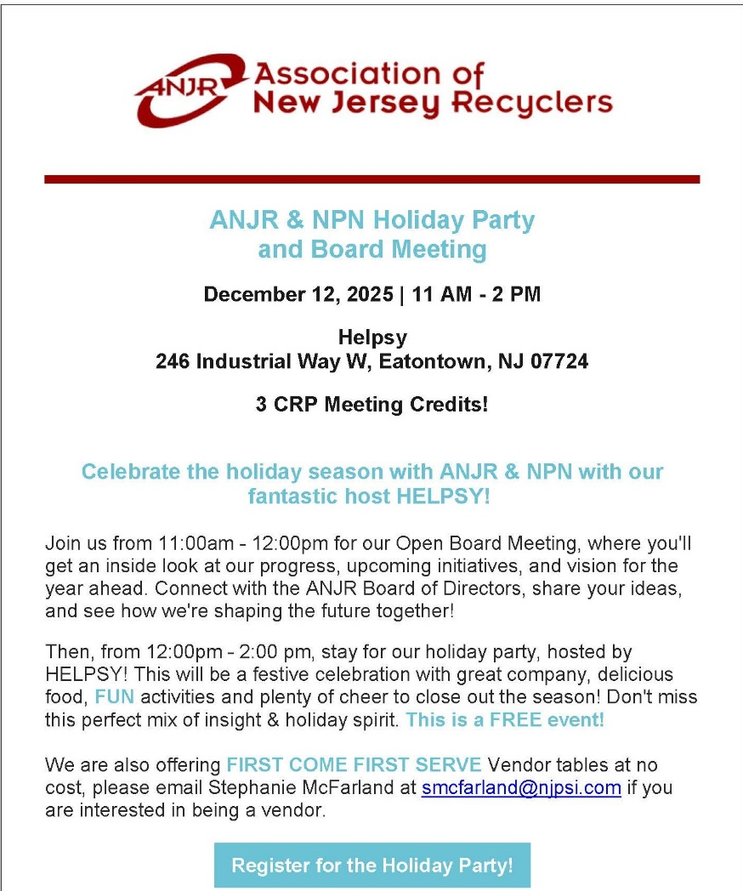


Slide 5


Slide 6
Shared Service Agreements

Slide 7
2025 Programs Recap

Slide 8
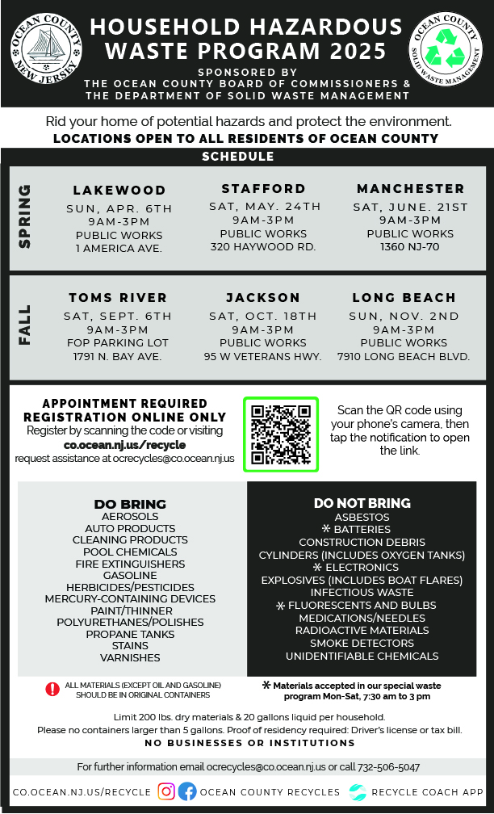
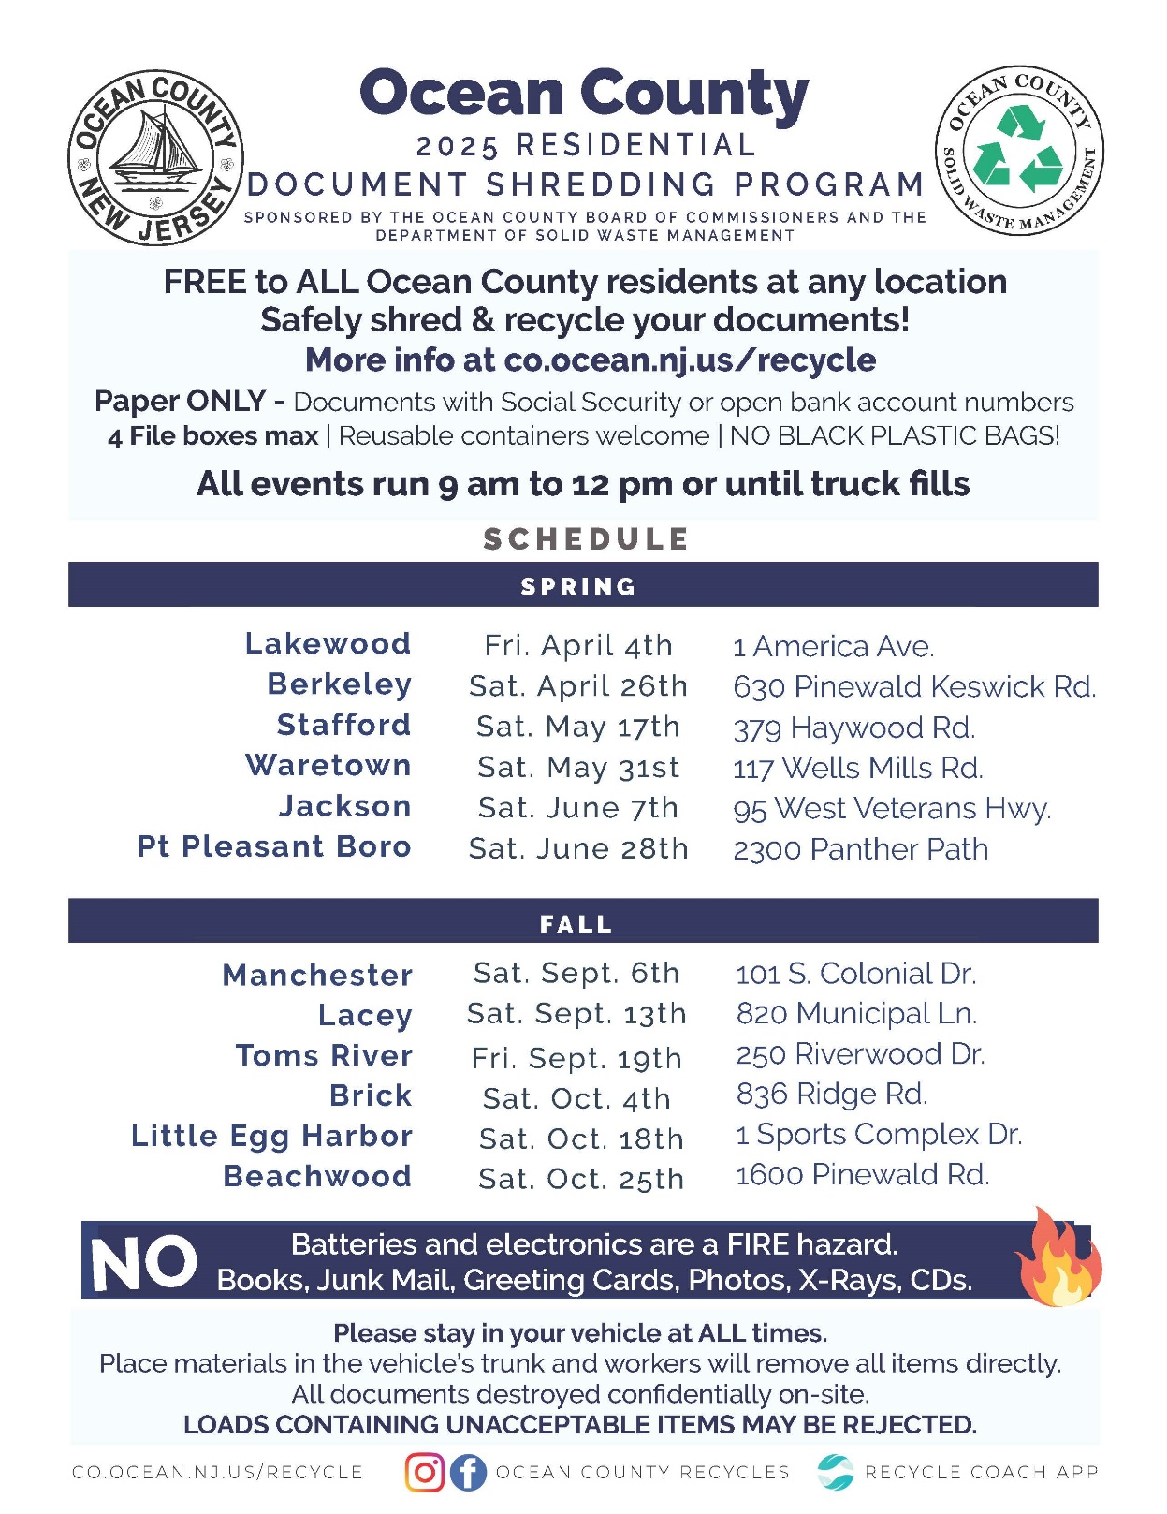

Slide 9


Slide 10
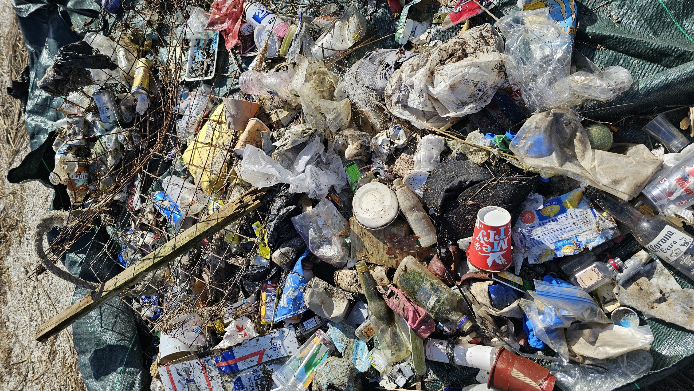
Clean Communities Reports & Recap

Slide 11
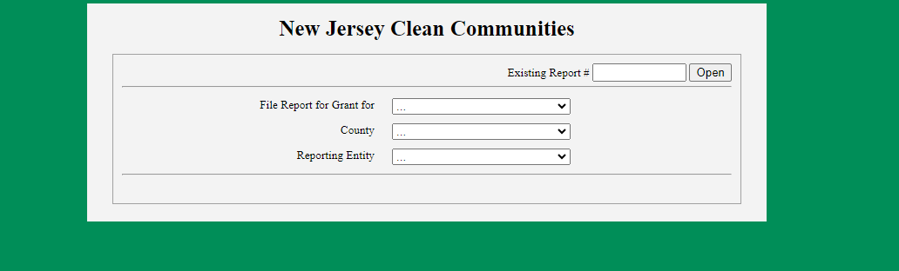
Submit your annual statistical report
Funds received for a calendar year must be utilized during the 18-month period
Beginning January 1 and ending June 30 of the following year

Slide 12
Outreach + Materials

Slide 13
2025 Outreach Stats!
Recycling | 32
Clean Communities | 25
Compost | 37
Waste Reduction | 9
Total | 103

Slide 14
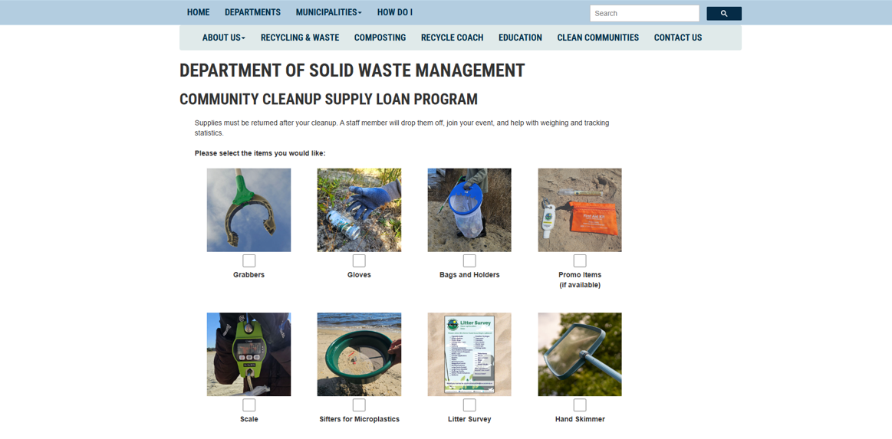

Slide 15
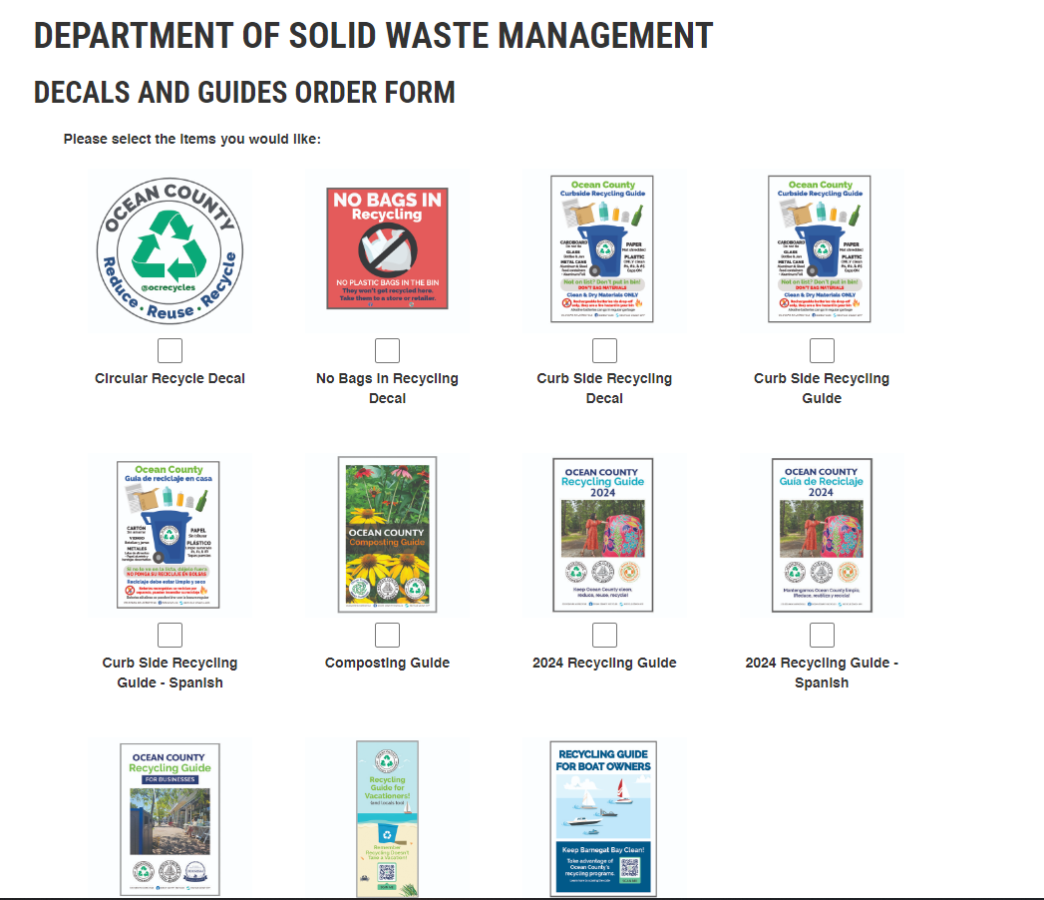

Slide 16
Recycling Guide Review (Contacts/Changes)

Slide 17
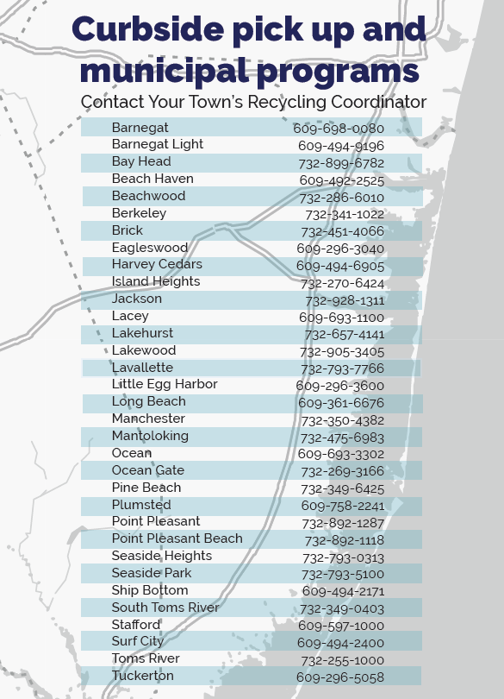

Slide 18



Slide 19
What to expect for 2026 (Tonnage Reports, Schedules, etc)

Slide 20
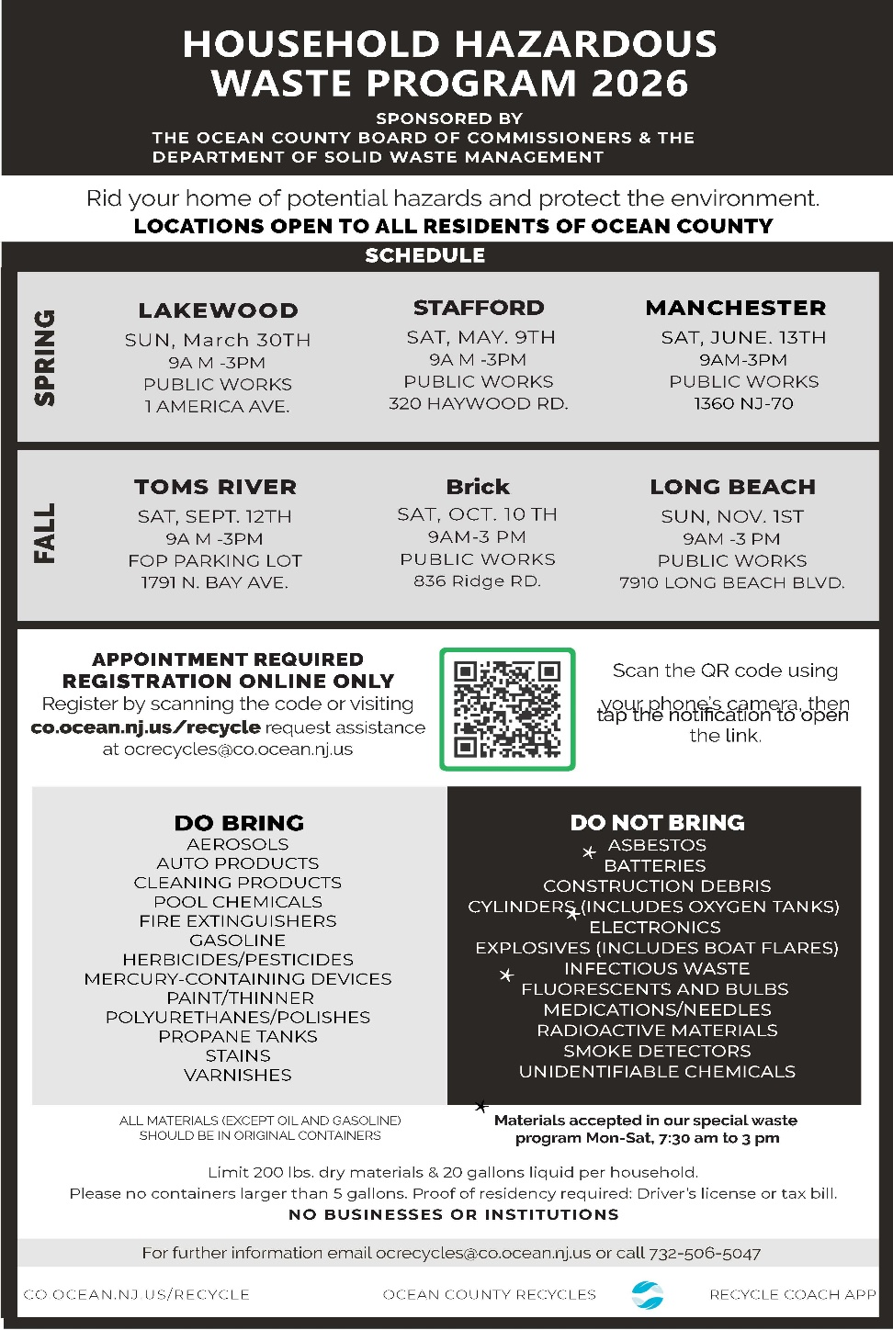
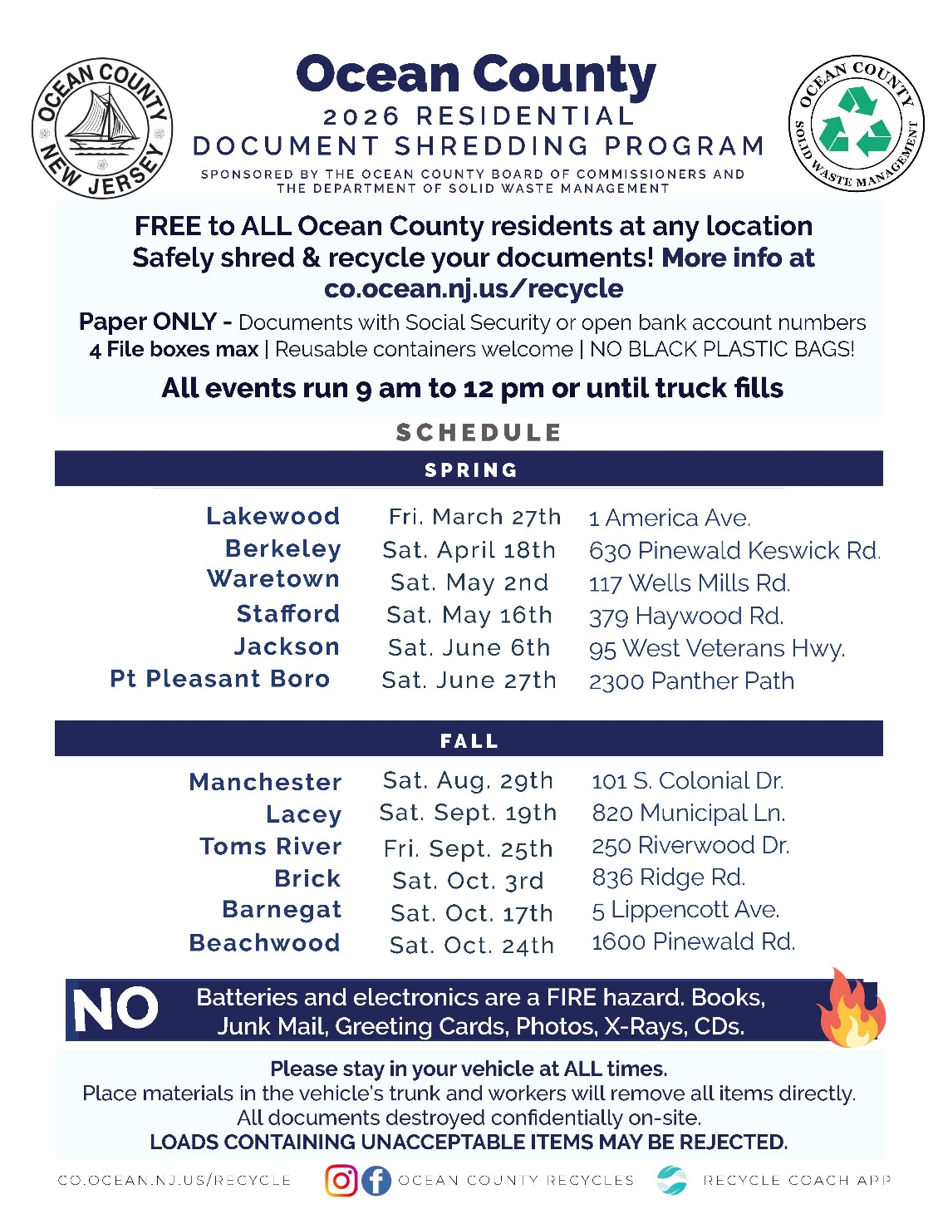
Tentative Dates: DO NOT SHARE!

Slide 21
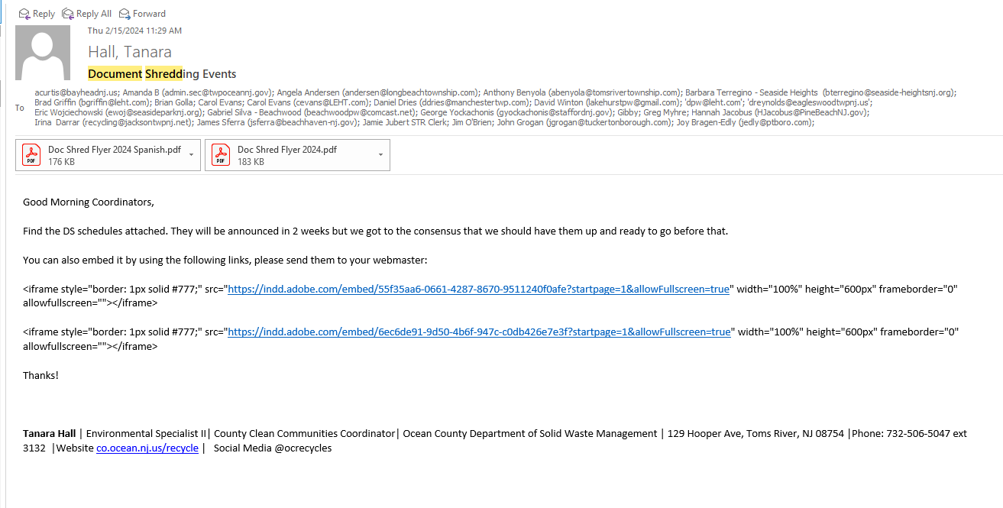
Document Shredding & HHW Agendas

Slide 22
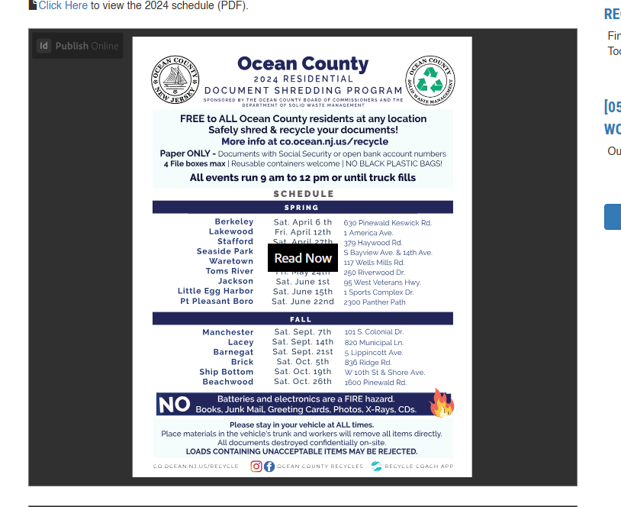

Slide 23
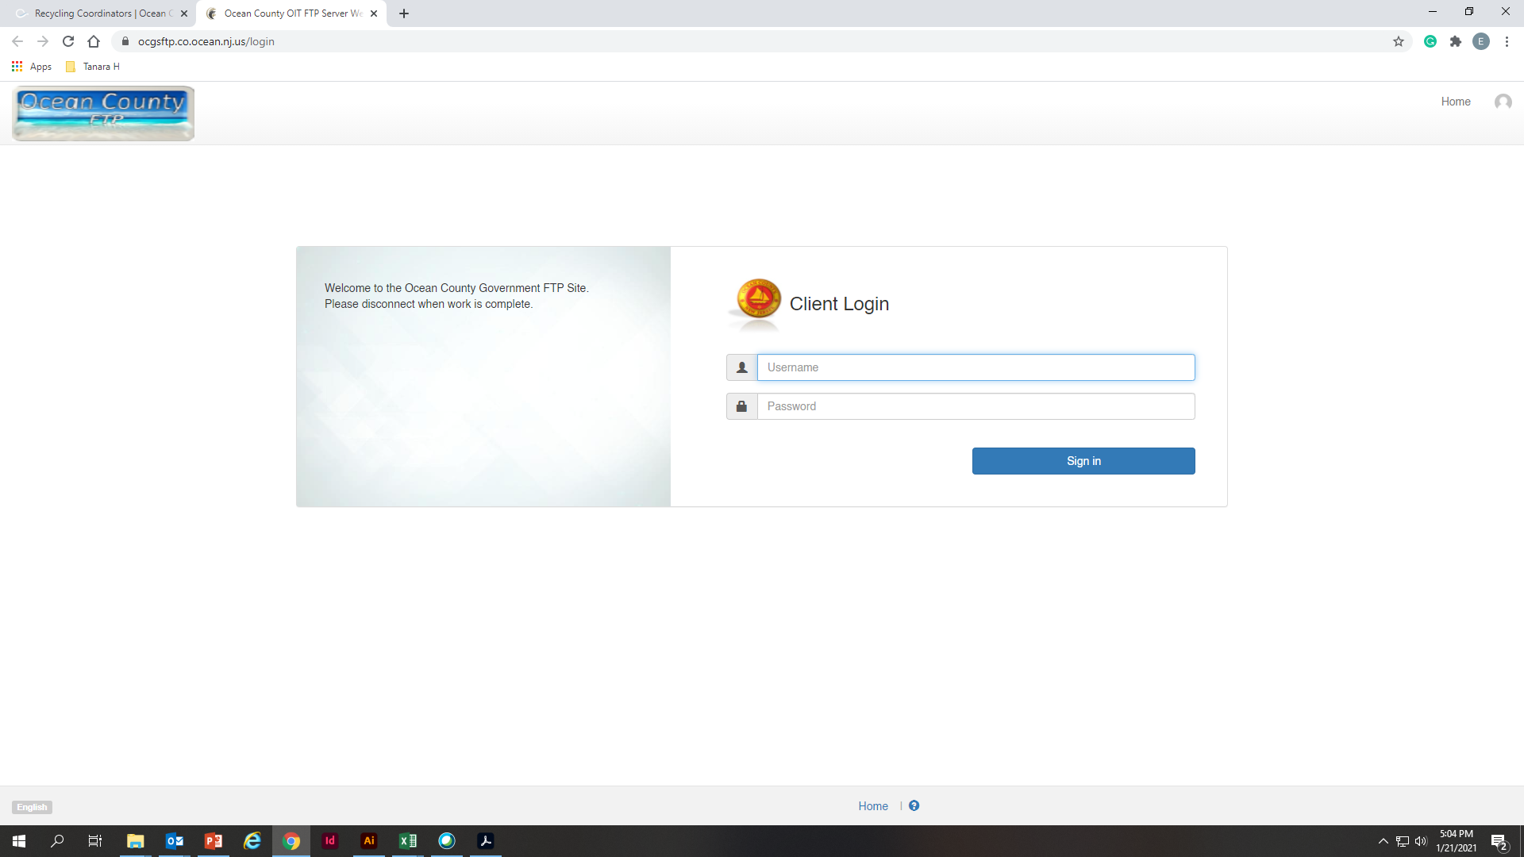
How can I access the documents
ocgsftp.co.ocean.nj.us
Username: SWMVendorFTP
Password: Vend4SWM_FTP!

Slide 24
Tonnage Reports
Scale Totals – End of January
Business reports from Jan to April

Slide 25
Health Department

Slide 26
Health Department
1. End of year recycling reports.

Slide 27
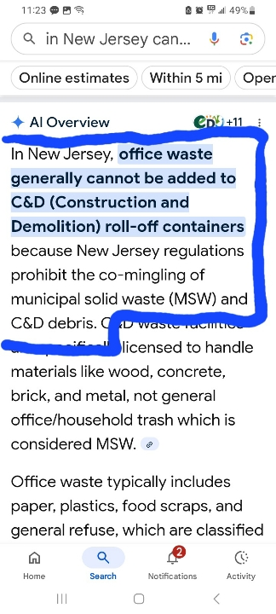
2. Office waste
in C&D roll-off c
ontainers.

Slide 28
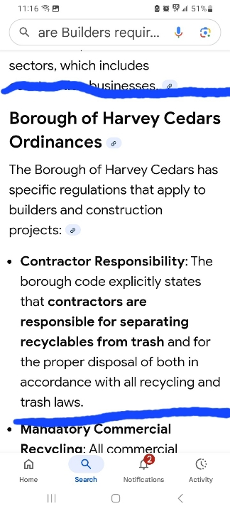
3. Raising recycling numbers by enforcing source separation at construction sites.

Slide 29
Support Group

Slide 30
Thank you!

