Slide 1


OCEAN COUNTY MUNICIPAL COORDINATORS MEETING
April 2026
1.5 CRP | 1.5 NJCCC
MEETING POINTS
MTG Reports - Tips from the NJDEP
BBBlitz
Upcoming Events
Recycling Guides

Slide 2
MTG Reports

Slide 3
BBBlitz

Slide 4

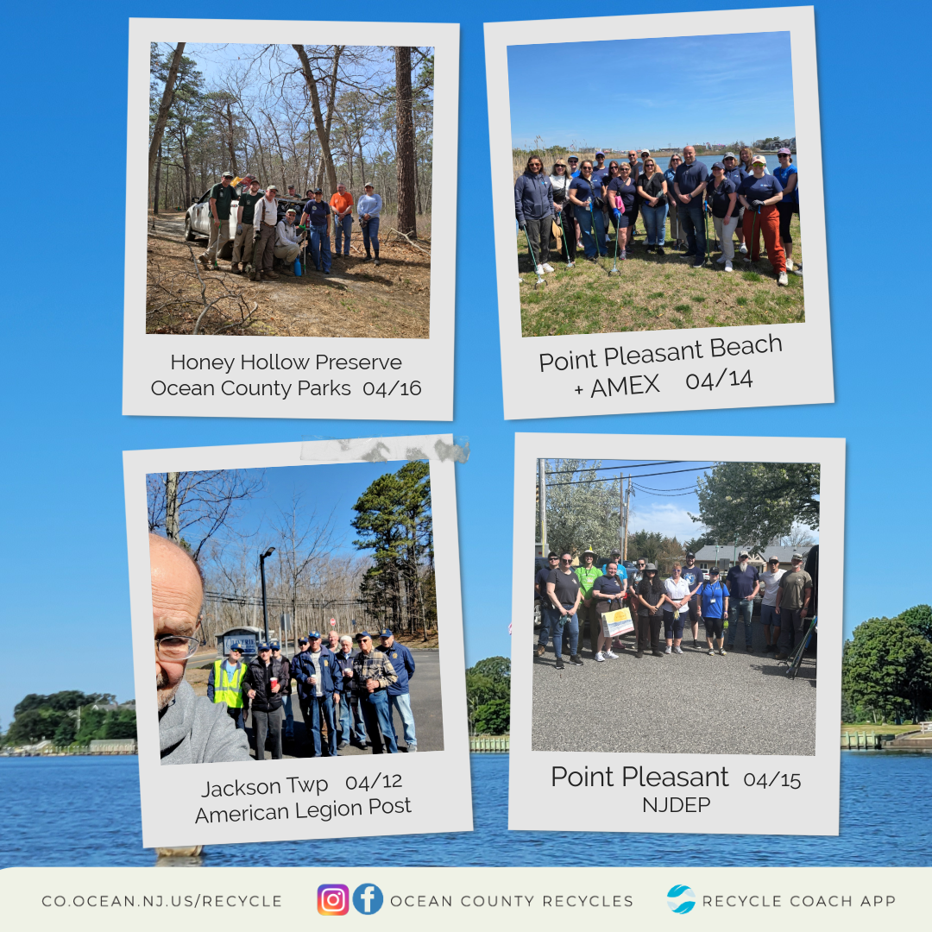

Slide 5
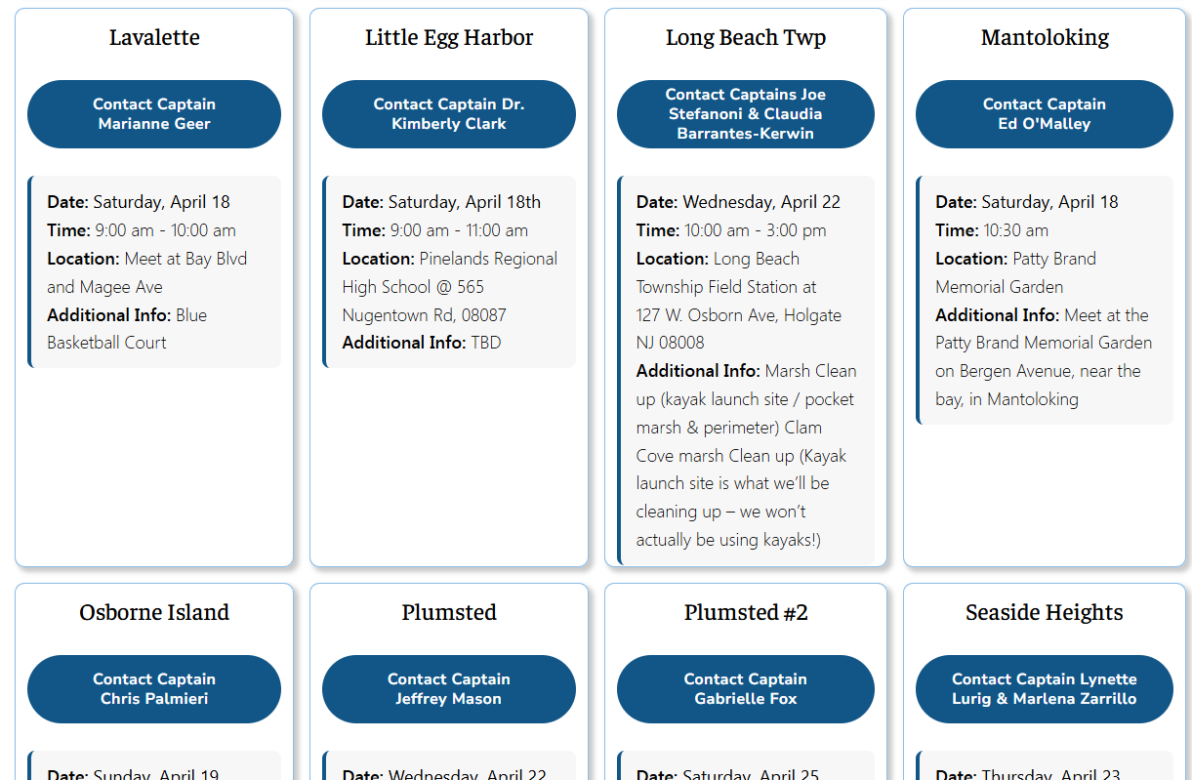
From 22 to 54 Cleanups!

Slide 6
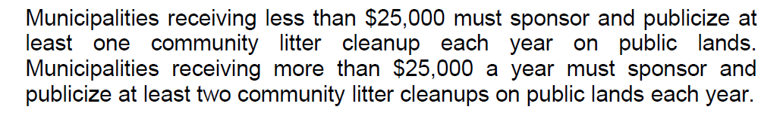
Remember…

Slide 7



Send us your schedules
If you need help creating a flyer, reach out!

Slide 8
Correction Cleanups
We are looking for recurrent spots for a pilot program

Slide 9
New Bin Wraps

Slide 10
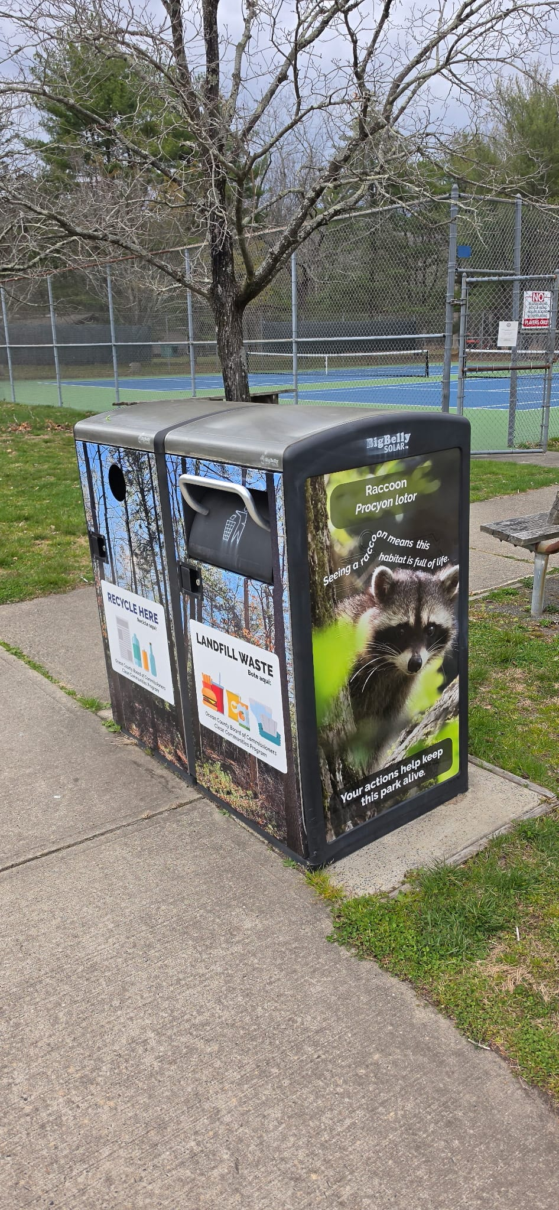
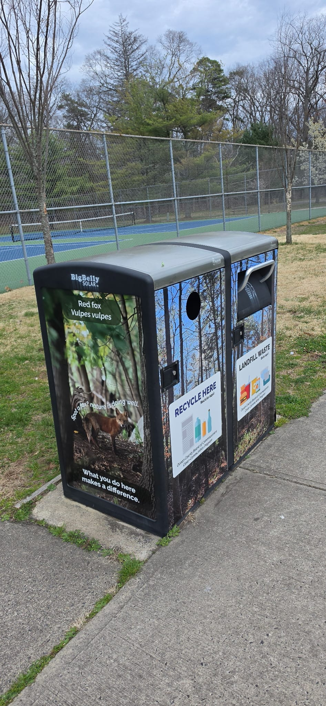
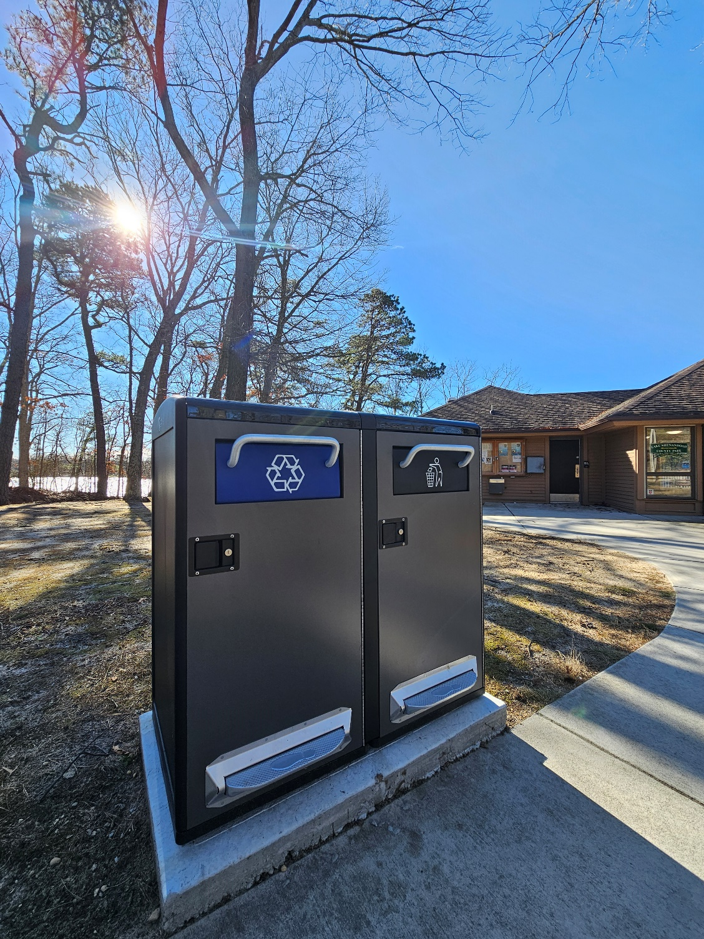

Slide 11
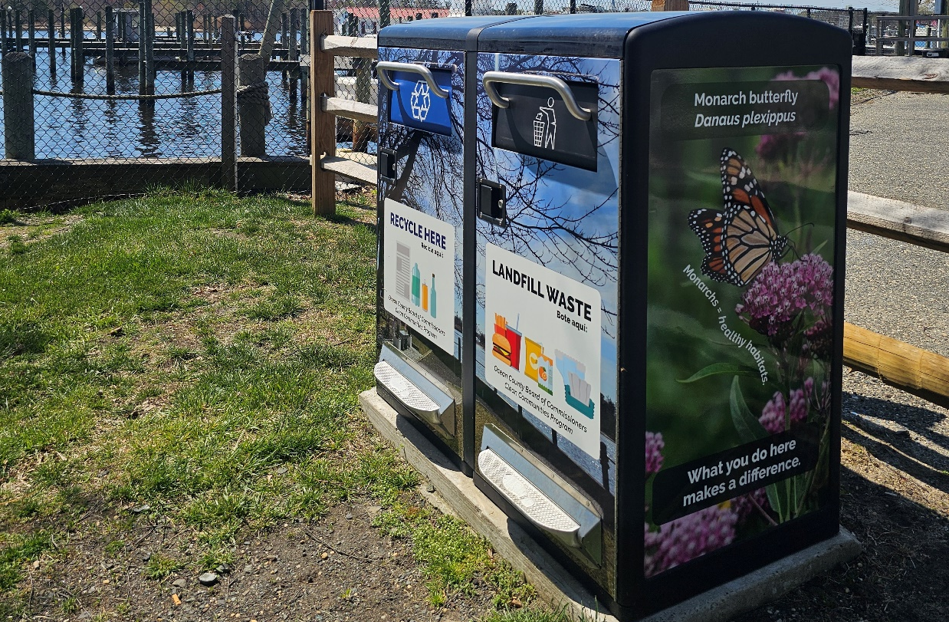
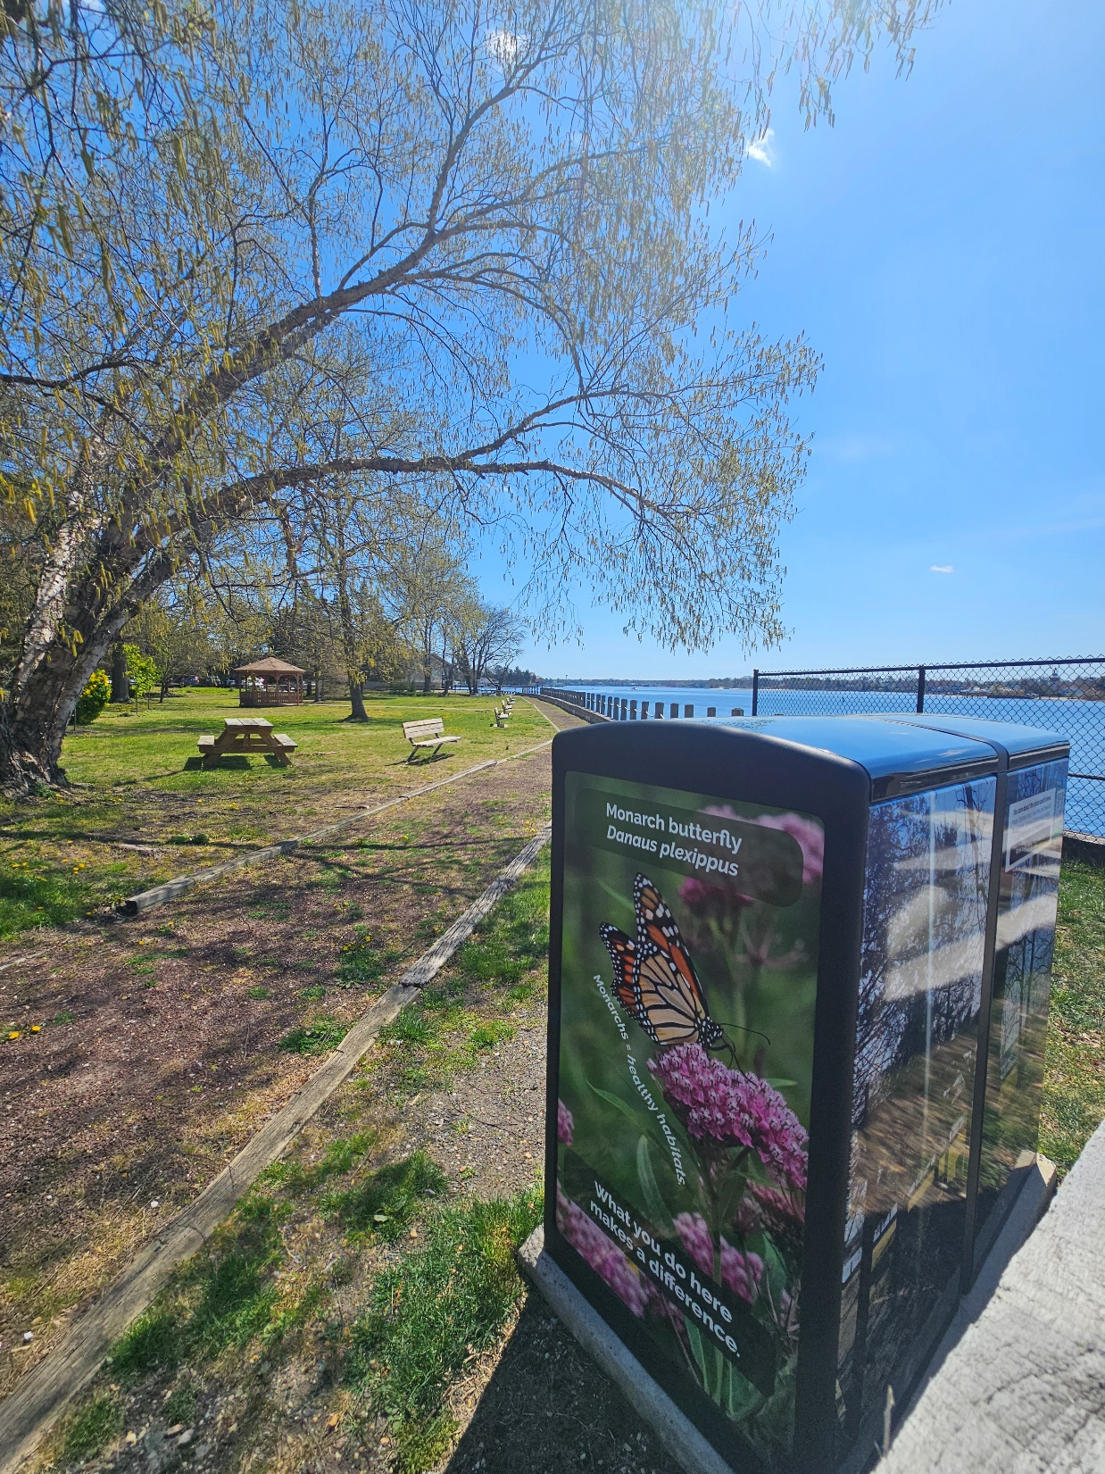
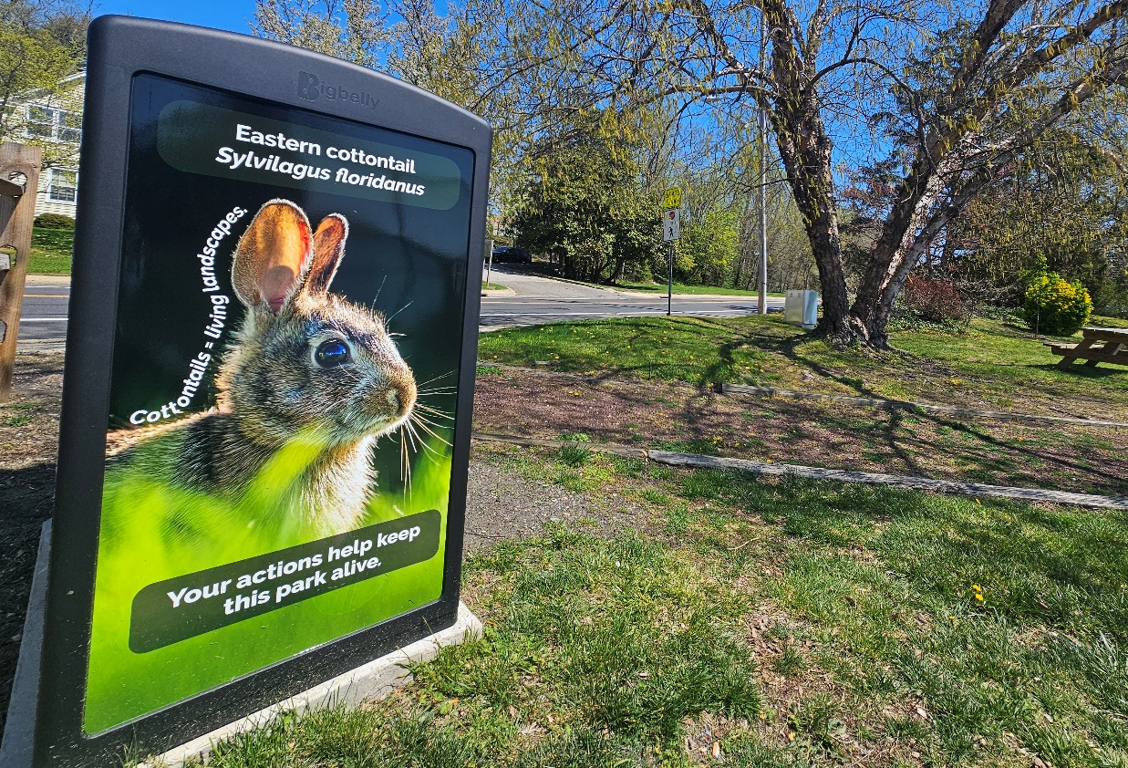

Slide 12
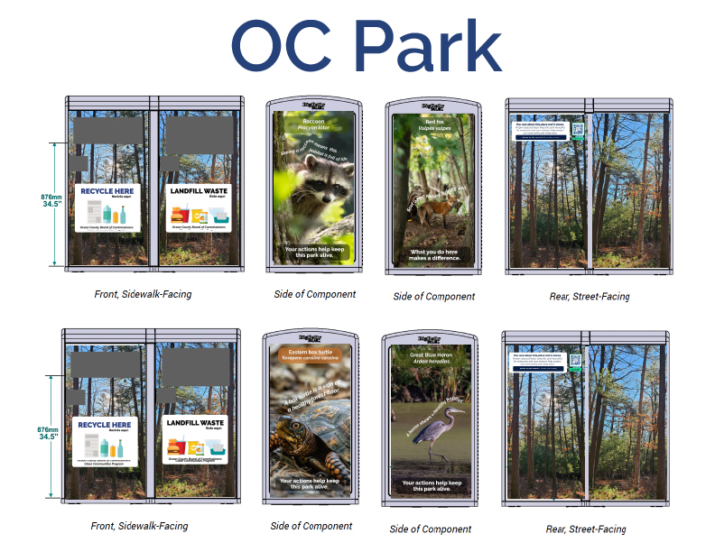


Slide 13
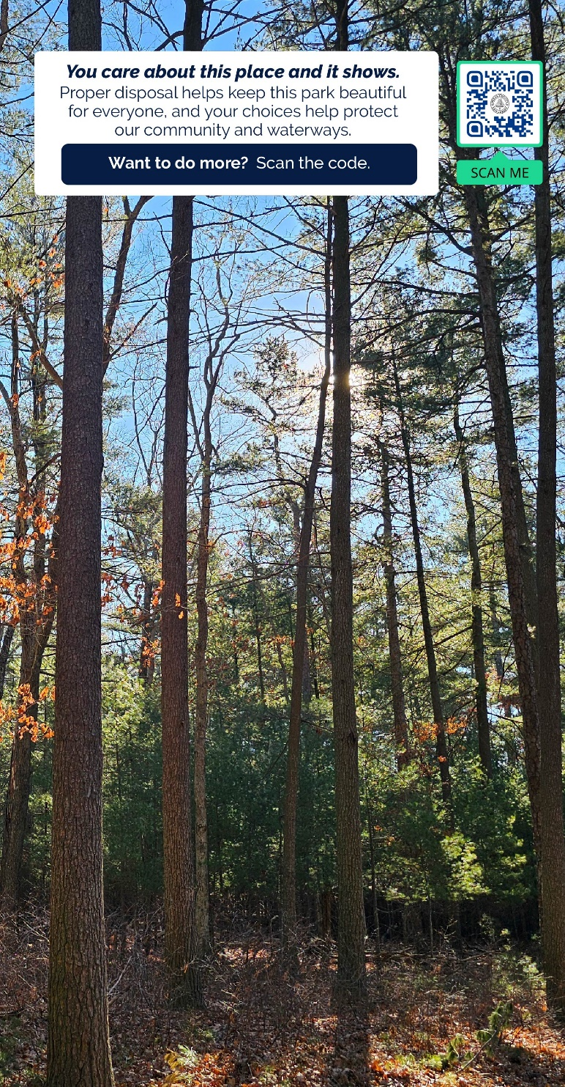









Slide 14
Upcoming Events

Slide 15

Lunch and Learn “Lets Chat About Stats” which will be Wednesday May 13th from noon to 1.

Slide 16

Tuesday, May 5, 2026
NJDEP Waste Wise Meeting
Time: 10:00 am

Slide 17


Slide 18
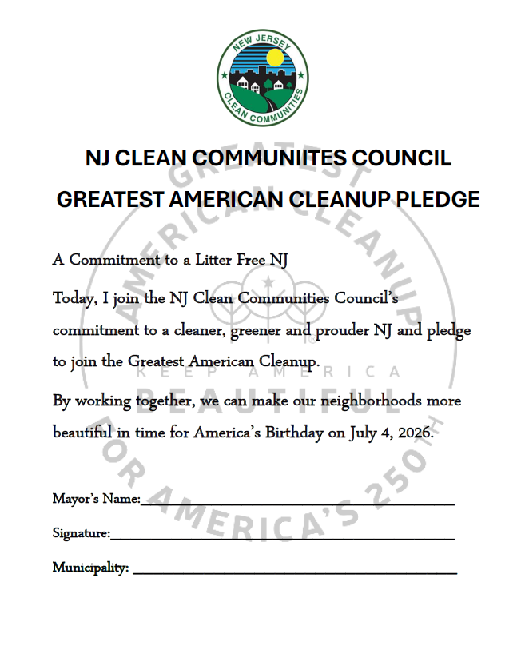
In addition to signing the pledge, can make sure you register your municipality’s participation by visiting the official Keep America Beautiful
https://kab.org/greatest-american-cleanup/

Slide 19

October 8th & 9th
The Mainland Manahawkin

Slide 20

Sponsorship & Ads Opportunities

Slide 21


Slide 22
2026 Meeting Schedule:
September 11, 2026 @ NRC Education Center (800 Towbin Ave., Lakewood)
November 20, 2026 @ Cattus Island County Park (1170 Cattus Island Blvd., Toms River

Slide 23
Recycling Guides

Slide 24


Slide 25
Please check your websites and materials to make sure they are consistent with our guidelines

Slide 26
Thank you!

