Slide 1


OCEAN COUNTY MUNICIPAL COORDINATORS MEETING
February 2026
1.5 CRP | 1.5 NJCCC
MEETING POINTS
MTG Reports - Tips from the NJDEP
2026 Doc Shred + HHW Events Schedule
BBBlitz + Barnegat Bay Partnership
Upcoming Events
Skip the Stuff Law
Support Group - Flag Disposal
New Recycling Guides
Outreach + Materials Pick-up

Slide 2
MTG Reports - Tips from the NJDEP

Slide 3
2026 Doc Shred & HHW Events

Slide 4


Slide 5


Slide 6
BBBlitz
Barnegat Bay Partnership

Slide 7


Slide 8
Over 22 cleanups in 2025
Little Egg Harbor - Pinelands Regional High School
Point Pleasant
Eagleswood
Tuckerton Blitz Great Bay Area
Manchester Little League Field
Brick Blitz DeCamp Wildlife Trail Edwin B Forsythe
LBT Blitz
Barnegat Twp Blitz
Manchester Little League Field
Plumsted Blitz Entrance to Colliers Mills WMA
Barnegat Light Blitz
Seaside Heights Blitz
Jackson Blitz
Lakewood - Lake Shenandoah County Park
Cattus Island
Brick Blitz #2 Riverwalk Refuge
Ship Bottom Blitz
Mantoloking Blitz
Brick Beach
Stafford Blitz
Island Heights Blitz
Eagleswood Blitz

Slide 9
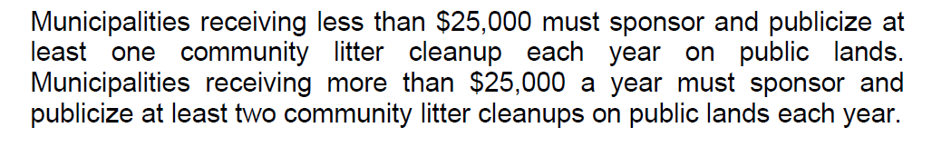
Remember…

Slide 10



Send us your schedules
If you need help creating a flyer, reach out!

Slide 11
Skip the Stuff

Slide 12

We did it before it was cool
Lavallette resident
Reduce by Request Campaign winner of a Clean Communities Award in 2024

Slide 13

Dine-in? Reusable utensils are the standard
Bundled utensil packs phase out next January
Takeout? Single-use items are available by request
Online orders default to no utensils or condiments

Slide 14
Upcoming Events

Slide 15
2026 Meeting Schedule:
February 13, 2026 @ NRC Education Center (800 Towbin Ave., Lakewood)
April 17, 2026 @ OC Fire Academy (200 Volunteer Way, Waretown)
September 11, 2026 @ NRC Education Center (800 Towbin Ave., Lakewood)
November 20, 2026 @ Cattus Island County Park (1170 Cattus Island Blvd., Toms River

Slide 16


March 4-6, 2026
at Caesars
Atlantic City

Slide 17

2026 New Jersey Coastal and Climate Resilience Conference
March 9 -11, 2026
Seaview Hotel
Galloway, NJ
CEUs available
For more info, visit njcoastalresilience.org

Slide 18

March 31st
BBBlitz Kick off meeting
Supply pickup

Slide 19

Tuesday, May 5, 2026
NJDEP Waste Wise Meeting
Time: 10:00 am

Slide 20
Support Group – Flag Disposal

Slide 21
New Recycling Guides

Slide 22


Slide 23



Slide 24



Slide 25
Outreach + Materials Pick-up

Slide 26
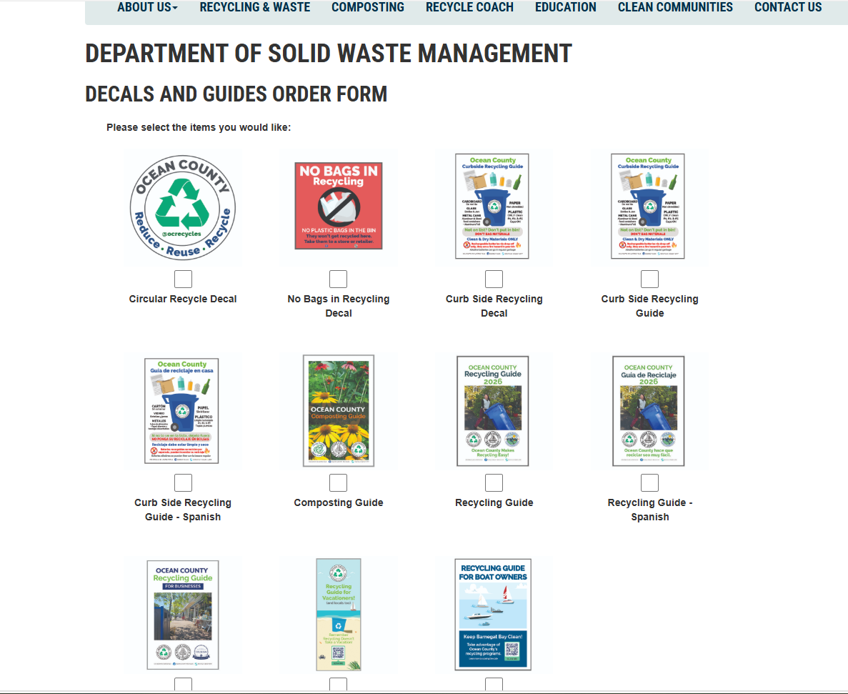

Slide 27
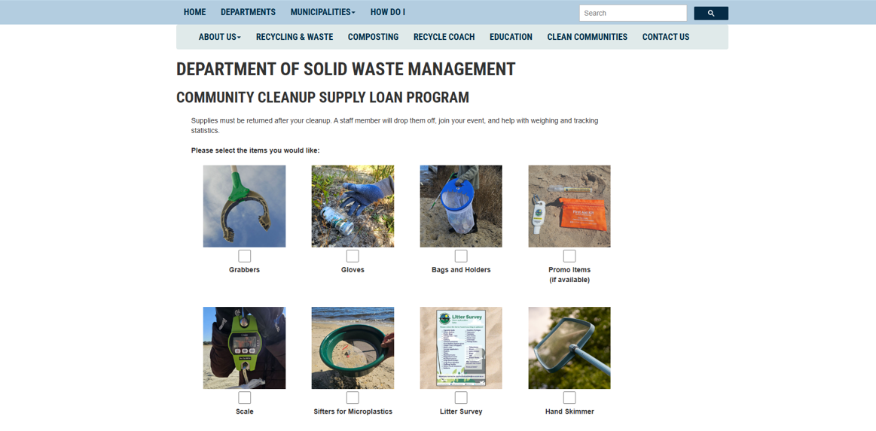

Slide 28
Please check your websites and materials to make sure they are consistent with our guidelines

Slide 29
Thank you!

