Slide 1


OCEAN COUNTY MUNICIPAL COORDINATORS MEETING
April 2025
1.5 CRP | 1.5 NJCCC
MEETING POINTS
Revenue Share
Document Shredding / HHW / Boat Flares
Barnegat Bay Blitz
Outreach & Materials
Tonnage Reports

Slide 2
Revenue Share

Slide 3


Slide 4
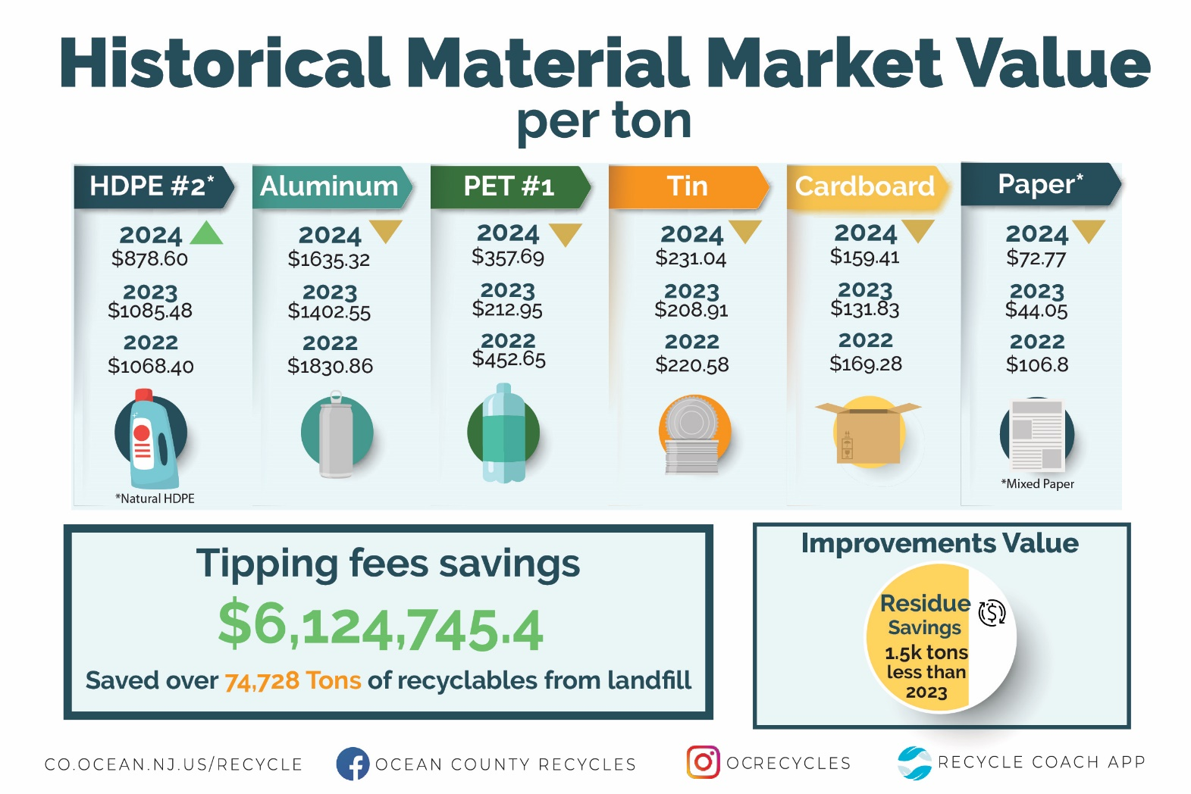

Slide 5
Document Shredding / HHW

Slide 6



Slide 7
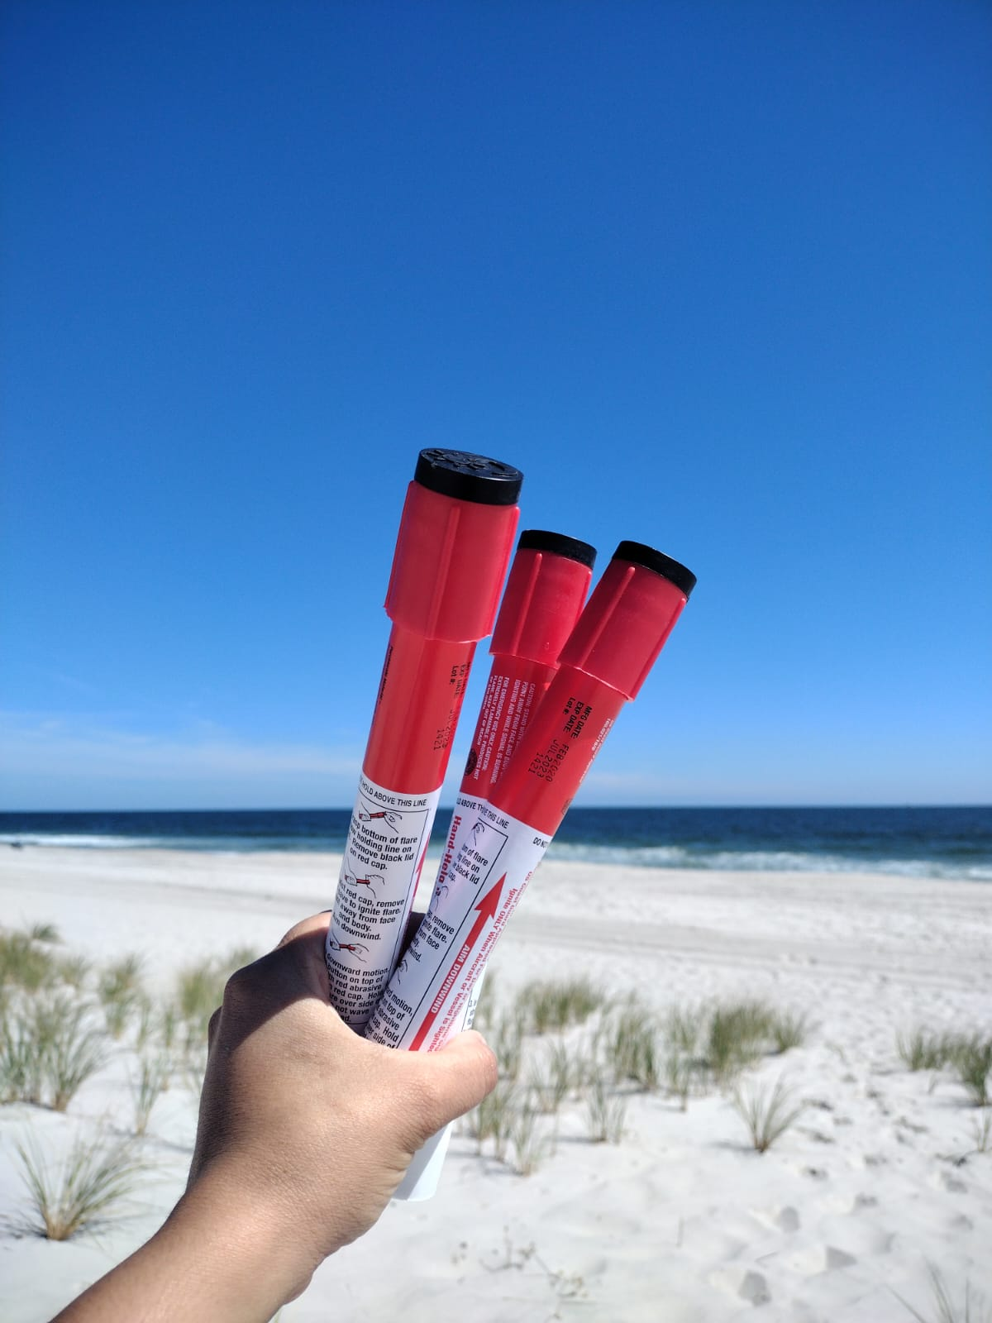
Boat Flare Announcement
June 18th
August 20th
October 22nd
Switching to Wednesdays
Registration required
1pm to 3pm

Slide 8
Barnegat Bay Blitz
April 12th to April 19th, 2025

Slide 9
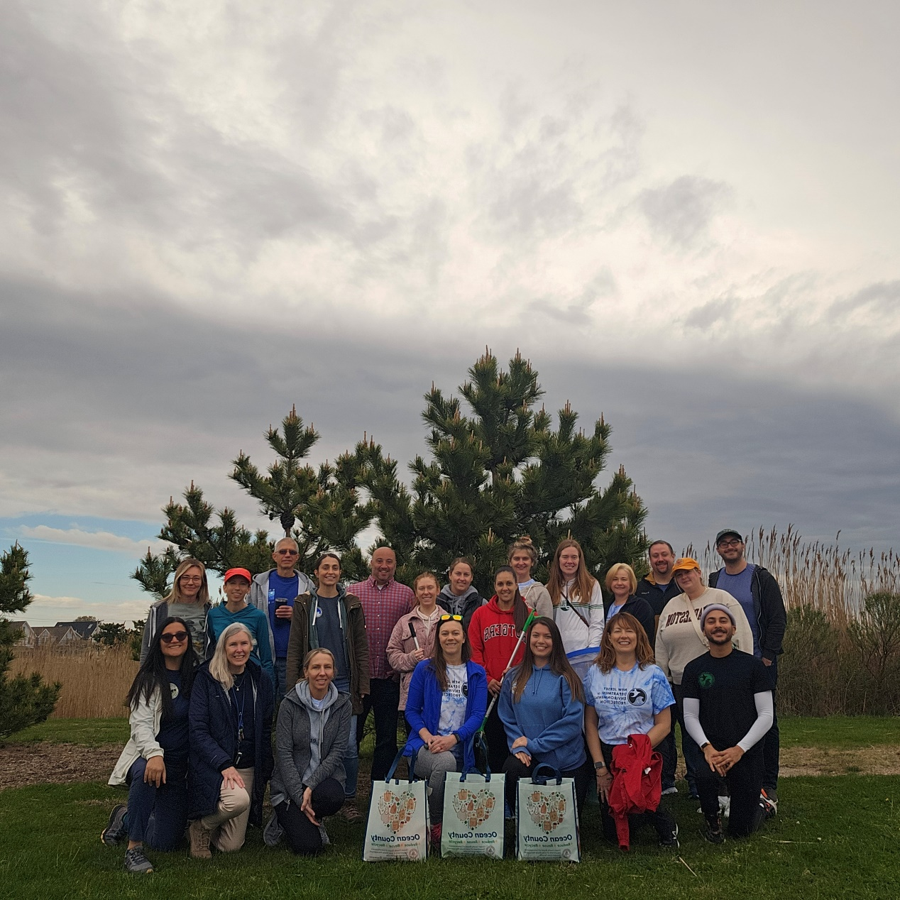


Slide 10
03.22.2025 | Little Egg Harbor - Pinelands Regional High School | James Ardoin Supplies from OC
04.10.2025 | Point Pleasant | Matthew Scott Supplies from PP
04.12.2025 | Tuckerton Blitz Great Bay Area | Cameron Shapiro
04.12.2025 | Manchester Little League Field | Nicole Lelievre
04.13.2025 | Brick Blitz DeCamp Wildlife Trail Edwin B Forsythe | Forrest Jennings Supplies from Brick
04.15.2025 | LBT Blitz | Joe Stefanoni and Frank McLaughlin Supplies from LBT
04.15.2025 | Barnegat Twp Blitz | Lauren Keltos
04.16.2025 | Manchester Little League Field | Nicole Lelievre
04.16.2025 | Plumsted Blitz Entrance to Colliers Mills WMA | Jeff Mason
04.17.2025 | Barnegat Light Blitz
04.17.2025 | Seaside Heights Blitz | Lynett Lurig & Marlena Zarrillo
04.17.2025 | Jackson Blitz | Peyton Curley Supplies from Jackson
04.17.2025 | Lakewood - Lake Shenandoah County Park | Sheyla Casco Supplies from OC Parks
04.19.2025 | Brick Blitz #2 Riverwalk Refuge | Ray Lechien Supplies from Brick
04.19.2025 | Ship Bottom Blitz | Matt Bernstein Supplies from Ship Bottom
04.19.2025 | Mantoloking Blitz | Ed O'Malley
04.19.2025 | Brick Beach | Ronald Cerracchio Supplies from Brick
04.26.2025 | Stafford Blitz | Rachel Baldwin/Phil Preston Supplies from Stafford
04.26.2025 | Island Heights Blitz | Sophia Church Supplies from OC
04.26.2025 | Eagleswood Blitz | Nicholas Engroff

Slide 11
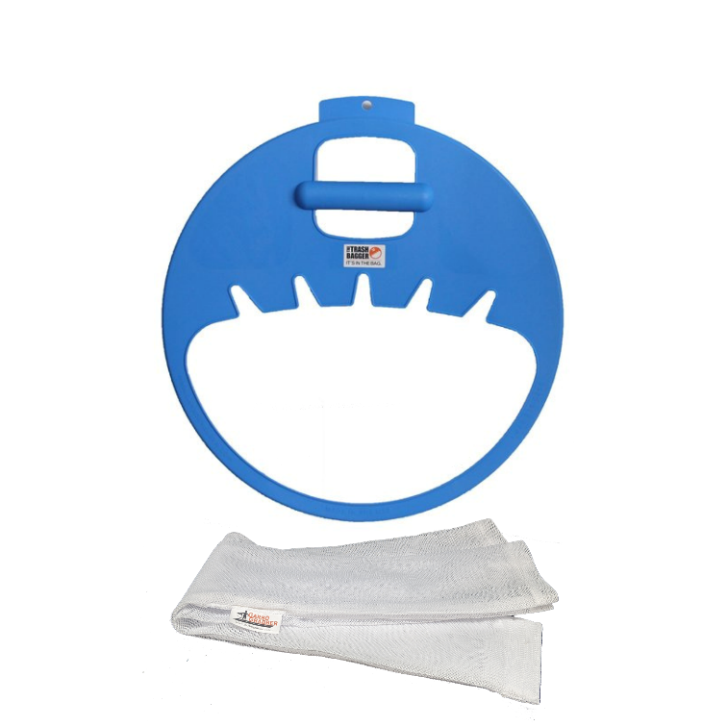



Slide 12

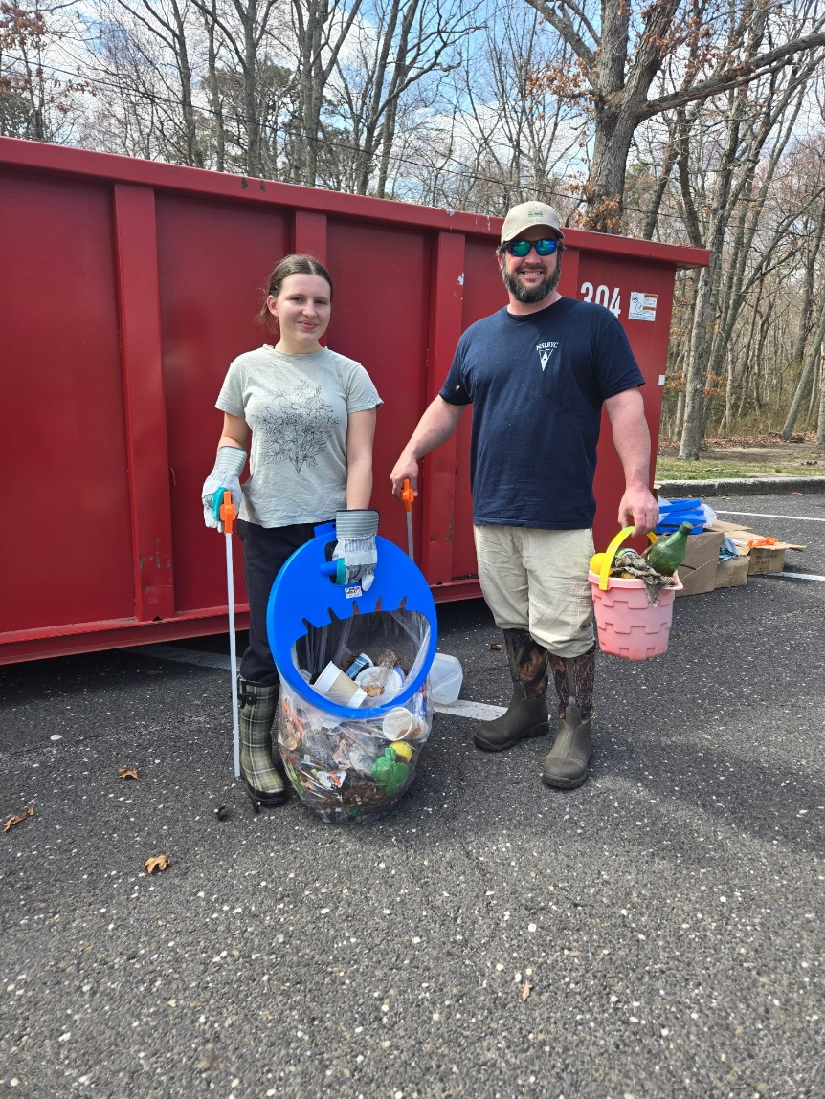
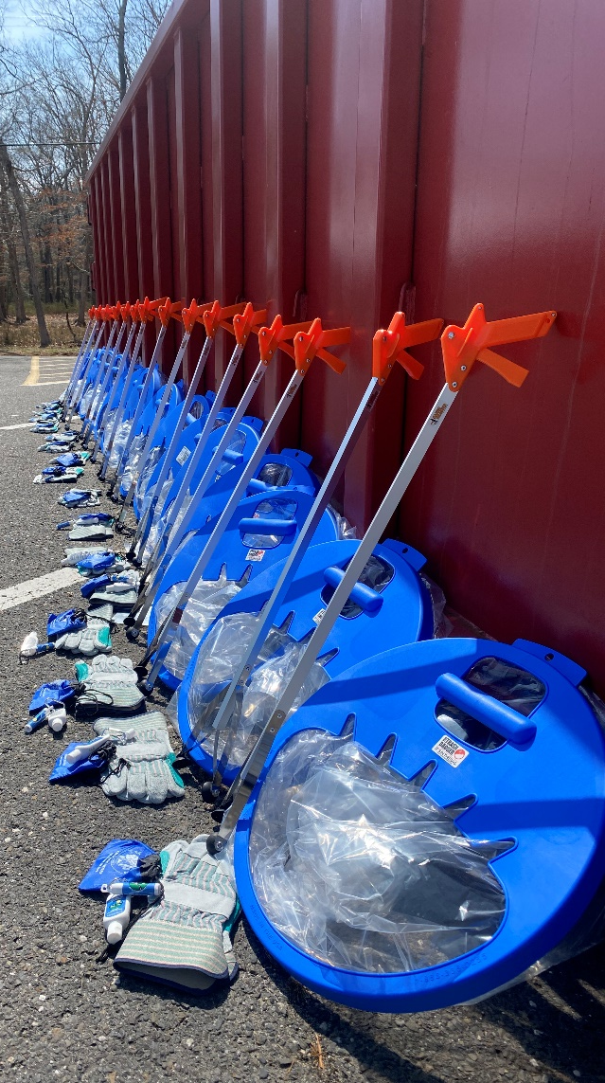

Slide 13
Outreach Materials

Slide 14

Grab them!!!!

Slide 15
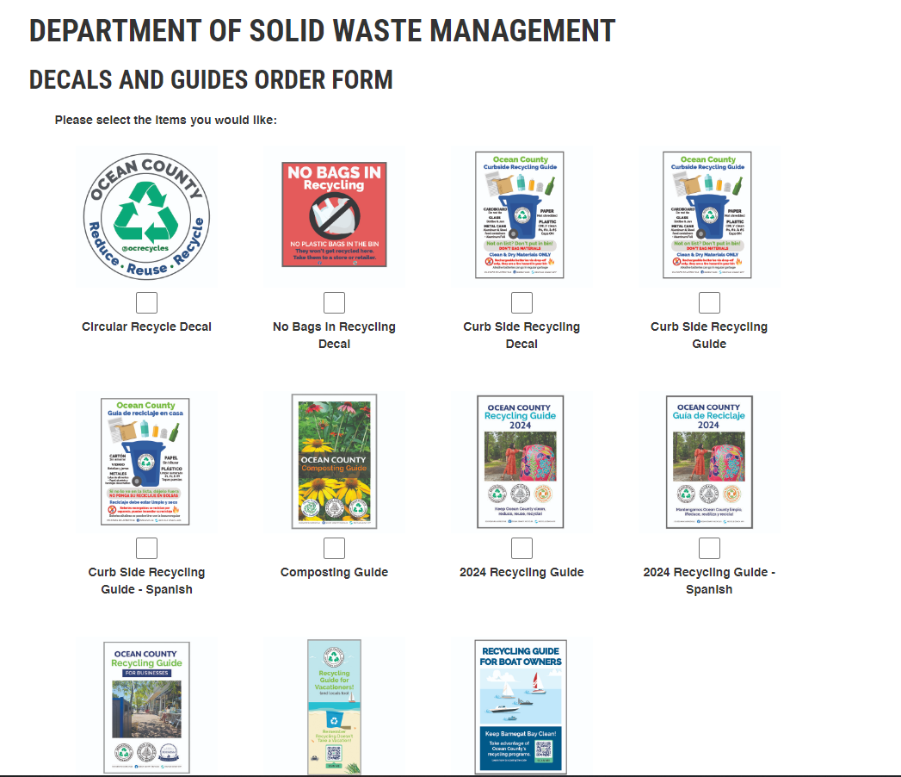

Slide 16
Tonnage Report Season
Deadline for our review: April 1st
State deadline: April 30th

Slide 17
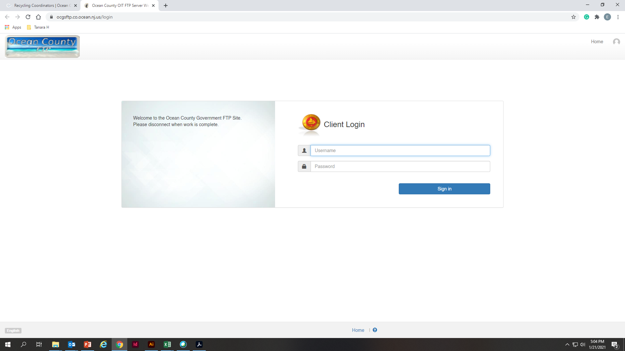
How can I access the reports?
ocgsftp.co.ocean.nj.us
Username: SWMVendorFTP
Password: Vend4SWM_FTP!

Slide 18
I’m new, what reports am I expecting?
Residential
Reports from Ocean County Recycling Centers.
Reports from vendors for materials received at your municipal center.
Commercial
All other reports added to the Class A, B, C, or D folders.
Any report received from items not collected at municipal or county recycling center.

Slide 19
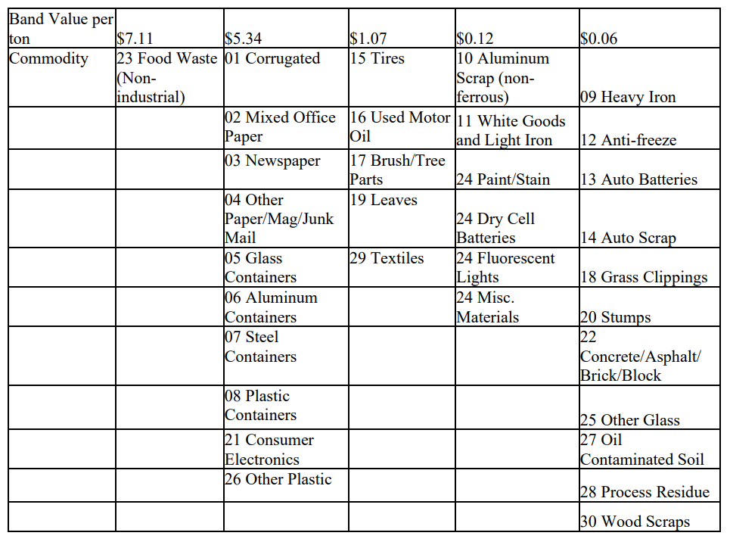

Slide 20
Thank you!

