Slide 1
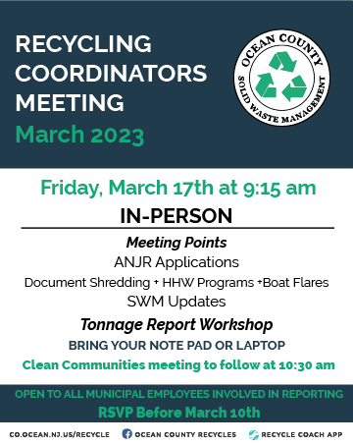

Slide 2

Reminder
Solid Waste Management

Slide 3
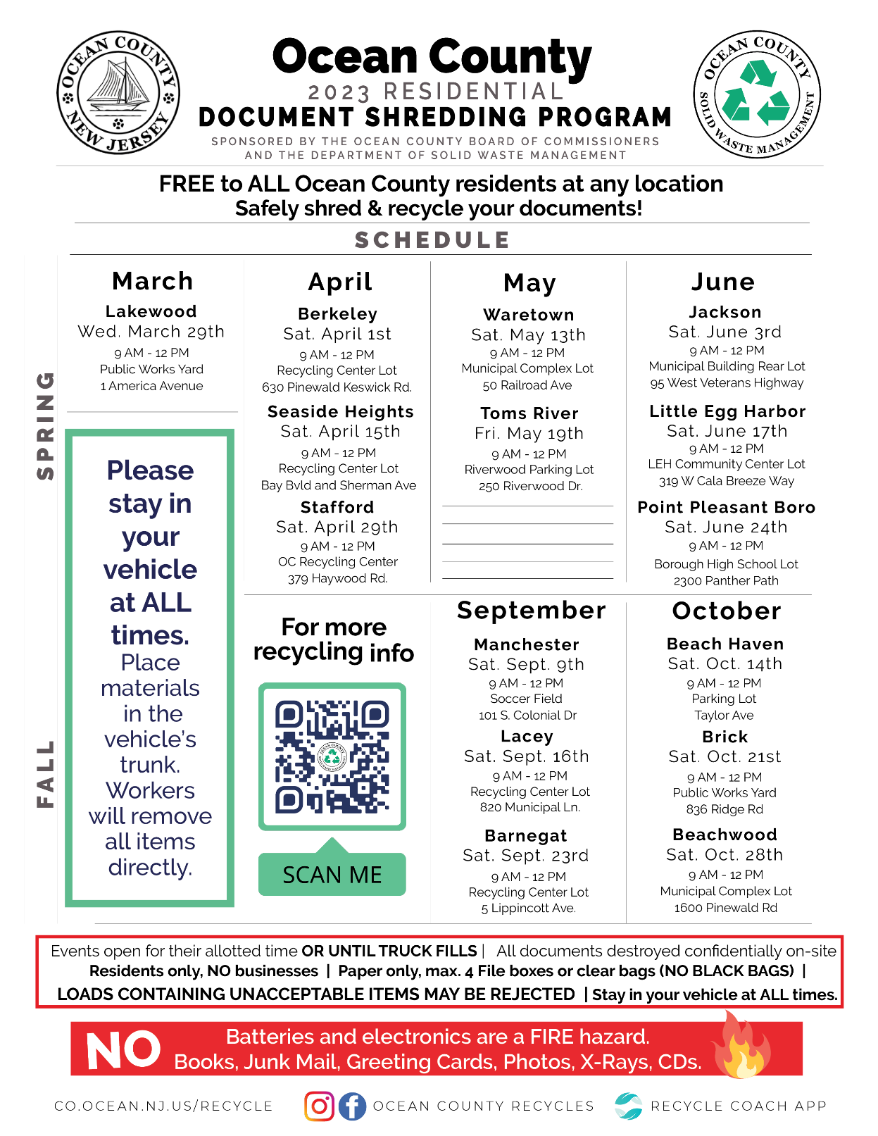
Almost here!
Solid Waste Management

Slide 4
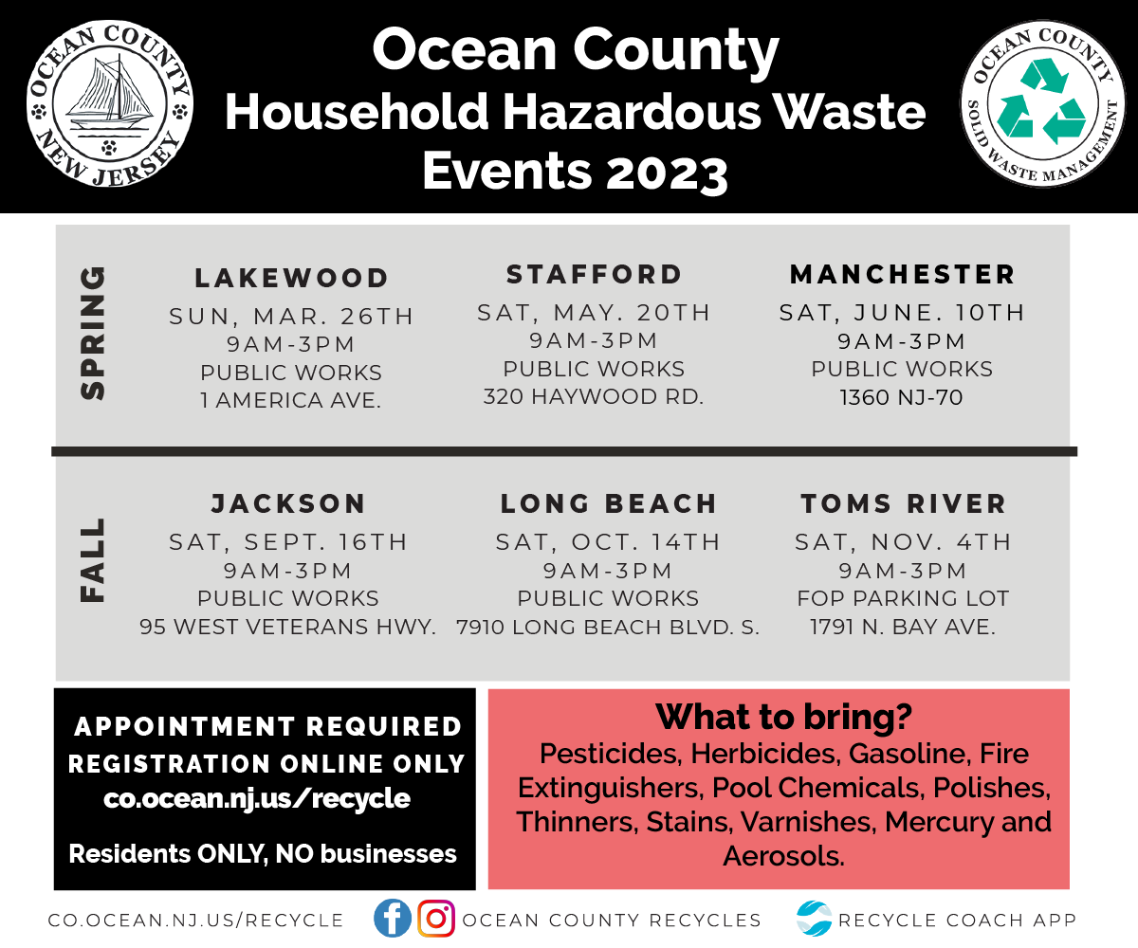
Solid Waste Management

Slide 5

Solid Waste Management

Slide 6
SWM Updates
Solid Waste Management

Slide 7
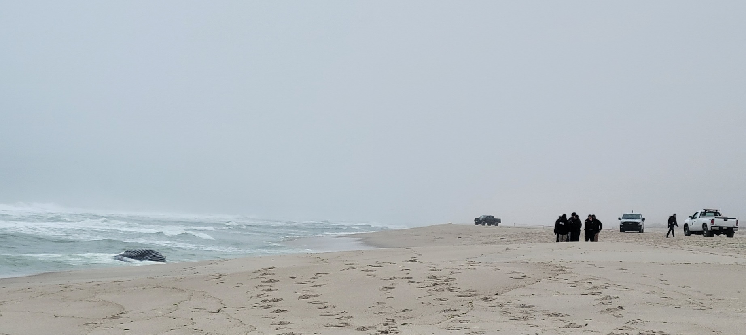
Seaside Park - Whale
Call the Marine Mammal Stranding Center 609-266-0538 for Necropsy
Disposal options
Bury on site
Monmouth County Landfill
Other parties outside the municipal crew: NOAA
Atlantic Marine Conservation Society
NJDEP
Solid Waste Management

Slide 8
Tonnage Grants
Solid Waste Management

