Slide 1
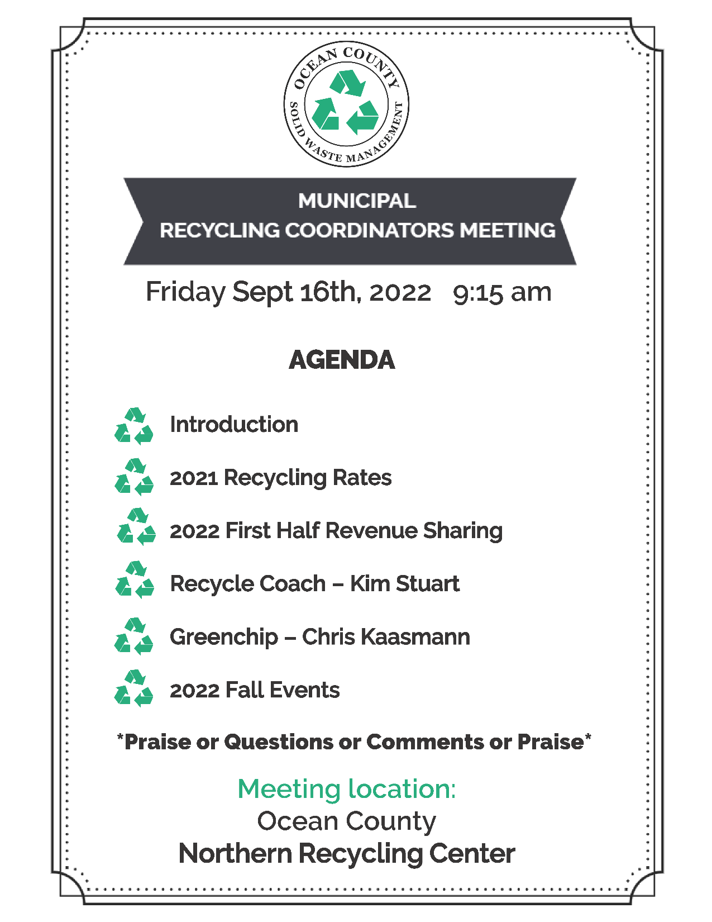

Slide 2
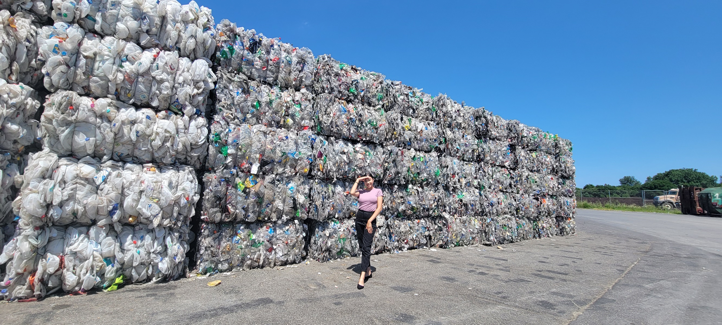
Our new star: Margaret DeLeón-Rivera
Solid Waste Management

Slide 3
2021 Recycling Rates
Municipality | Landfill | Out of County Waste | Recycled | Recycling %
Barnegat | 20314.75 |  | 10658.38 | 34%
Barnegat Light | 1227.6 | 134.92 | 444.395 | 25%
Bay Head | 1304.21 | 1065.33 | 1046.69 | 31%
Beach Haven | 3213.26 | 597.36 | 2883.32 | 43%
Beachwood | 7662.3 | 590.21 | 8274.4792 | 50%
Berkeley | 33965.35 | 1767.6 | 8677.4 | 20%
Brick | 69848.02 | 12496.16 | 196.2 | 0%
Eagleswood | 1319.9 | 118.5 | 3002.1864 | 68%
Harvey Cedars | 996.58 | 107.21 | 334.9505 | 23%
Island Heights | 1371.71 | 173.34 | 3172.22 | 67%
Jackson | 32969.46 | 17717.11 | 33211.55 | 40%
Lacey | 32125.21 | 2314.5 | 36266.38 | 51%
Lakehurst | 2066.42 | 120.8 | 1444.93 | 40%
Lakewood | 145355.17 | 14278.32 | 87182.1 | 35%
Lavallette | 3790.48 | 1583.95 | 4590.76 | 46%
Little Egg Harbor | 16001.17 | 721.05 | 7940.09 | 32%
Long Beach | 10939.88 | 5034.28 | 7702.84 | 33%
Manchester | 30163.42 | 1774.77 | 12373.41 | 28%
Mantoloking | 726.5 | 2250.56 | 1770.772 | 37%
Ocean | 6679.65 | 624.86 | 5929.0383 | 45%
Ocean Gate | 1420.67 | 216.08 | 568.96 | 26%
Pine Beach | 1606.50 | 315.35 | 413.45 | 18%
Plumsted | 1468.29 | 1432.69 | 5750.98 | 66%
Pt. Pleasant Borough | 11817.49 | 3979.228 | 11973.64 | 43%
Pt. Pleasant Beach | 5613.72 | 1459 | 4514.69 | 39%
Seaside Heights | 4721.87 | 974.26 | 1914.82 | 25%
Seaside Park | 2991.99 | 954.35 | 3289.78 | 45%
Ship Bottom | 1836.96 | 129.51 | 1450.55 | 42%
South Toms River | 2314.53 | 86.71 | 3002.58 | 56%
Stafford | 32332.33 | 2194.39 | 21222.05 | 38%
Surf City | 2503.28 | 710.07 | 821.01 | 20%
Toms River | 112203.33 | 12112.12 | 166356.37 | 57%
Tuckerton | 3463.83 | 575.41 | 1627.07 | 29%
Total | 606335.83 | 88609.998 | 460008.0414 | 40%
Solid Waste Management

Slide 4

Solid Waste Management

Slide 5
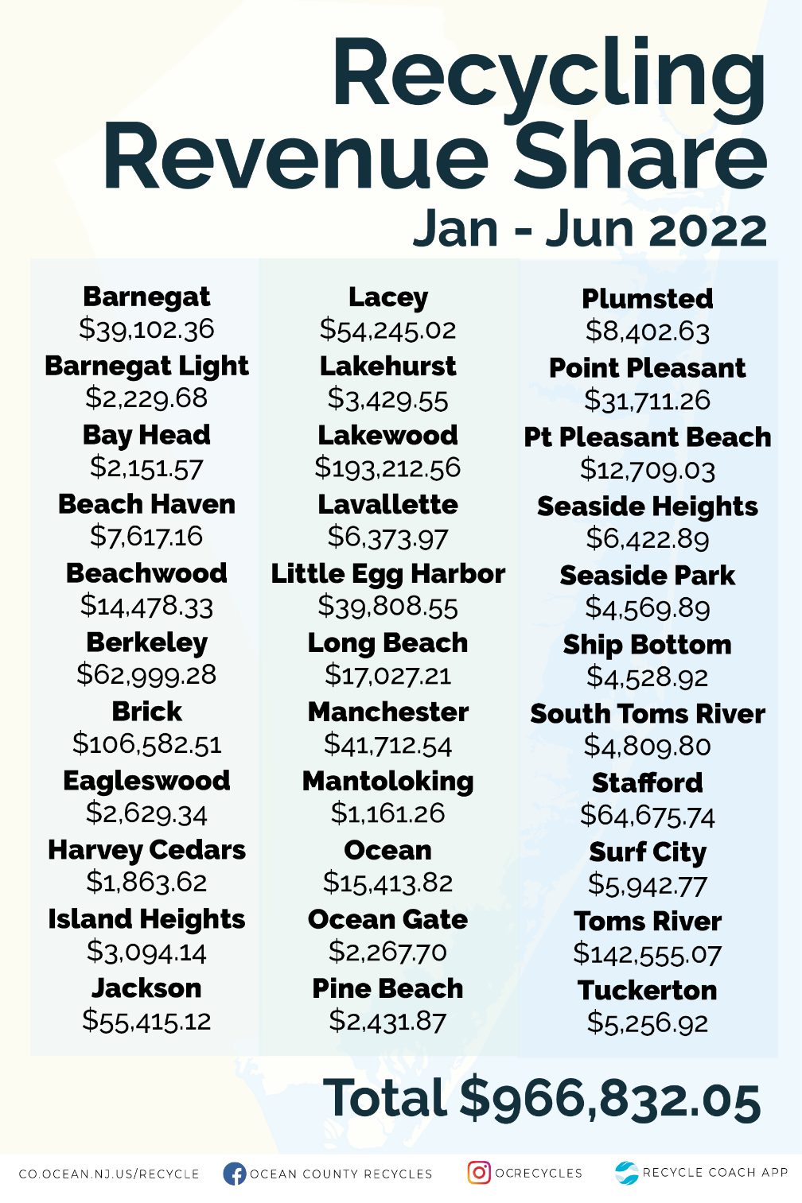
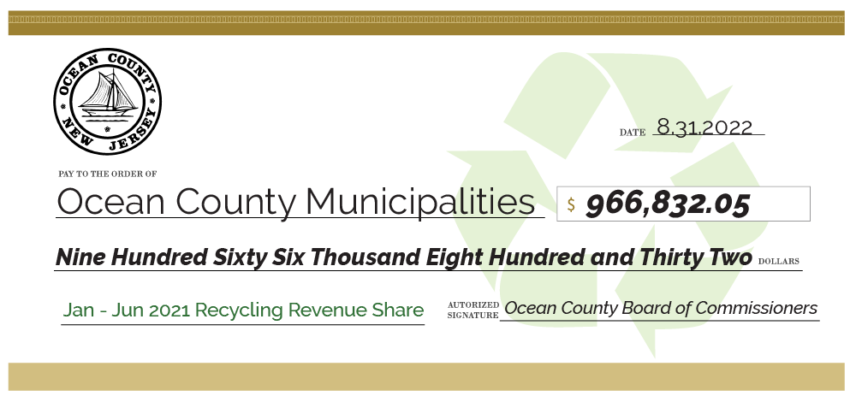
Solid Waste Management

Slide 6
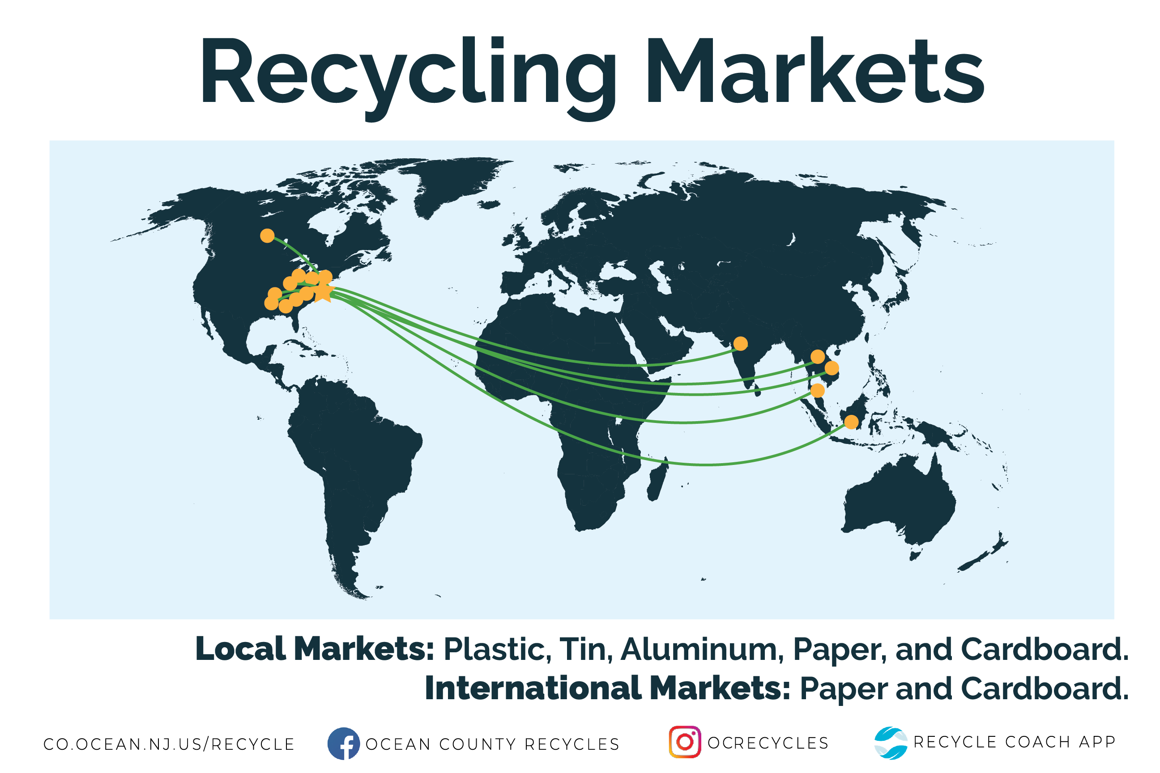
Solid Waste Management

Slide 7
Guest Speakers
Solid Waste Management

Slide 8
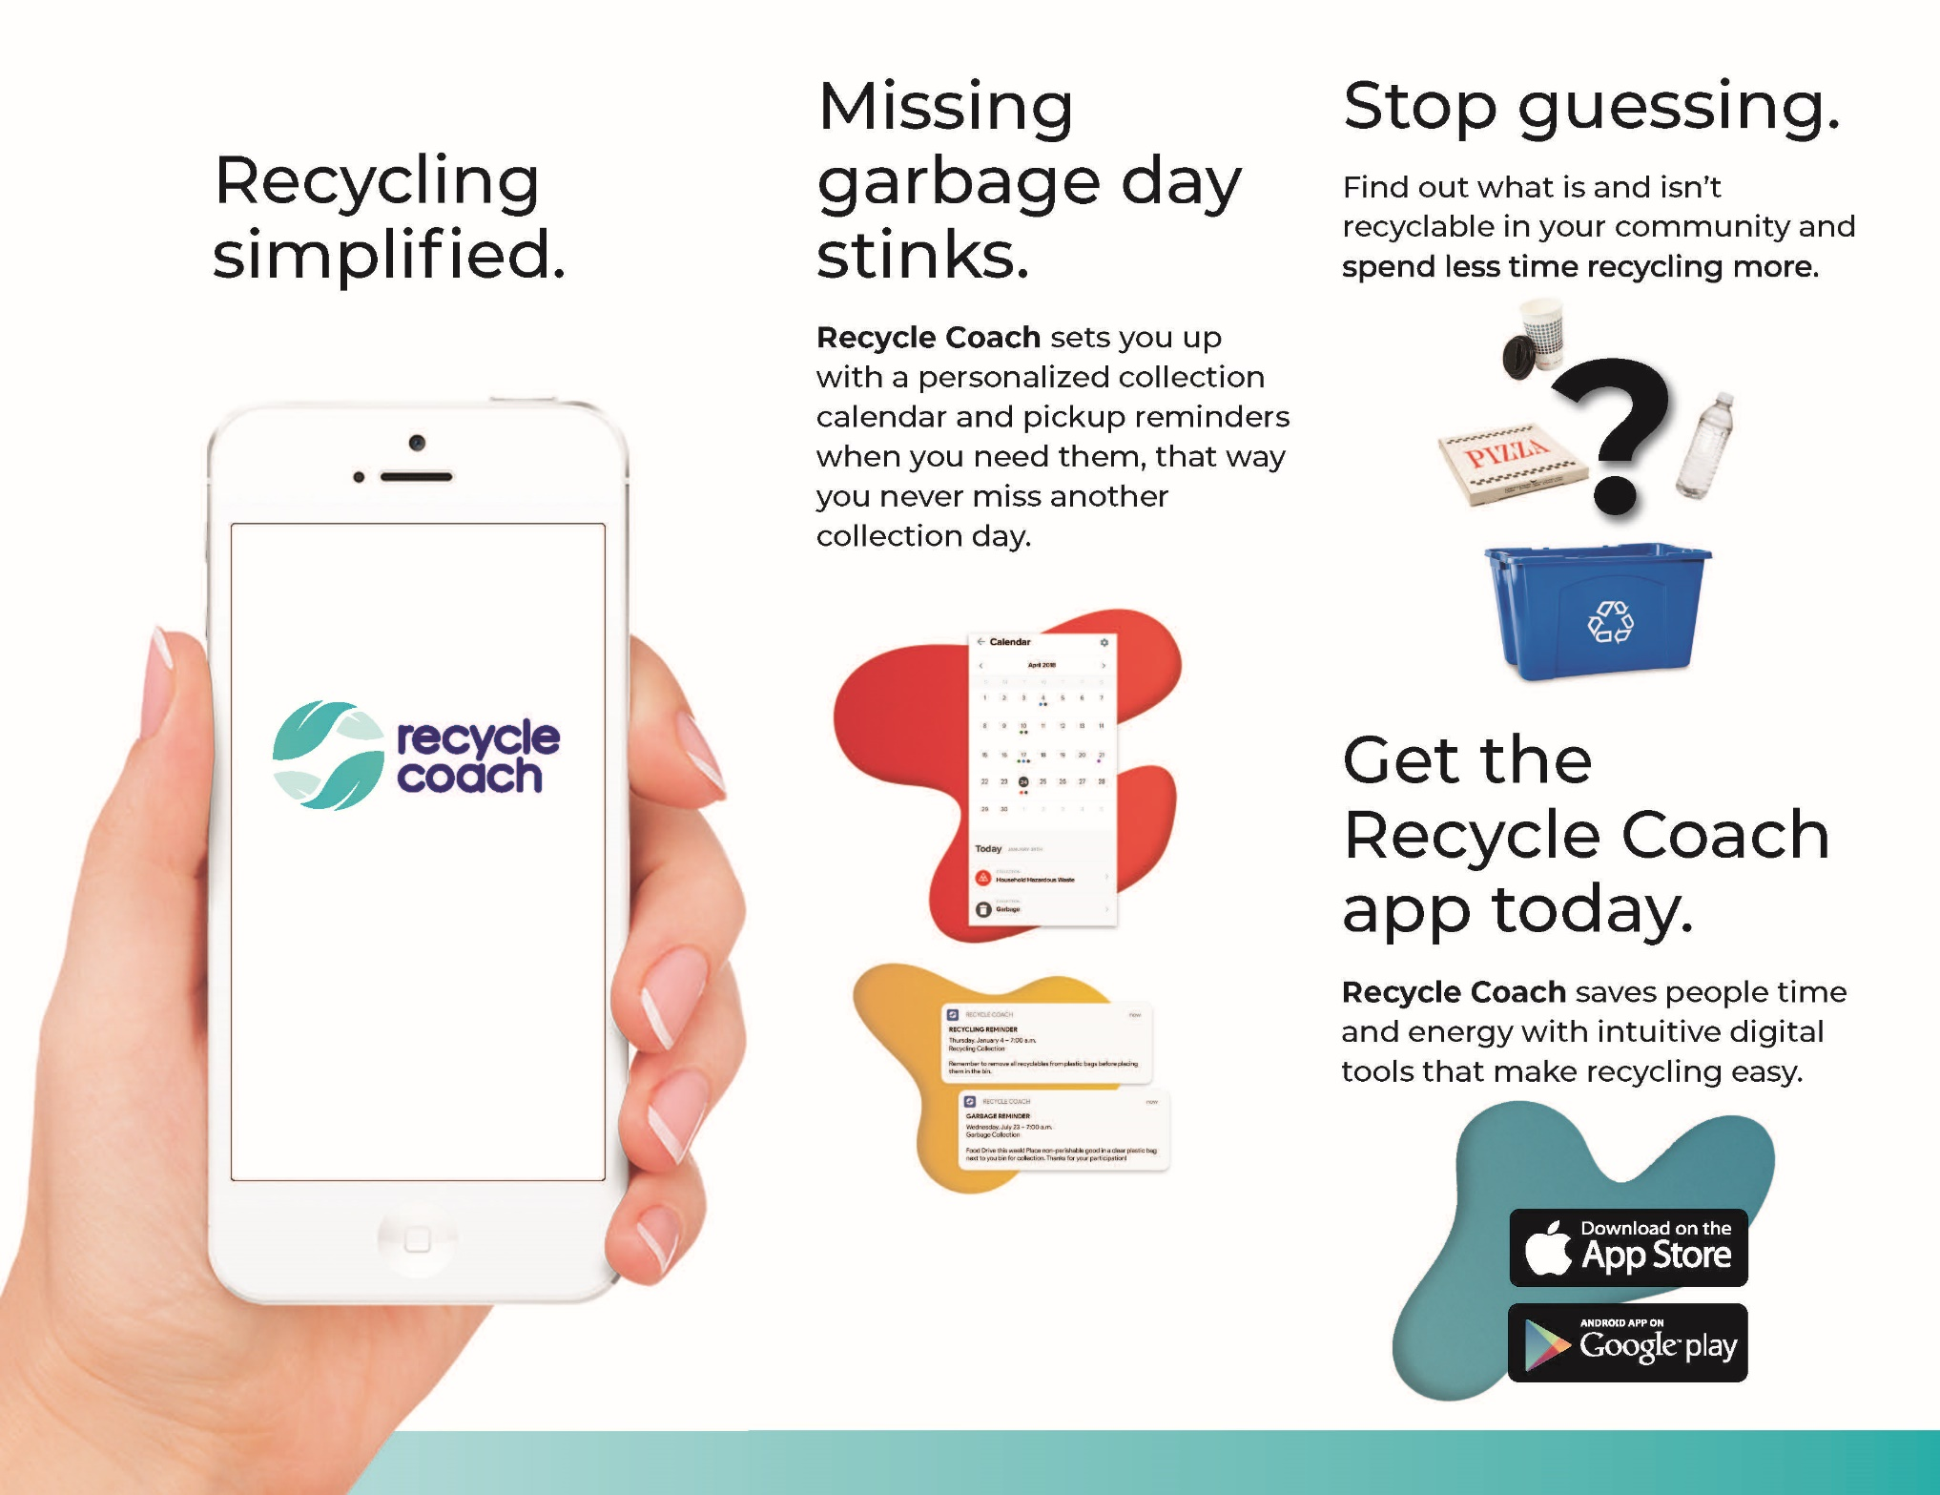
Solid Waste Management

Slide 9

Speaker:
Chris Kaasmann
Vice President of Compliance
Greenchip
Solid Waste Management

Slide 10
2022 Fall Events
Solid Waste Management

Slide 11


Solid Waste Management

Slide 12

Solid Waste Management

Slide 13



Partnership

Slide 14
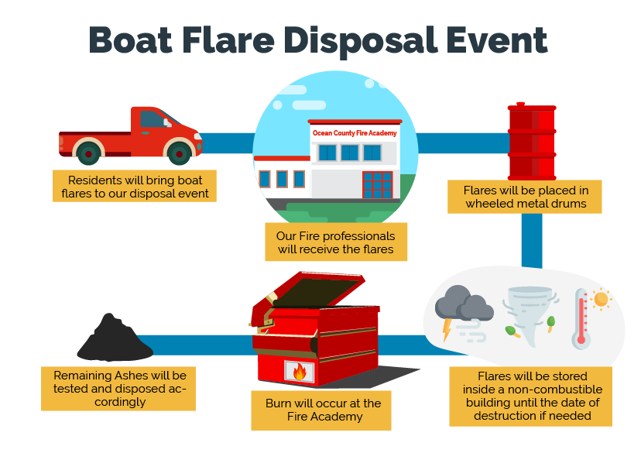
Currently under NJDEP review!
Solid Waste Management

