Slide 1

MUNICIPAL TONNAGE GRANT PROGRAM
Report Tips & Tricks & Recommendations
Recycling Coordinators Meeting 04/11/25

Slide 2
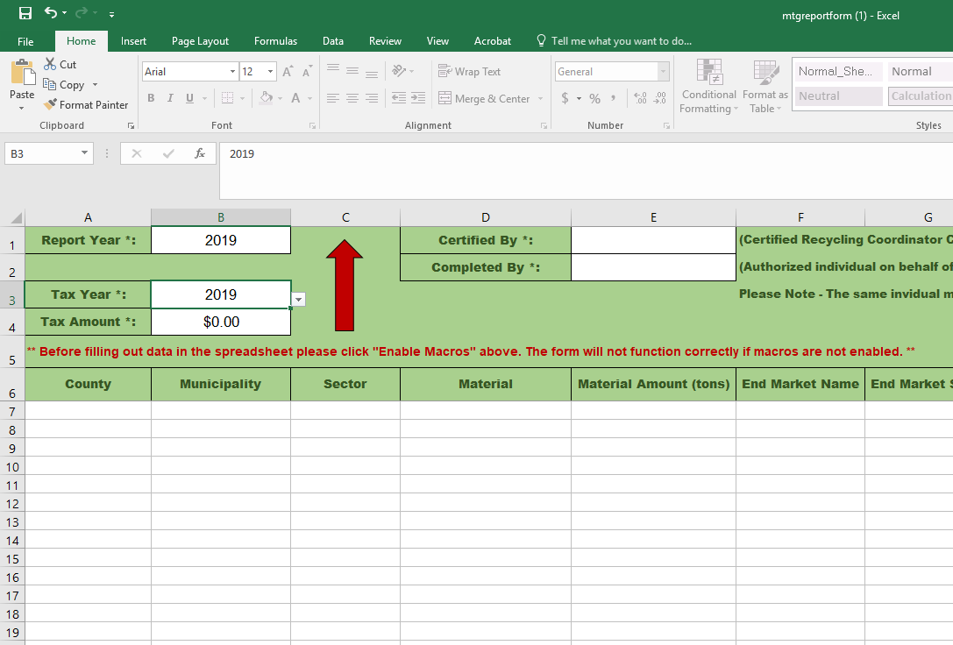
NJDEP Municipal Tonnage Grant (MTG) Applications
NJDEP (tonnagegrant@dep.nj.gov)
Ocean County Solid Waste Management
Submit MTG applications by April 30th each year
Able to revise recycling data after submission, until June 15th each year
cc ocrecycles@co.ocean.nj.us on your submission to the DEP so we can review your reports and provide comments (i.e. look for missing tonnage)

Slide 3
2025 NJDEP MTG Application
Requirements For Complete 2025 MTG Application Submission
1.) Completed MTG Application.
-Tonnage Report Form (Excel) (MUST BE SIGNED BY CRP) (Revisions permitted until June 15)
-MTG Expenditures Form (Excel)--- List 2021 MTG grant amount, detail any funds used in 2024
2.) Signed “Statement of Compliance/Intent” Form (PDF)
-Signed by your MRC (MRC does NOT have to be a CRP) stating they attended a Coordinators Meeting in 2024 (must provide date of meeting) and will do so again in 5
-Must also state intent to tour a Class A Recycling Facility in 2024 (even years only)
3.) Signed “Standards for Municipalities” Form (PDF)
-Signed by your Mayor stating your town complied with the requirements set forth in N.J.A.C 7:26A-11 in 2024 and will do so again in 2025.

Slide 4
MTG SUBMISSION REQUIREMENT
Complete application packages shall be submitted via email to tonnagegrant@dep.nj.gov.
Display the name of the municipality whose application is being submitted in the subject heading, as well as the grant year in which the submission pertains.
The name and phone number of the CRC signing the Recycling Tonnage Report and the municipal official endorsing the submission of the Recycling Tonnage Report shall be included in the body of the email.

Slide 5
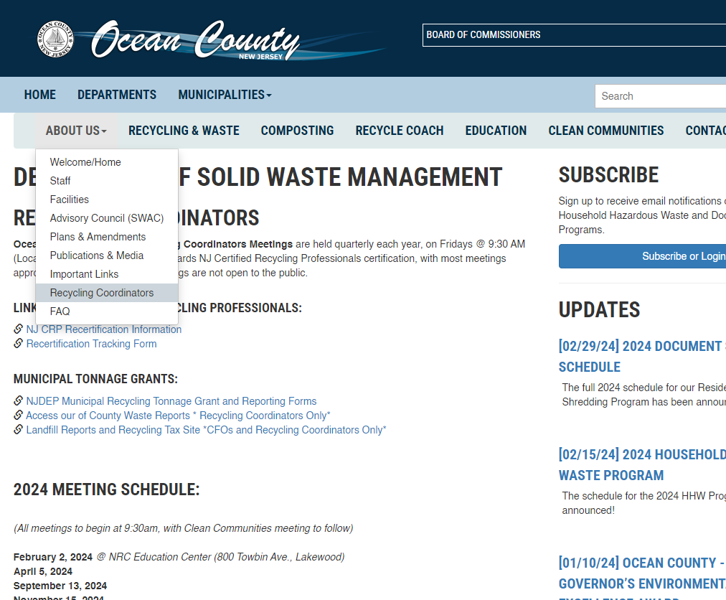
Where is ALL THIS STUFF?
Co.ocean.nj.us/recycle

Slide 6
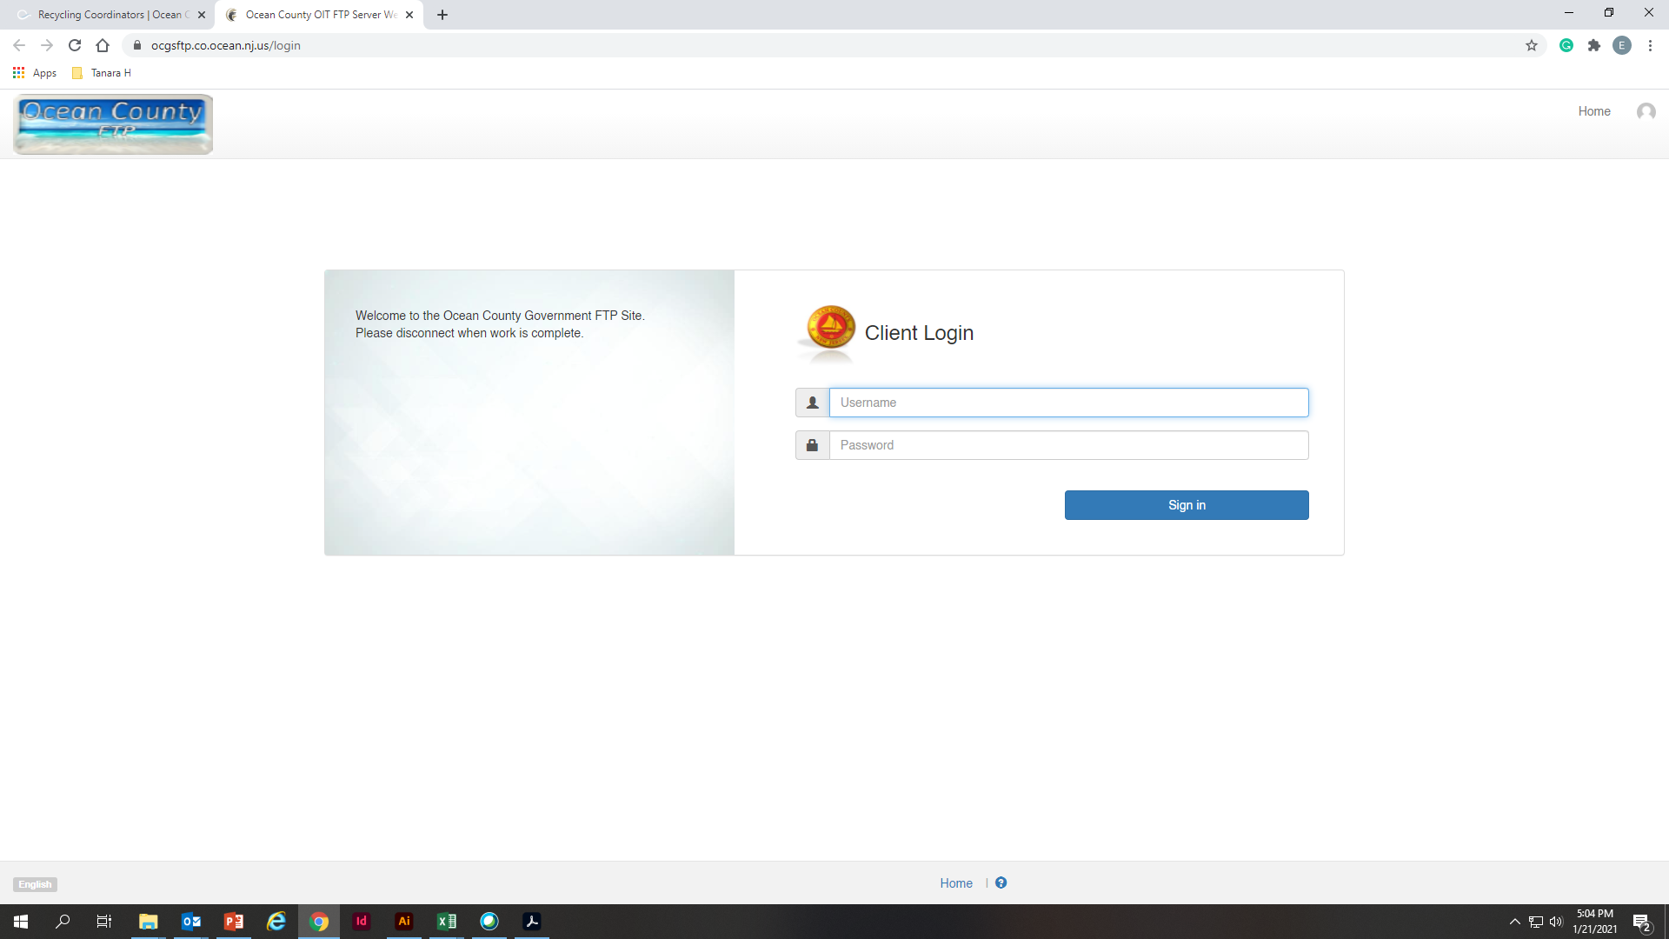
Remember The FTP is a Friend To……People?
ocgsftp.co.ocean.nj.us
Username: SWMVendorFTP
Password: Vend4SWM_FTP!

Slide 7
Remember to use
Items to report
OC Reports Recycling + Compost
Document Shredding Events
Call2Recycle Totals
E-Waste / Motor Oil / Scrap vendors
Commercial Dumpsters (WM, SOLTERRA, REPUBLIC, TRISTATE, etc.)
Millings

Slide 8
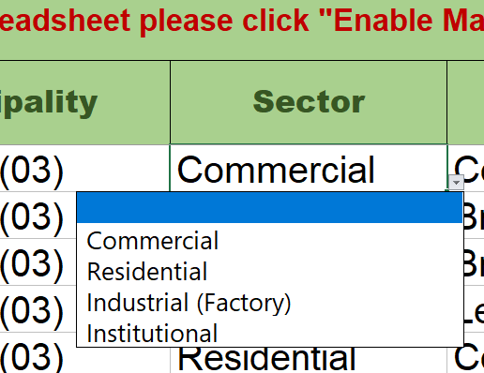
Residential Sector
Ocean County Recycling & Composting Reports
Special Waste Reports
Igloo Totals
Any reports from your municipal recycling centers.

Slide 9
Commercial SECTOR
Industrial is pretty much never a thing (apologies to WM).
Some companies (Colgate, Tri-State), bring recyclables to their facility --- those are reports we need to get from them.
Use all other reports (excluding ours) --- WM, Meadowbrook, etc.
Republic does both, request report that separates the material brought to our facility.

Slide 10
Commercial Reports BY Type
Class A
Class B
Class D
Metal, glass, paper, plastic, and cardboard.
Construction
Class C
Organics
Food waste
Yard Trimmings (Leaves)
Electronics, Batteries, Motor Oil, etc.
Single Stream
Brush & Tree Parts

Slide 11
End Markets
Last person/entity handling the waste.
If unknown (or uninterested) you will write the name of the Hauler or Store.
Examples:
  A store recycles their material on site = end market will be the name of the store
  A store pays a hauler to remove the material = end market will be the name of the hauler
  The material came to our facility = end market is Ocean County Solid Waste Management.

Slide 12
End Market ADDRESSES
Don’t stress ‘em too much, put “¯\_(ツ)_/¯” as the Street Address for all I care…
But if you ARE worried, the FTP has a “Common End Market Addresses” File
Addresses for Waste Management, Meadowbrook, Mazza, Lorco, etc. in file.
See also: “Recyclers list for MTG Reports” for addresses, email contacts, etc.
FTP>SWM>Municipal Coordinators>Recycling>Tonnage Reports 2023-2024
All Residential SS Tonnage:
Ocean County Northern Recycling Center
NJ | 601 New Hampshire Ave. | Ocean (15) | Lakewood (15) | 08701 | 7323670802

Slide 13
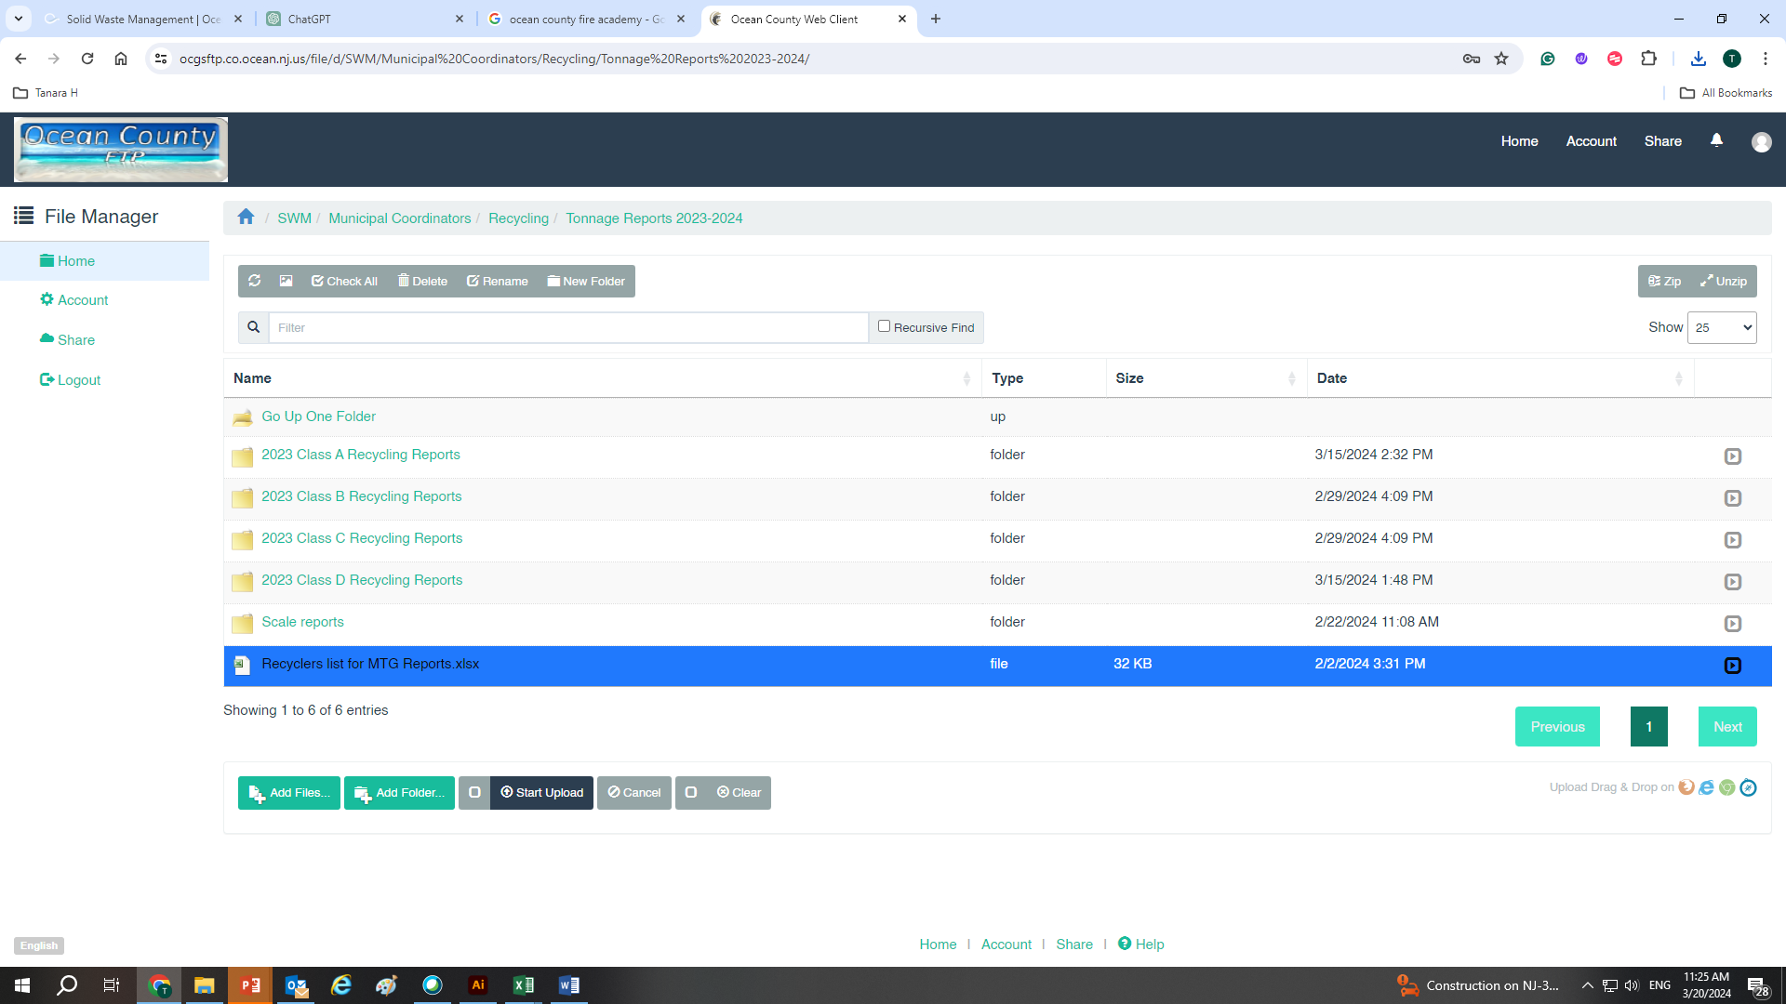
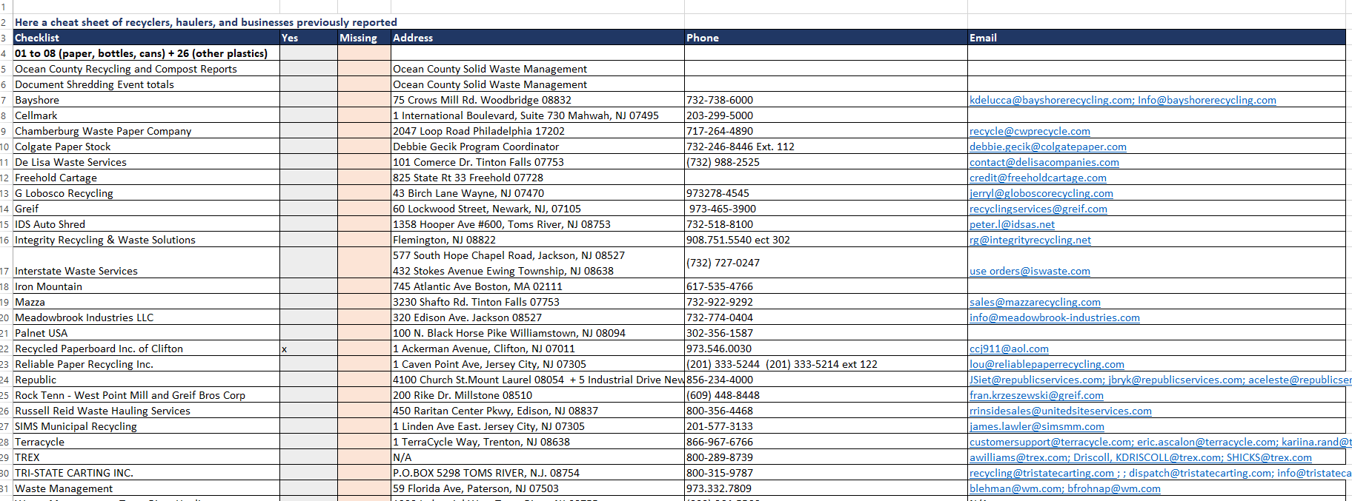

Slide 14
Double Reporting
Commercial Reports may come from both a store and the hauler that picked up from said store.
If using the store’s tonnage report, deduct from the hauler’s total.
Example (Made up):
  Kohls sending their film to TREX (in report)
  TREX reporting the film received from Kohls.

Slide 15
Common Reporting Mistakes
Conversion Errors
  Report in TONS ONLY
  Gallons, pounds, cubic yards need to be converted into tons using the conversion table within the tonnage report (or download at https://www.nj.gov/dep/dshw/resource/Tonnage/Conversion%20Table.pdf)

Slide 16
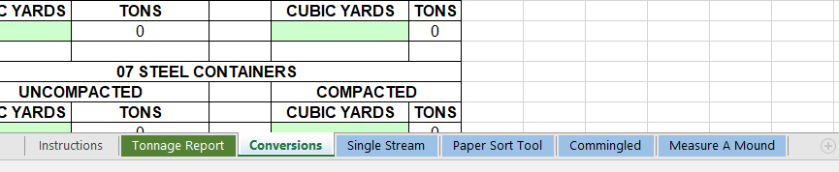
Conversions

Slide 17
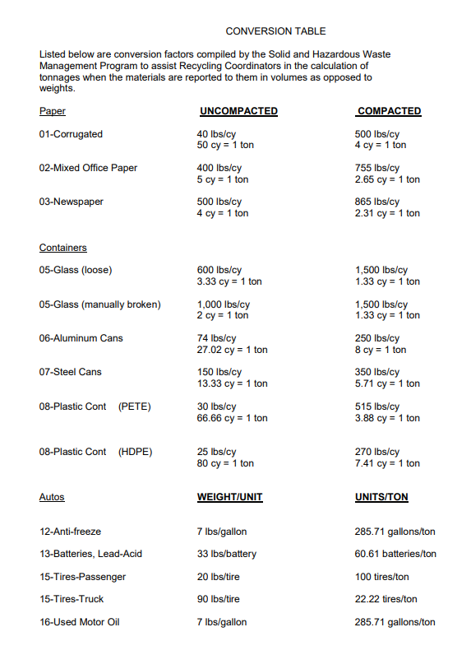
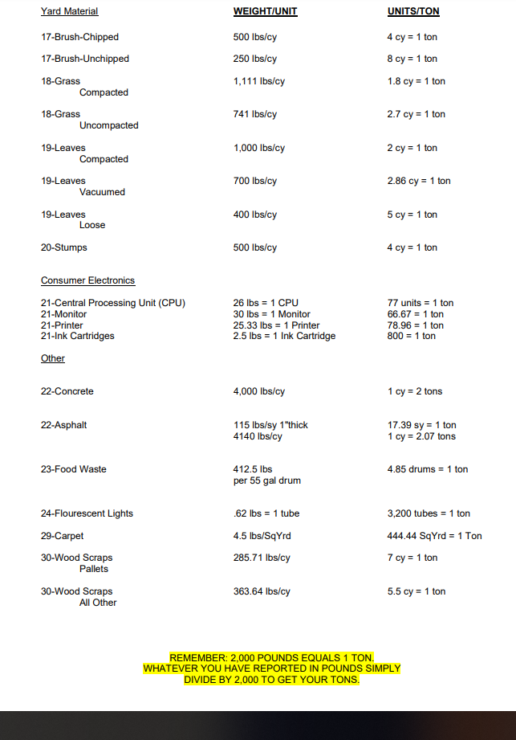

Slide 18
Plan for MRC CHANGES
Do you have a new Recycling Coordinator?
Retiring soon?
Keep at least 5 years of data (mandatory in case of an audit).
Keep contacts up to date in an Excel Spreadsheet.
Remember the DEP can help you as well tonnagegrant@dep.nj.gov
DEP also offers classes on how to fill out tonnage reports.
Check their website for the official forms and tutorials https://www.nj.gov/dep/dshw/resource/Tonnage/index.htm

Slide 19
CRP Signature is a must
MTG Tonnage Report MUST be signed by a Certified Recycling Professional (CRP)
No CRP on staff?
Most coordinators here are certified, don’t wait until April 29th to find a CRP
*County may sign once for towns under certain circumstances

Slide 20
There's no such thing as a stupid question*
If you have any questions please reach out, we will try to get you the answer as quick as we can.
    Easiest way to reach us all simultaneously: ocrecycles@co.ocean.nj.us
We can set up a date to do the report with you.
Need help? We can set up a Webex meeting to share screens and assist you with your report.
*SEAN EDIT: Some exceptions may apply here

Slide 21
Thank you
Have a nice day!

