Slide 2
Document Shredding
15 Events
Populations over 9000 residents
The Islands will count as 1 town each
Consistent dates yearly
Solid Waste Management

Slide 3
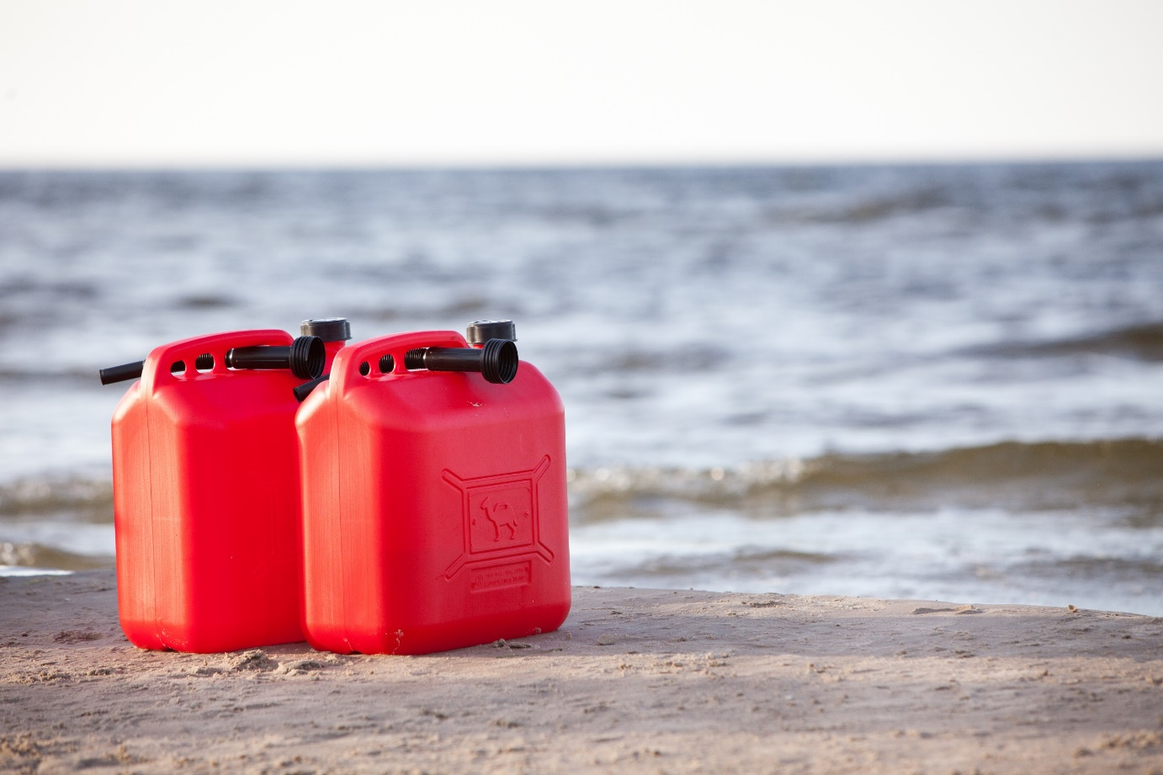
Household Hazardous Waste
6 Events
All events will announced at once
Solid Waste Management

Slide 4
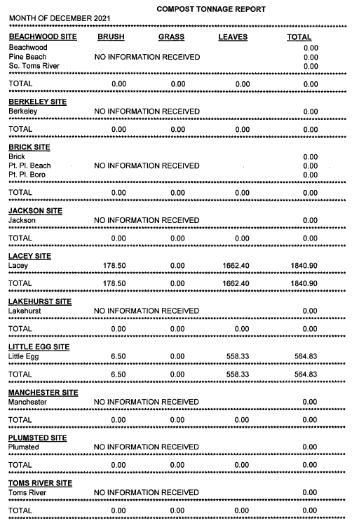
Leaves and brush tonnage
Tonnage Reports
Permit Exemptions to prove you are not exceeding the 10 000 cubic yards max.
Keep a log: How many transfers to the field x capacity of the truck
Solid Waste Management

Slide 5
2021 Recycling Rates
Municipality | Landfill | Out of County Waste | Recycled | Recycling %
Barnegat | 20314.75 |  | 10658.38 | 34%
Barnegat Light | 1227.6 | 134.92 | 444.395 | 25%
Bay Head | 1304.21 | 1065.33 | 1046.69 | 31%
Beach Haven | 3213.26 | 597.36 | 2883.32 | 43%
Beachwood | 7662.3 | 590.21 | 8274.4792 | 50%
Berkeley | 33965.35 | 1767.6 | 8677.4 | 20%
Brick | 69848.02 | 12496.16 | 196.2 | 0%
Eagleswood | 1319.9 | 118.5 | 3002.1864 | 68%
Harvey Cedars | 996.58 | 107.21 | 334.9505 | 23%
Island Heights | 1371.71 | 173.34 | 3172.22 | 67%
Jackson | 32969.46 | 17717.11 | 33211.55 | 40%
Lacey | 32125.21 | 2314.5 | 36266.38 | 51%
Lakehurst | 2066.42 | 120.8 | 1444.93 | 40%
Lakewood | 145355.17 | 14278.32 | 87182.1 | 35%
Lavallette | 3790.48 | 1583.95 | 4590.76 | 46%
Little Egg Harbor | 16001.17 | 721.05 | 7940.09 | 32%
Long Beach | 10939.88 | 5034.28 | 7702.84 | 33%
Manchester | 30163.42 | 1774.77 | 12373.41 | 28%
Mantoloking | 726.5 | 2250.56 | 1770.772 | 37%
Ocean | 6679.65 | 624.86 | 5929.0383 | 45%
Ocean Gate | 1420.67 | 216.08 | 568.96 | 26%
Pine Beach | 1606.50 | 315.35 | 413.45 | 18%
Plumsted | 1468.29 | 1432.69 | 5750.98 | 66%
Pt. Pleasant Borough | 11817.49 | 3979.228 | 11973.64 | 43%
Pt. Pleasant Beach | 5613.72 | 1459 | 4514.69 | 39%
Seaside Heights | 4721.87 | 974.26 | 1914.82 | 25%
Seaside Park | 2991.99 | 954.35 | 3289.78 | 45%
Ship Bottom | 1836.96 | 129.51 | 1450.55 | 42%
South Toms River | 2314.53 | 86.71 | 3002.58 | 56%
Stafford | 32332.33 | 2194.39 | 21222.05 | 38%
Surf City | 2503.28 | 710.07 | 821.01 | 20%
Toms River | 112203.33 | 12112.12 | 166356.37 | 57%
Tuckerton | 3463.83 | 575.41 | 1627.07 | 29%
Total | 606335.83 | 88609.998 | 460008.0414 | 40%
Solid Waste Management

Slide 6
SWM Updates
Currently 12/33 towns are members
Solid Waste Management

Slide 7
Meeting Dates
March 17th ,2023 - Tonnage Report Workshops
May 19th ,2023 - Tonnage Report Workshops
September 22nd ,2023 - Tour
November 17th ,2023 - End of the year business
Solid Waste Management

Slide 8
Holiday Ideas - Collections
Solid Waste Management

Slide 9
Recycling Center Tour
Solid Waste Management

