Slide 1
Recertification Credits

Slide 2
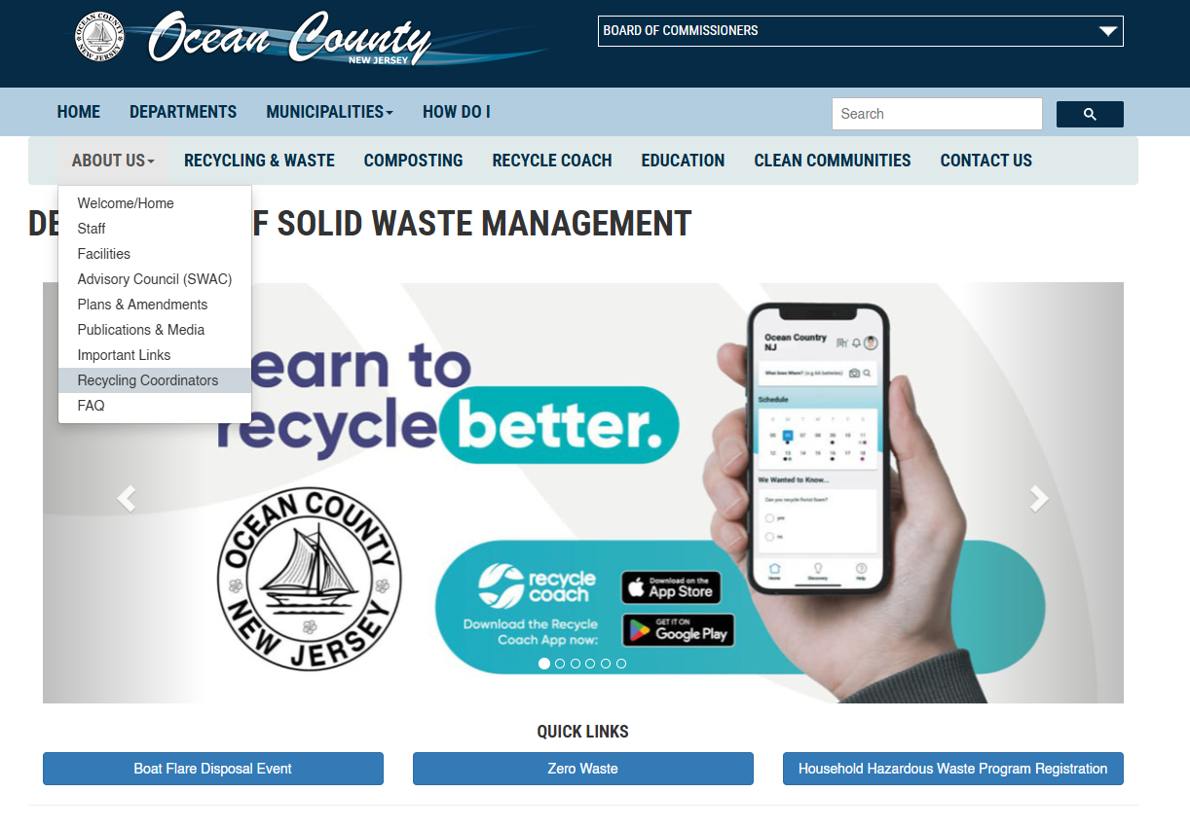

Slide 3
Opportunities for 2024
November 19 – NJ League of Municipalities – NJCCC session Room 401 at 2 p.m., 1.5 NJCCC credits
November 20 - NJ League of Municipalities 'More to Recycling than Curbside Collections‘ –Room 308 at 10:45 am - CMFO-.5 Off Mgmt|CCFO-1.5 Off Mgmt|CPWM-1.5 Tech|RMC-1.5 Prof Devel|QPA-1.5 Off Admin|NJCLE-1.5|PACLE-1.0|LGLP-.50|CRP-1/25|RPPO/RPPS-1.5 M/S | 1.5 NJCCC
December 11 – NJCCC Winter Webinar (virtual 2 NJCCC credits)

Slide 4

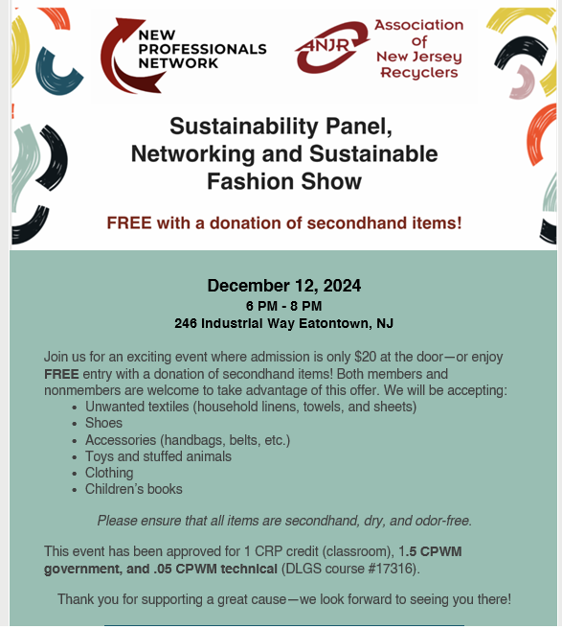

Slide 5


Slide 6
Shared Service Agreements

Slide 7
2024 Programs Recap

Slide 8
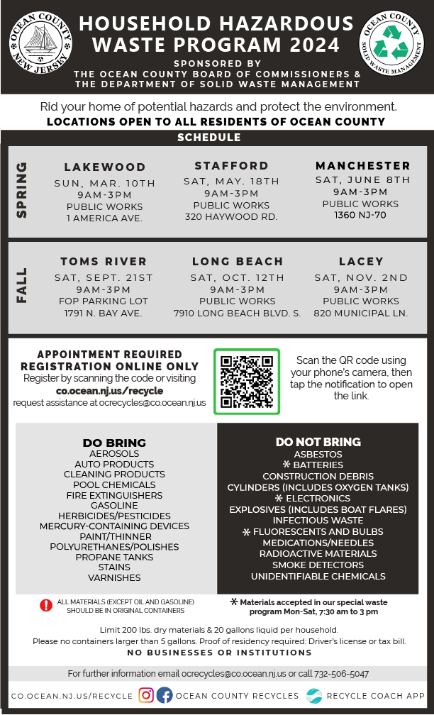


Slide 9


Slide 10
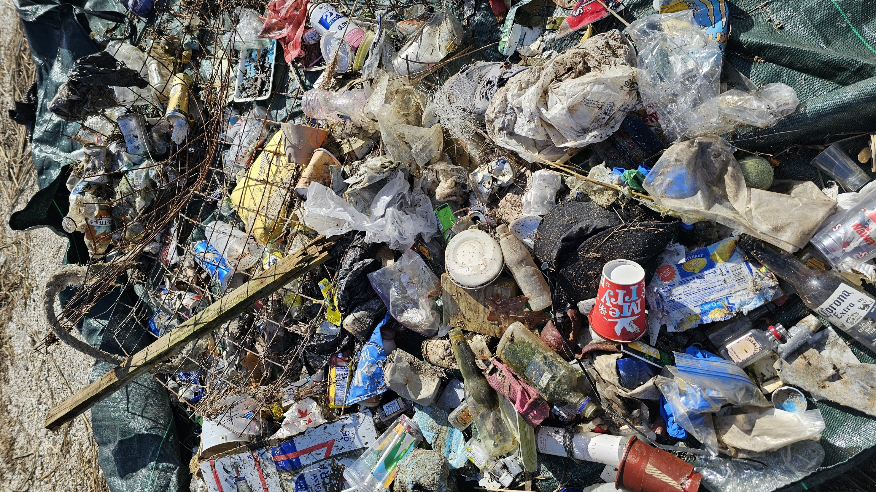
Clean Communities Reports & Recap

Slide 11
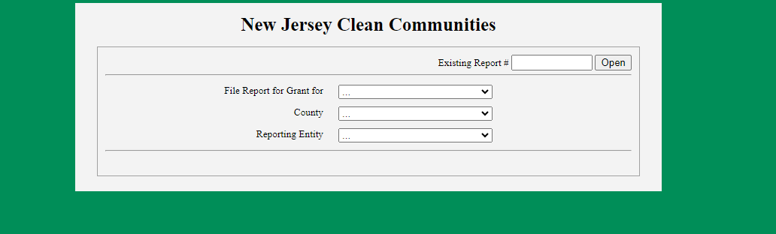
Last year
This year
Submitted | 367 | 83%
Open | 19 | 4%
Not Submitted | 57 | 20%
Submitted | 390 | 80%
Open | 22 | 5%
Not Submitted | 76 | 27%

Slide 12
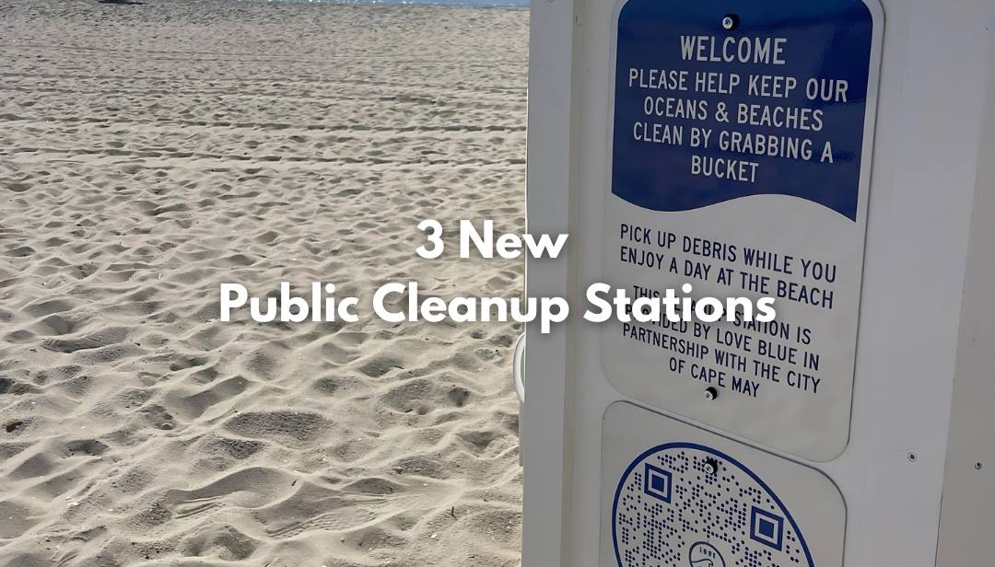
Ideas

Slide 13
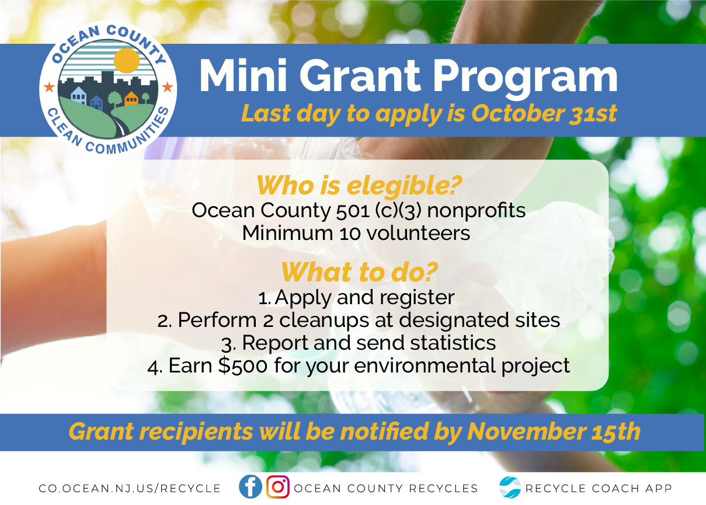

Slide 14
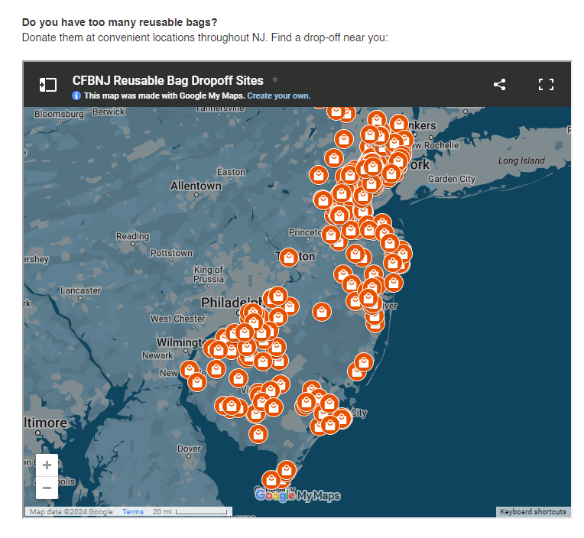
Bag drop off
QR Code
Drop-off sites
Donations
https://www.co.ocean.nj.us/OC/SolidWaste/frmRegContentSW.aspx?ID=5a5860e8-28d9-48db-ab89-b7a4f8317396

Slide 15
Outreach + Materials

Slide 16
Recycling | 27
Clean Communities | 39
Compost | 30
Waste Reduction | 13
Total | 109

Slide 17
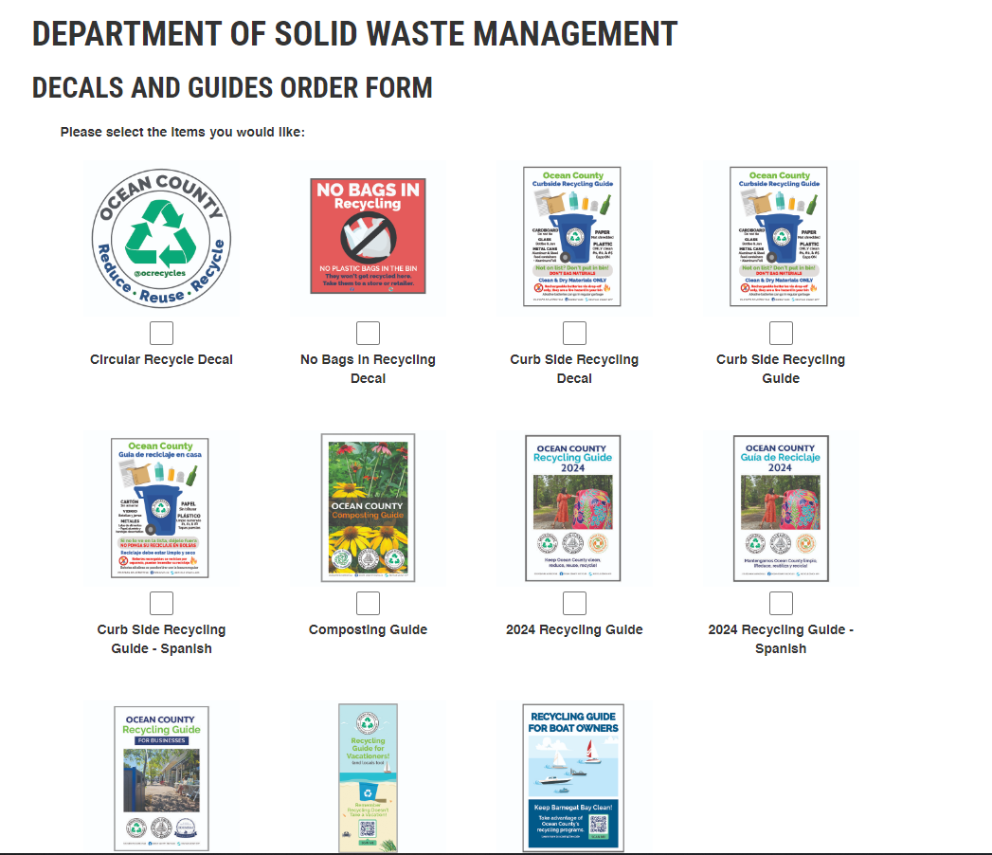

Slide 18
Recycling Guide Review (Contacts, changes)

Slide 19
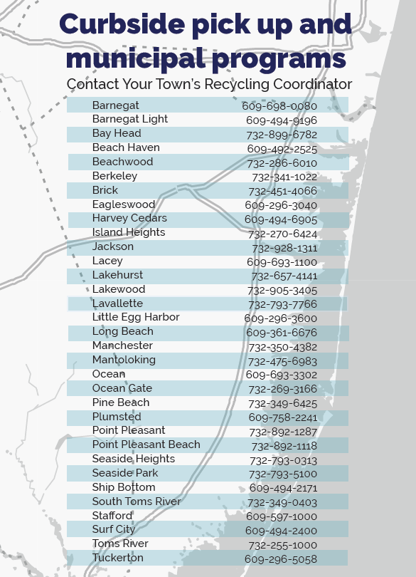

Slide 20



Slide 21
What to expect for 2025 (Tonnage Reports, Schedules, etc)

Slide 22
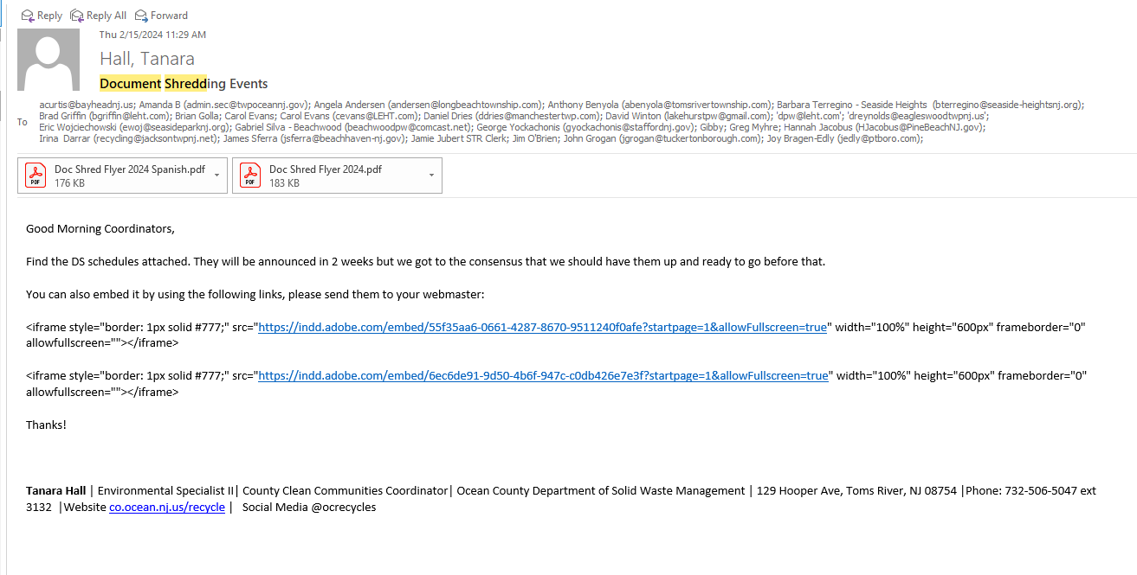
Document Shredding & HHW Agendas

Slide 23
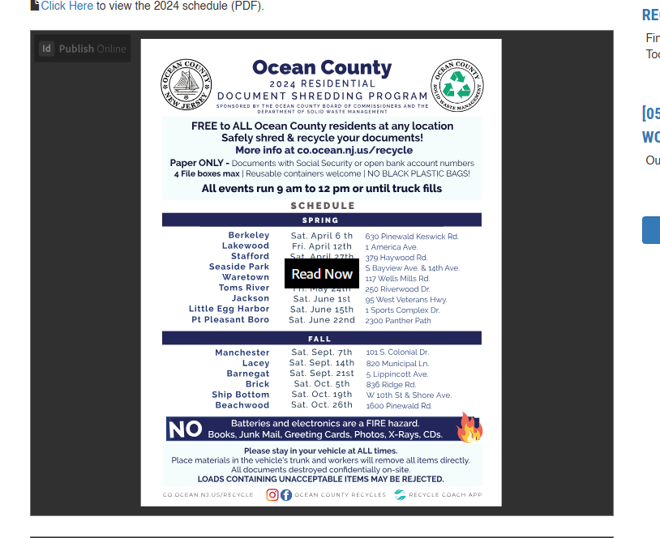

Slide 24
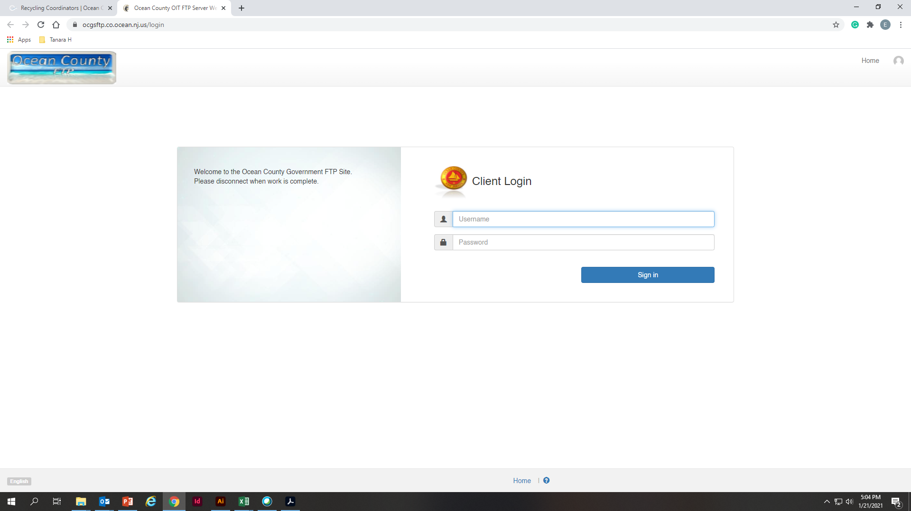
How can I access the documents
ocgsftp.co.ocean.nj.us
Username: SWMVendorFTP
Password: Vend4SWM_FTP!

Slide 25
Tonnage Reports
Scale Totals – End of January
Business reports from Jan to April

Slide 26
Health Department

Slide 27
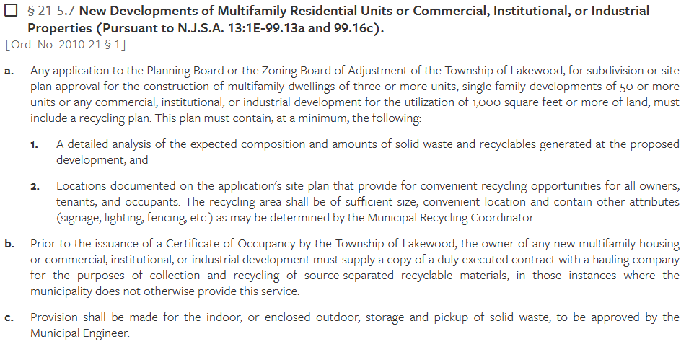

Slide 28
Support Group

Slide 29
Thank you!

